Slide 1


ORACLES forecasting Briefing Meteorology
Briefing on 08-09-2016 8am
Forecasting for flight 9/12-09-2016

Slide 2
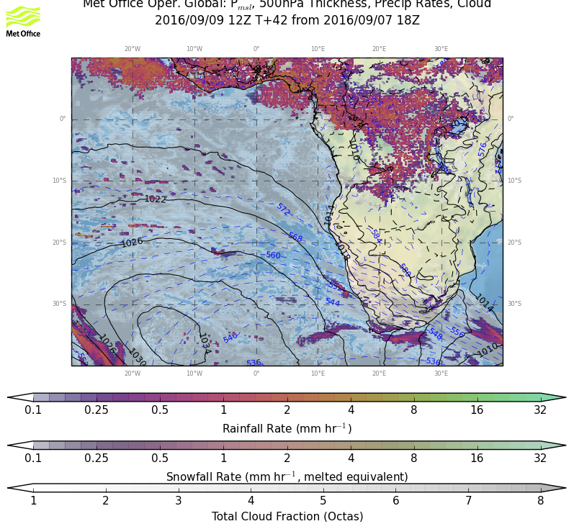
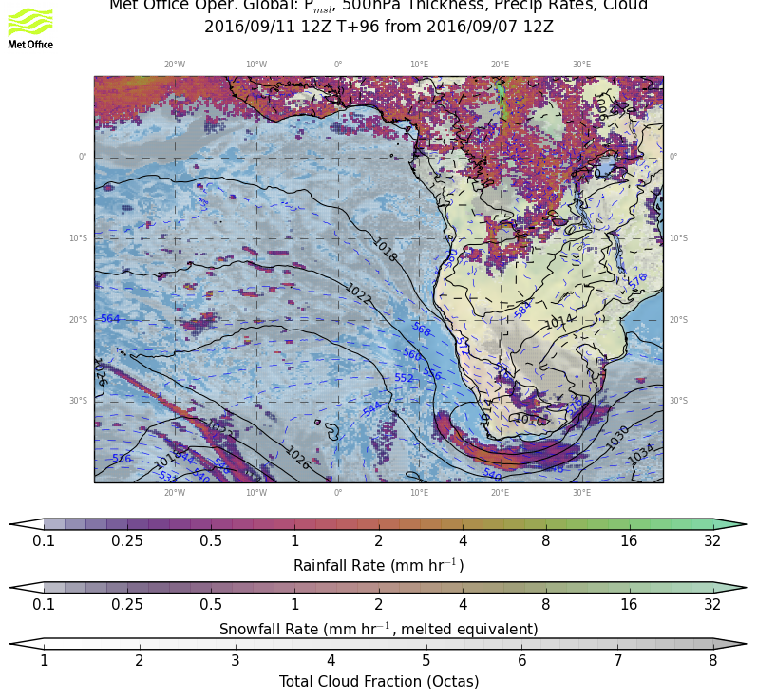
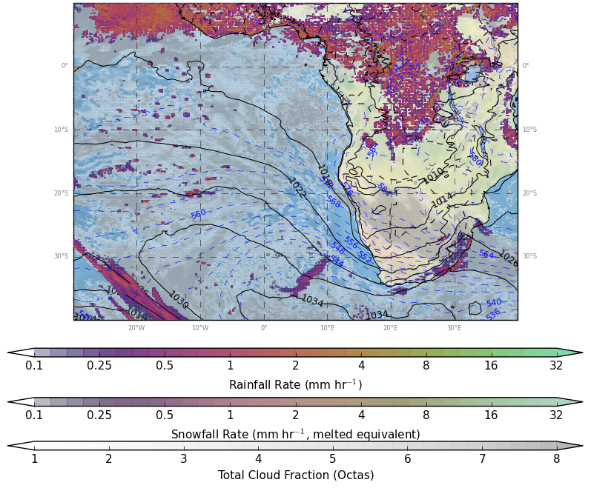
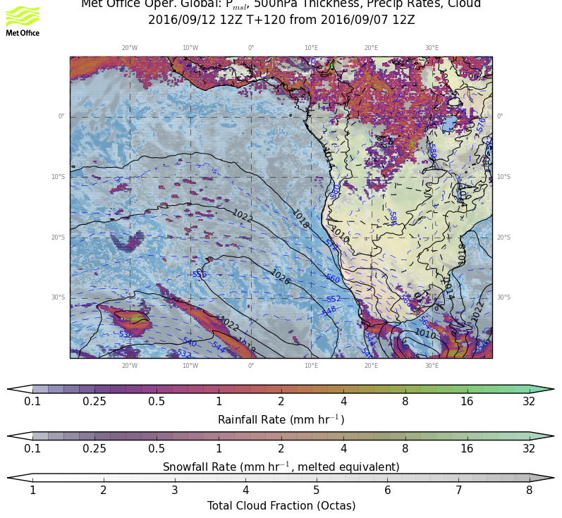
9/9 FRI, 12Z
Weather overview:
P msl
Cloud cover
Precip
9/11 SUN, 12Z
9/12 MON, 12Z
9/10 SAT, 12Z
RF
OF

Slide 3
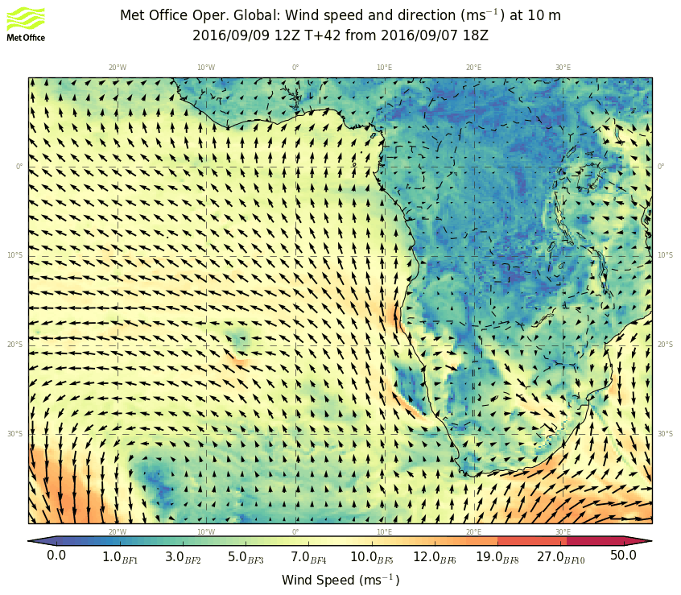
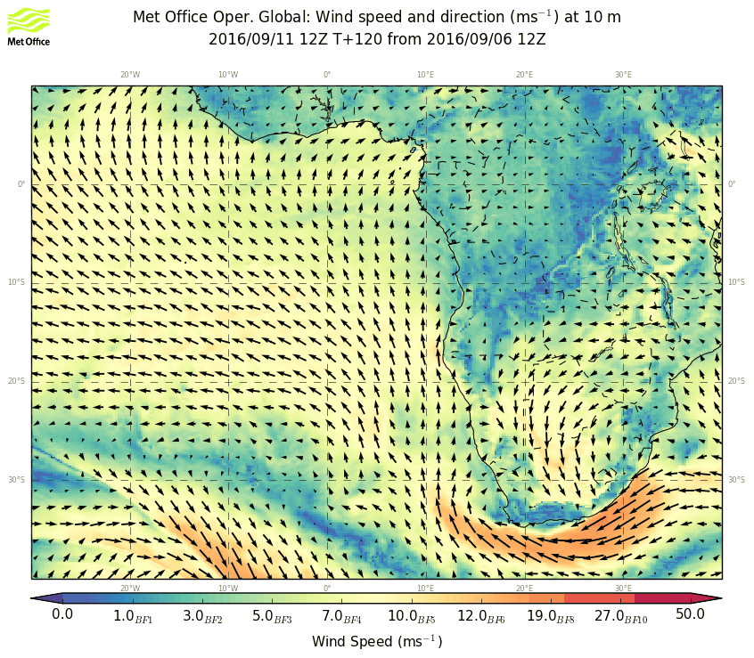
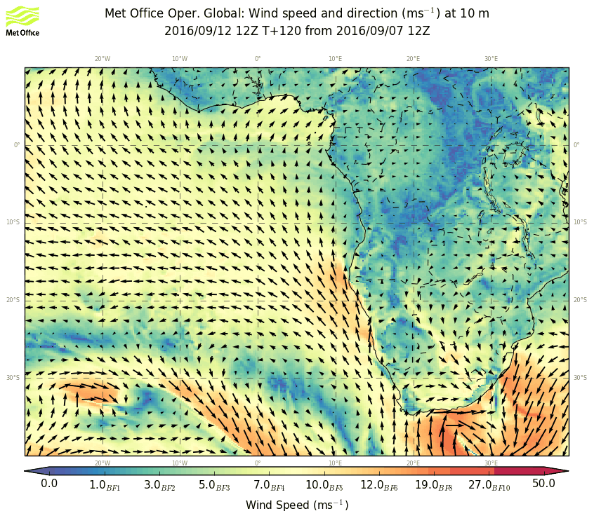
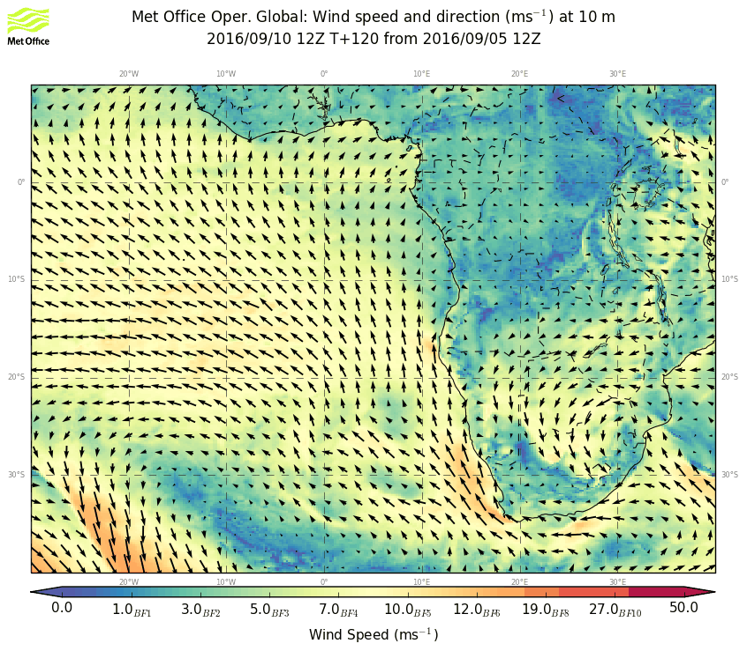
9/9 FRI, 12Z
WIND 10m
9/11 SUN, 12Z
9/12 MON, 12Z
9/10 SAT, 12Z
RF
OF

Slide 4
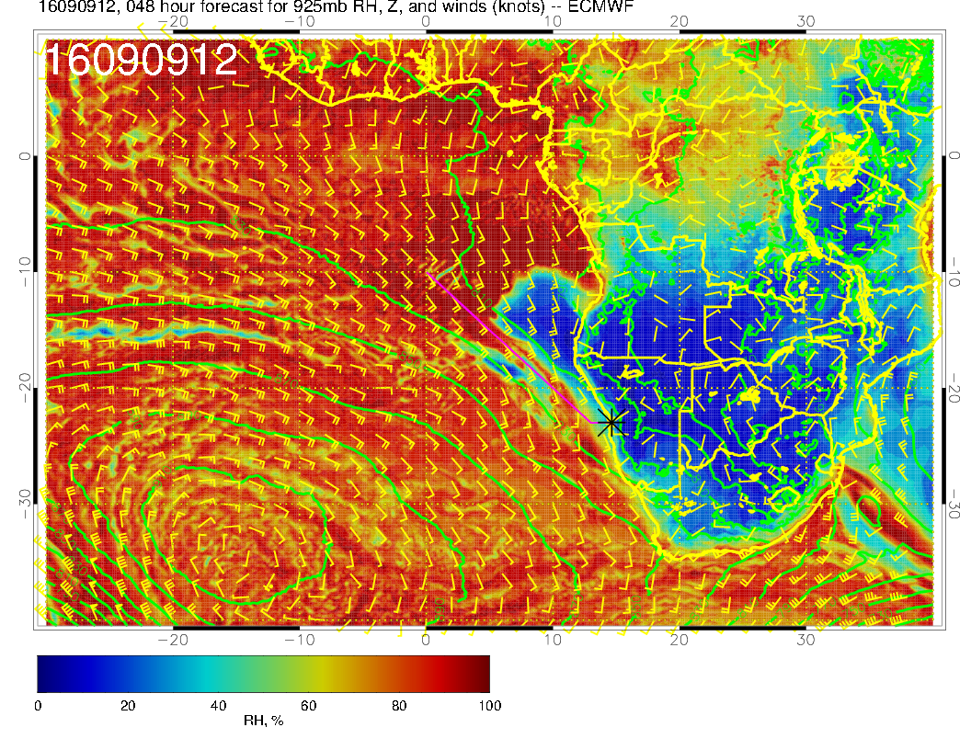
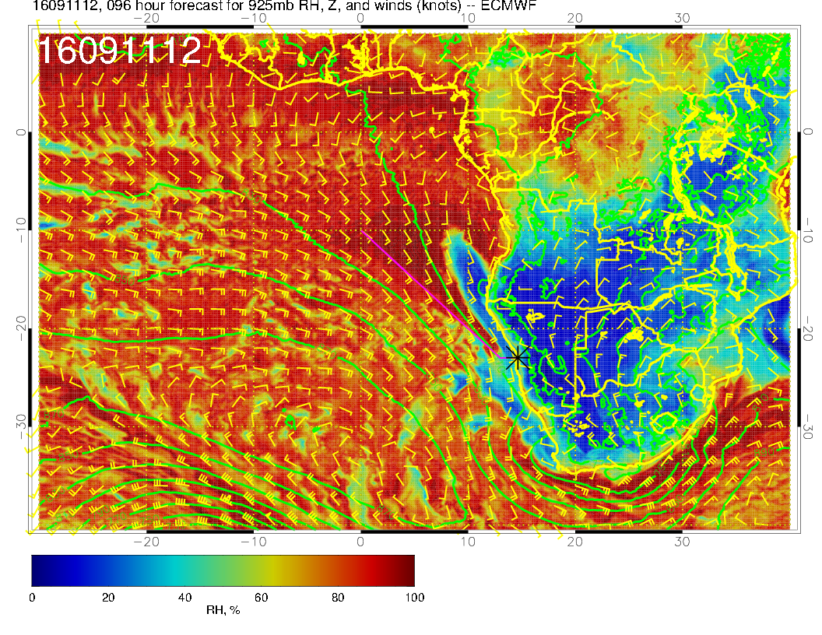
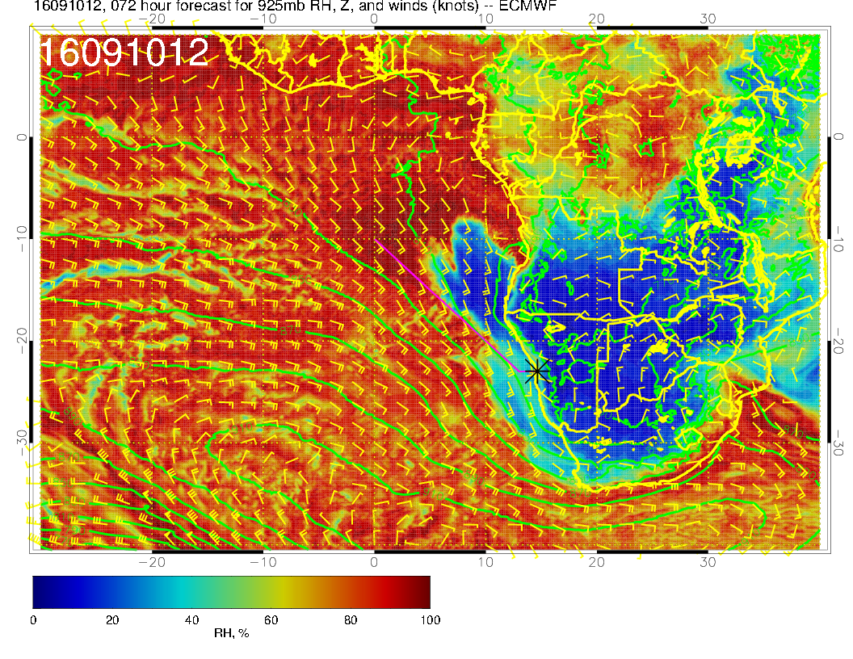
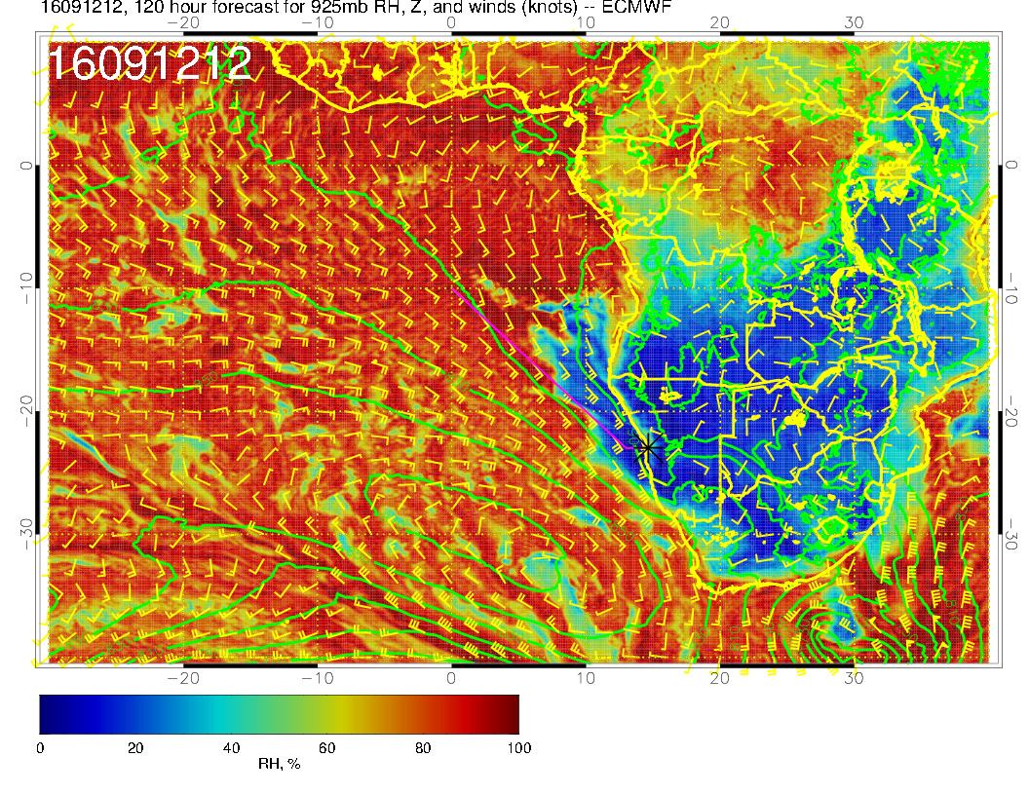
9/9 FRI, 12Z
925 hPa
9/11 SUN, 12Z
9/12 MON, 12Z
9/10 SAT, 12Z
RF
OF

Slide 5
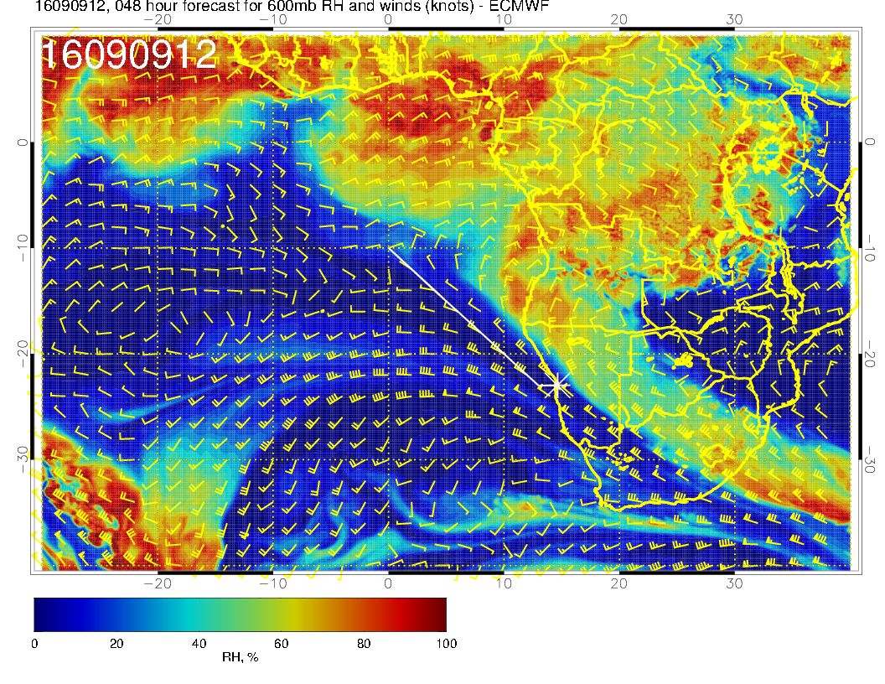
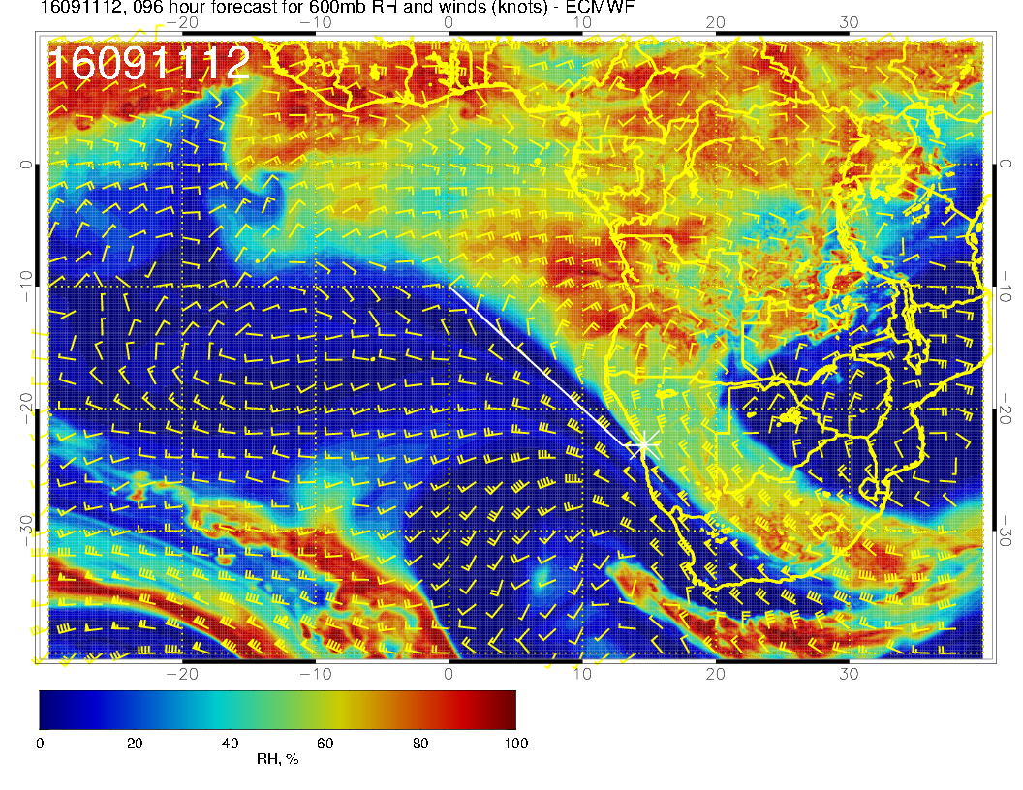
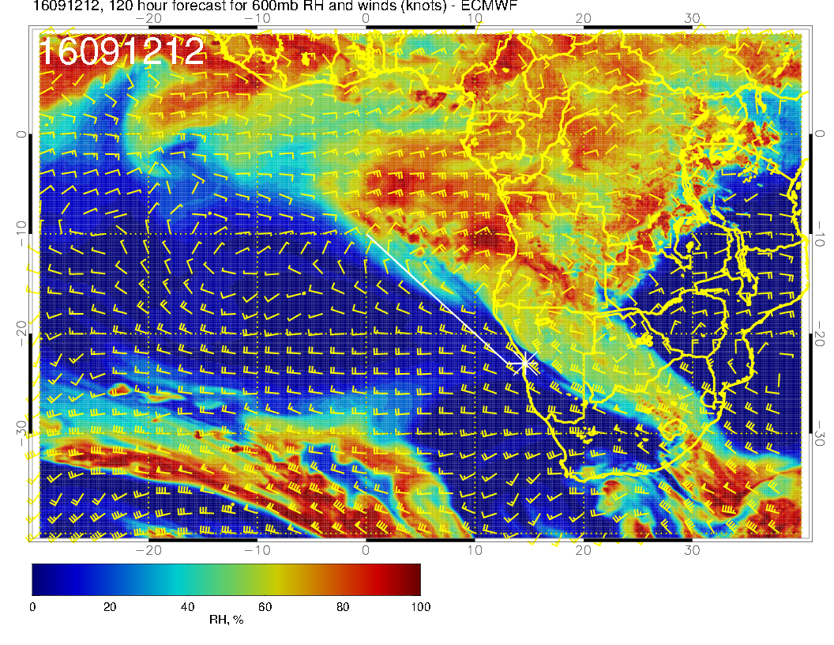
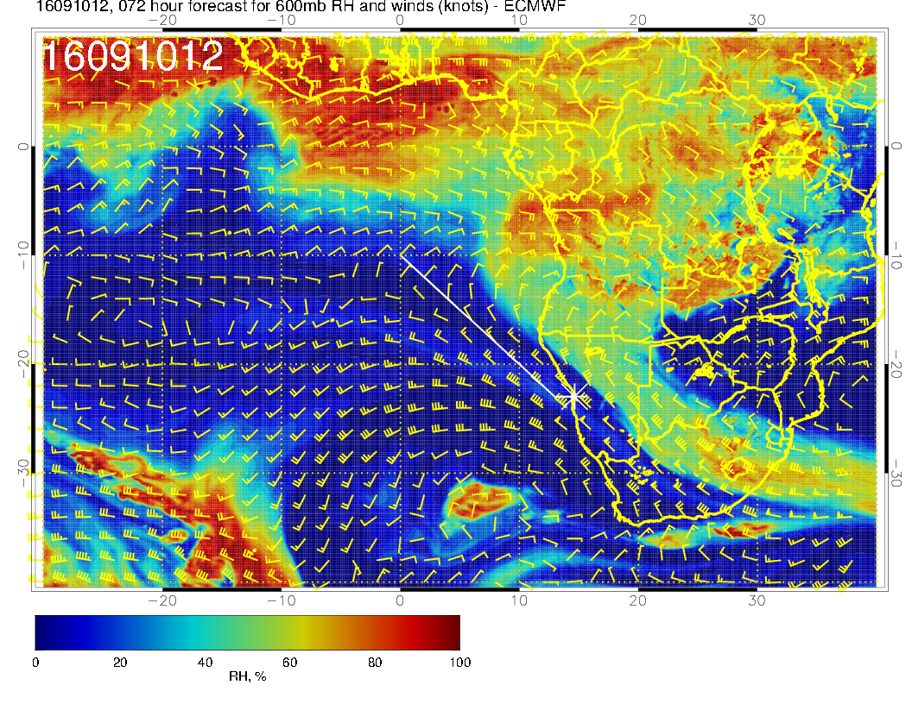
9/9 FRI, 12Z
600 hPa
9/11 SUN, 12Z
9/12 MON, 12Z
9/10 SAT, 12Z
RF
OF

Slide 6
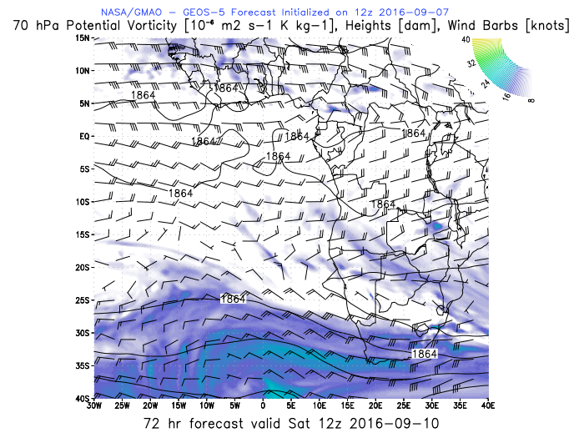
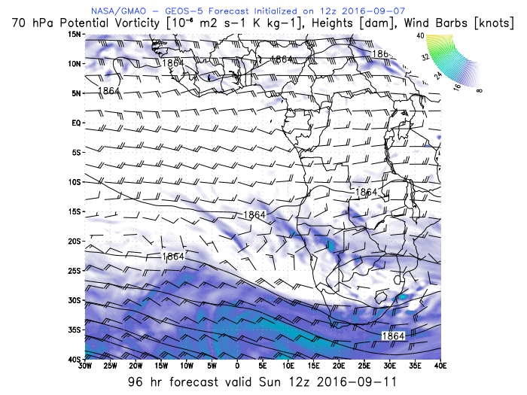
WIND 70 hPa
ER-2 alt
9/10 SAT, 12Z
9/11 SAT, 12Z
OF

Slide 7
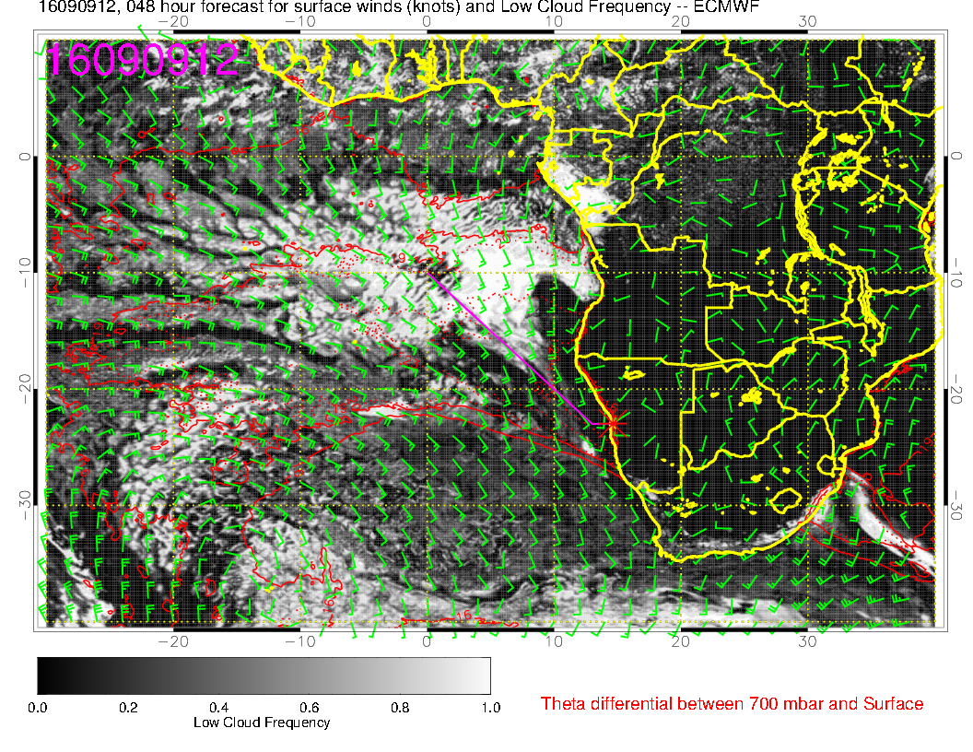
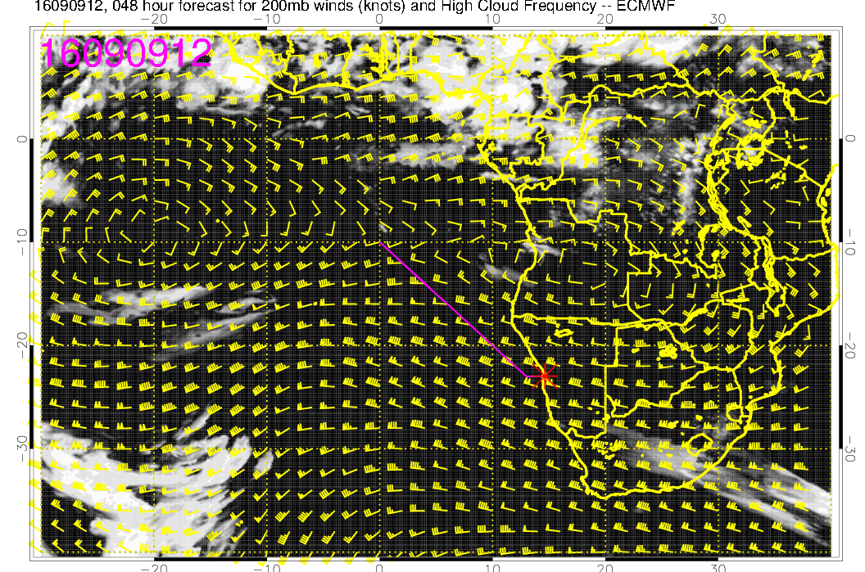
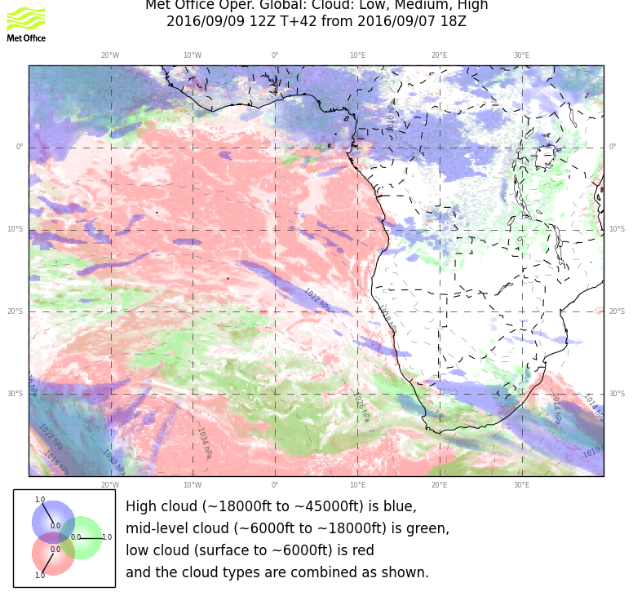
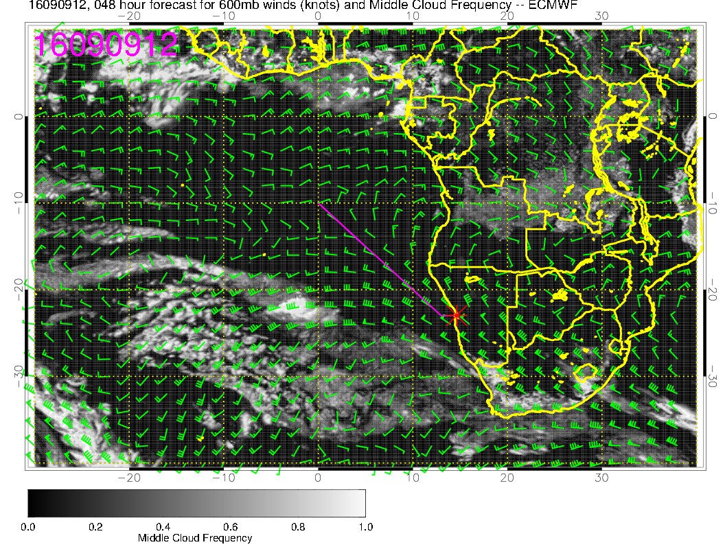
9/9 FRI, 12Z
low
high
mid

Slide 8
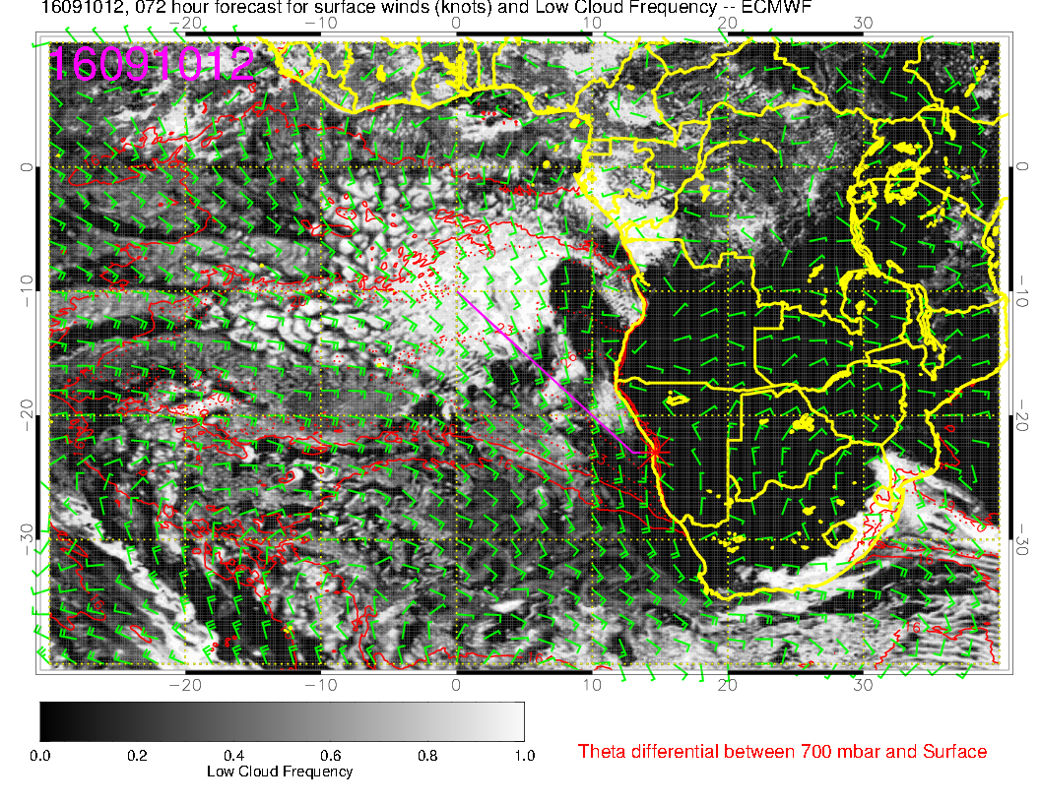
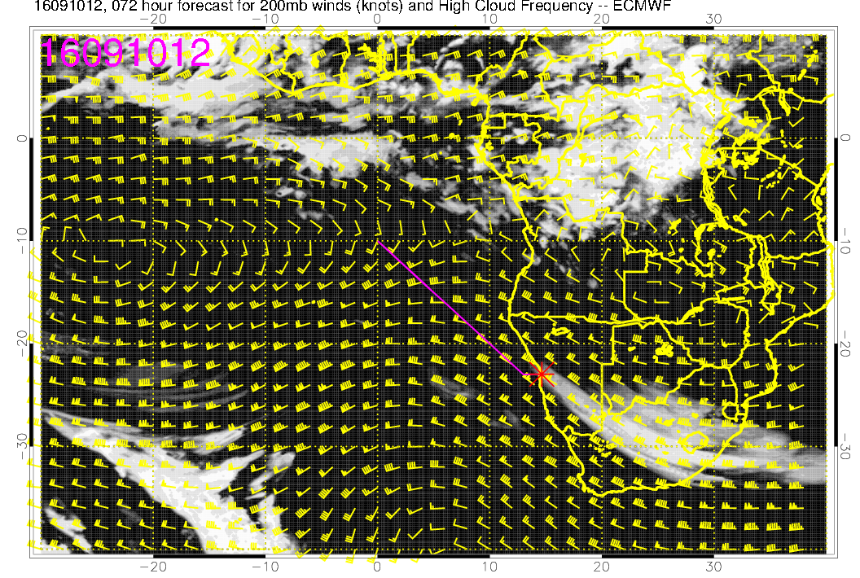
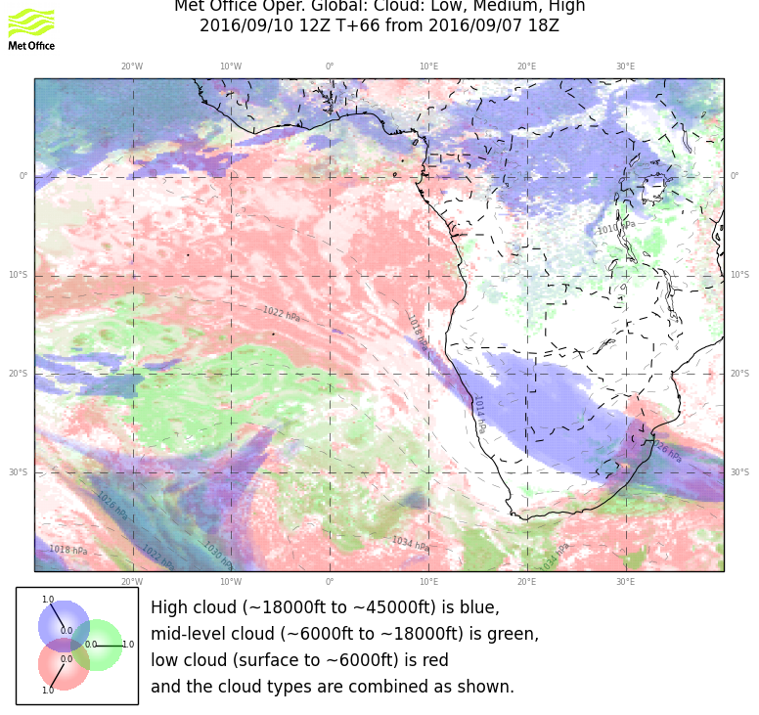
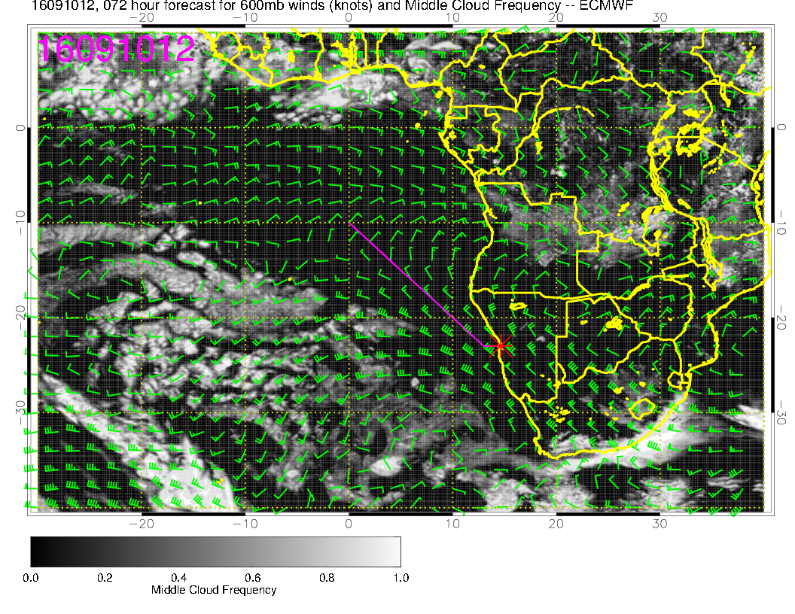
low
9/10 SAT, 12Z
high
TOF
mid

Slide 9
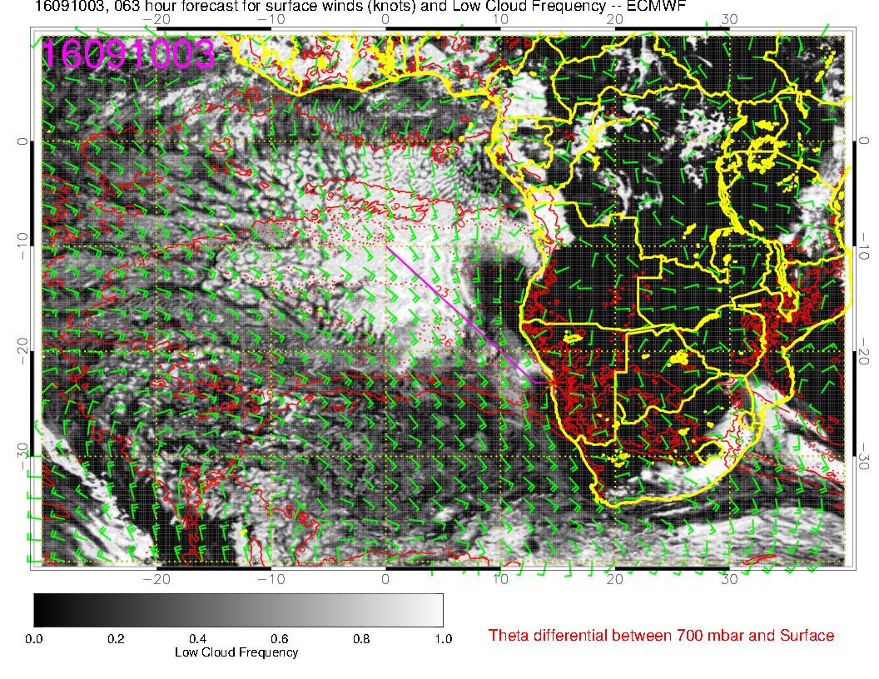
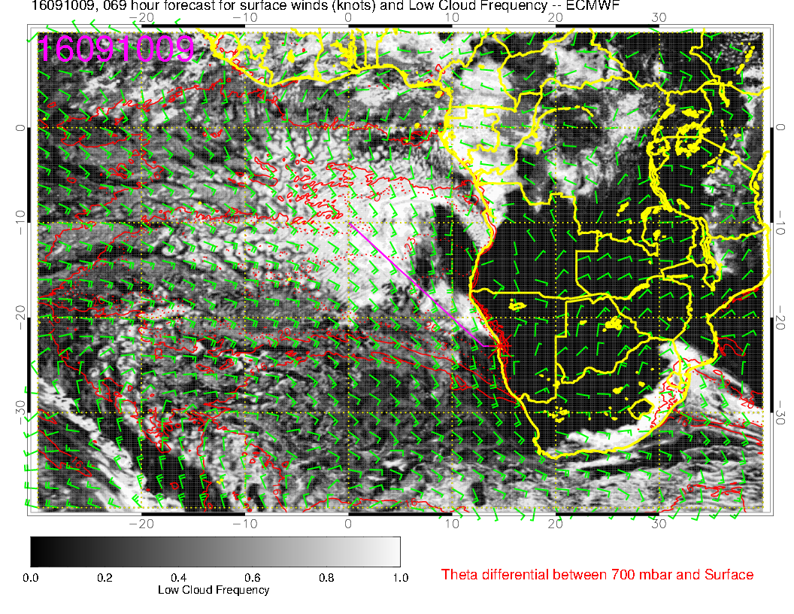
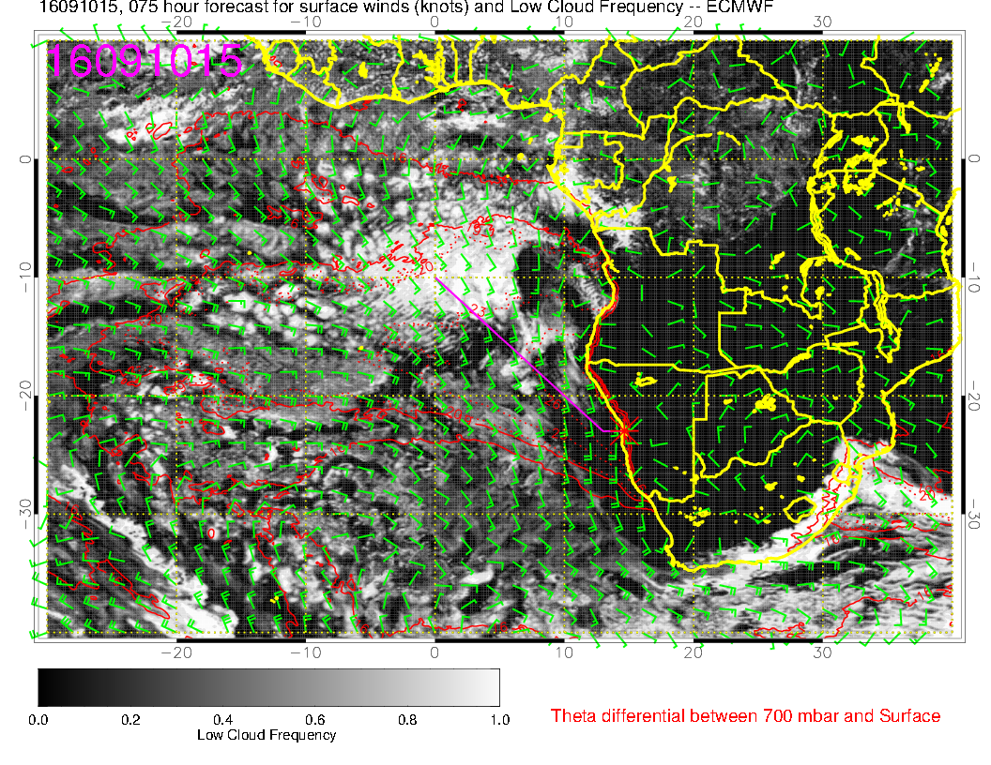
9/10 SAT, 12Z
3 Z
12 Z
TOF
9 Z
15 Z

Slide 10
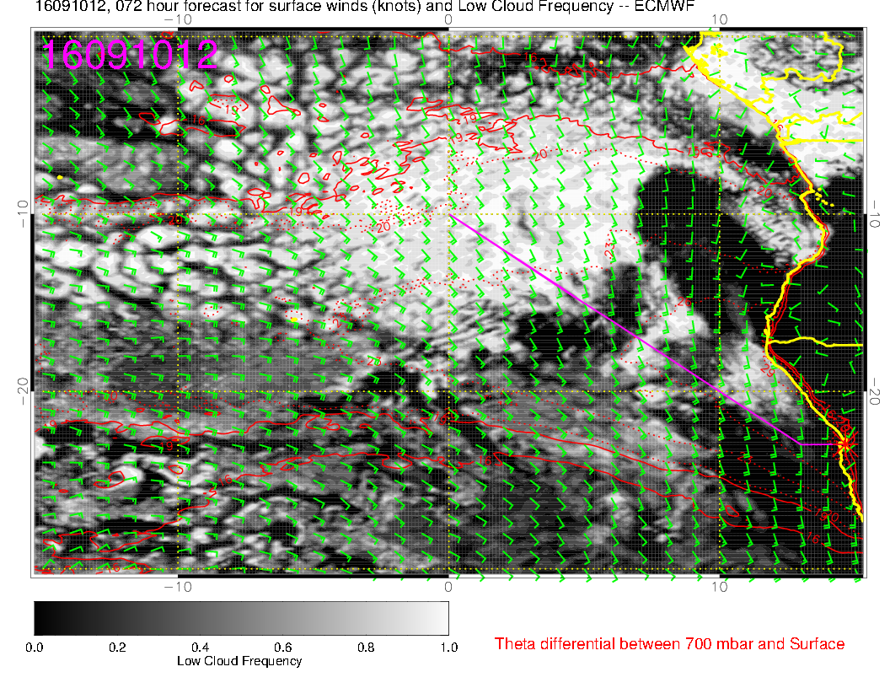
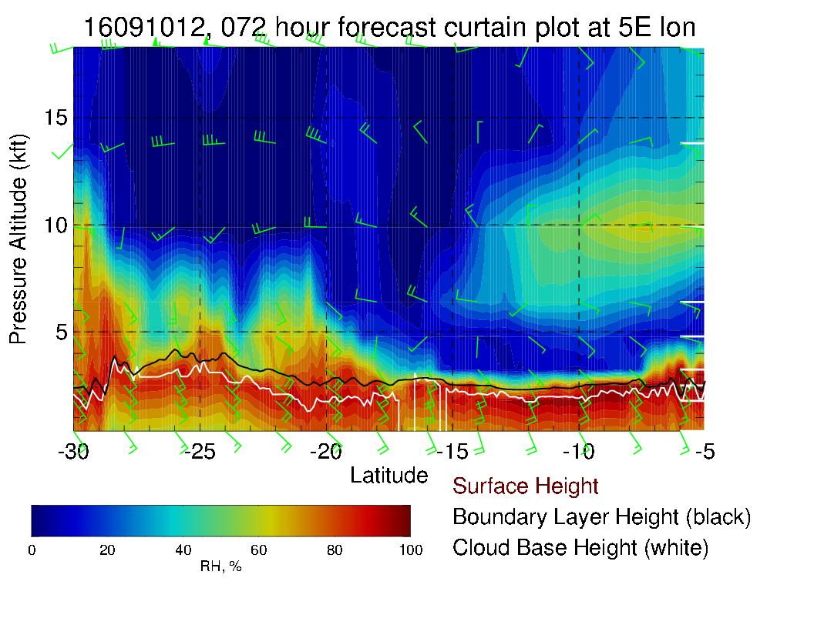
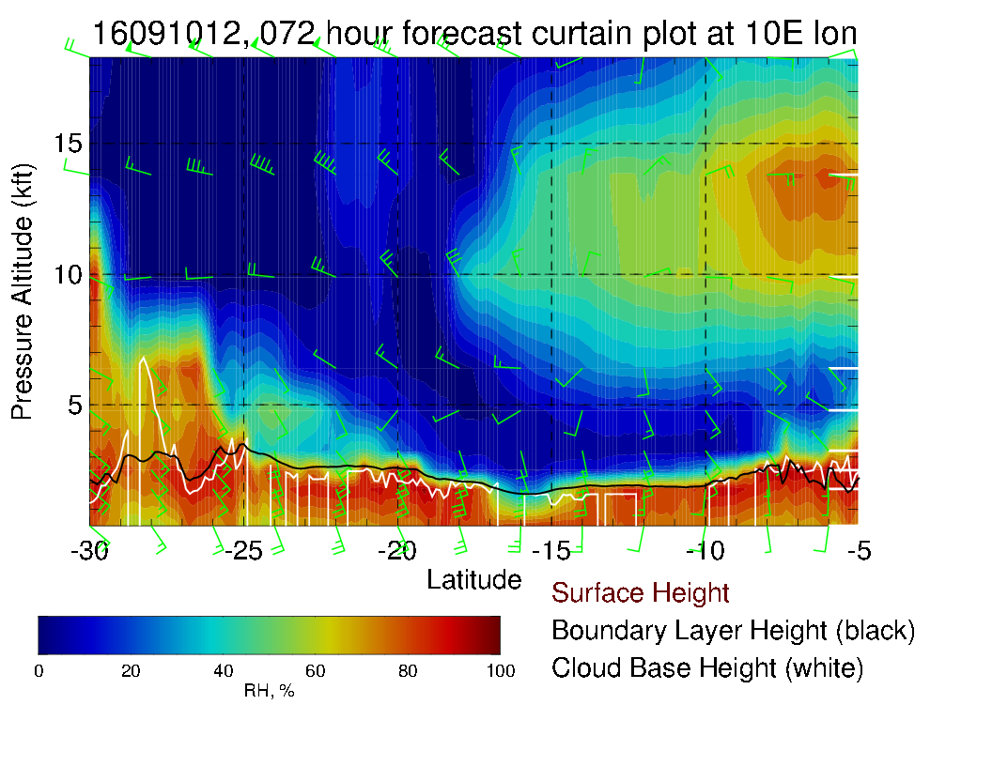
9/10 SAT, 12Z
OF

Slide 11
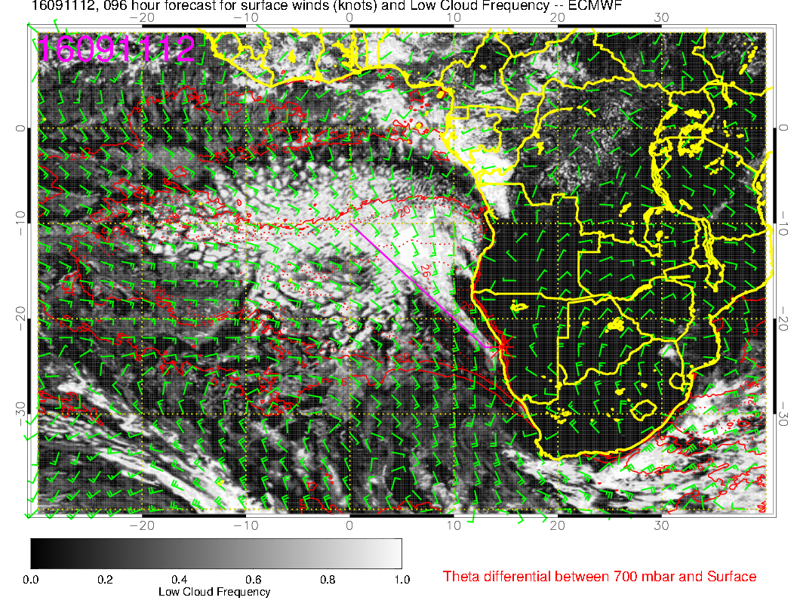
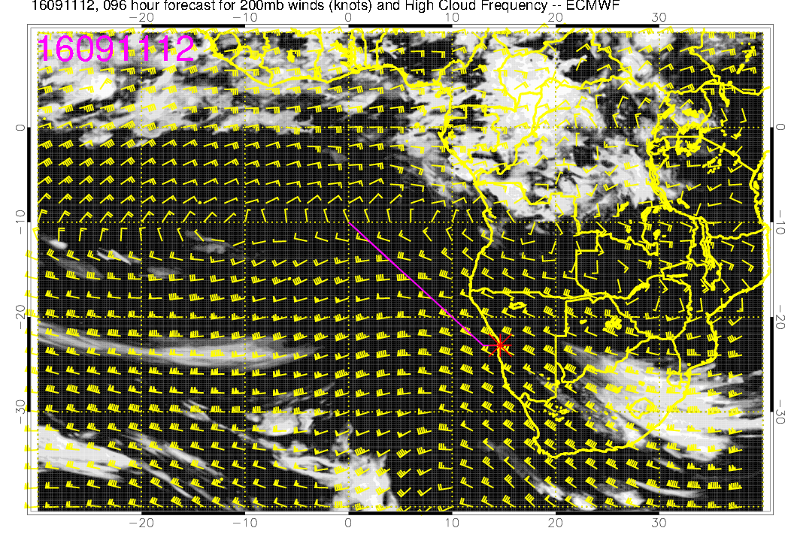
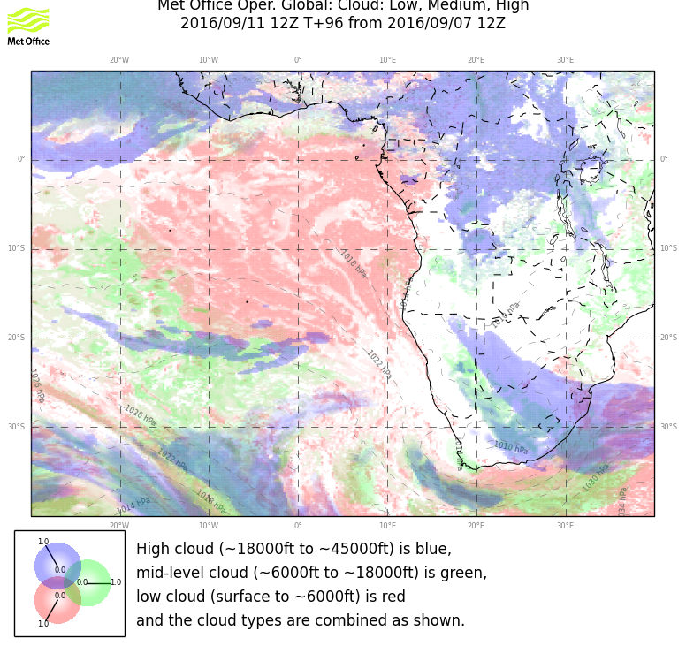
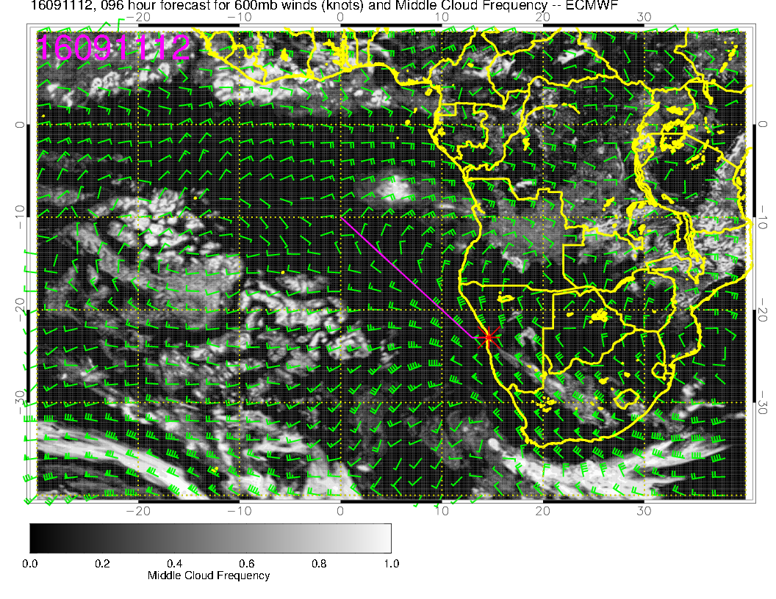
low
9/11 SUN, 12Z
high
mid

Slide 12
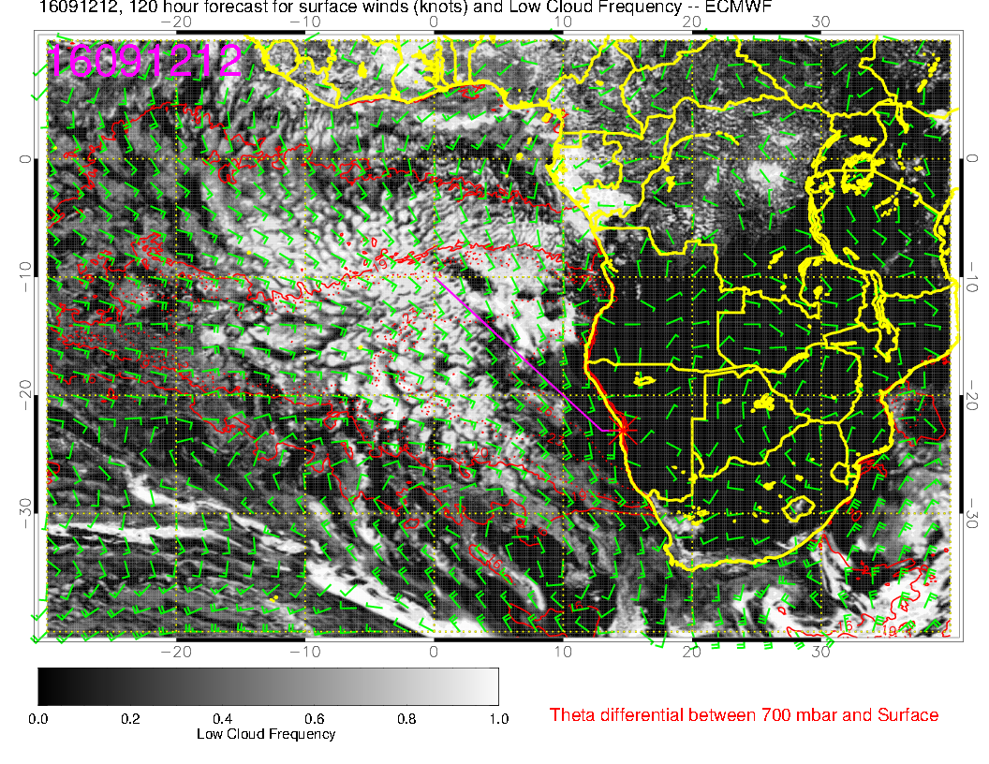
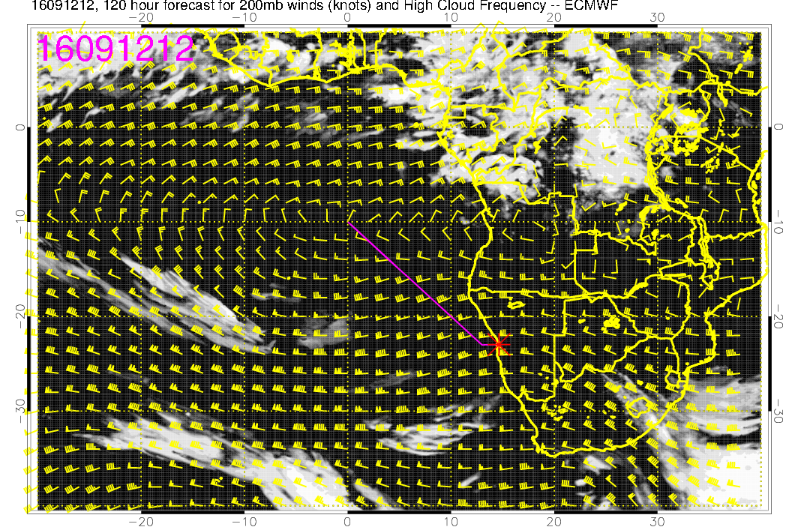
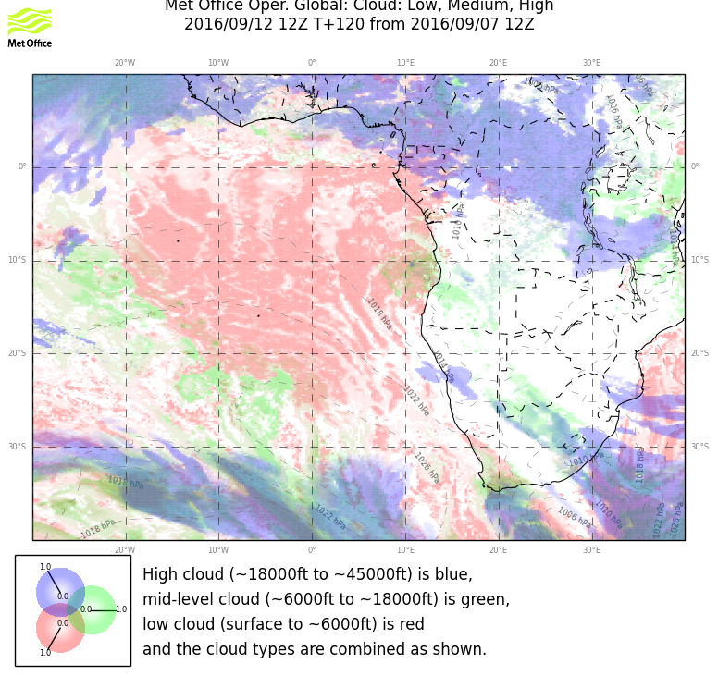
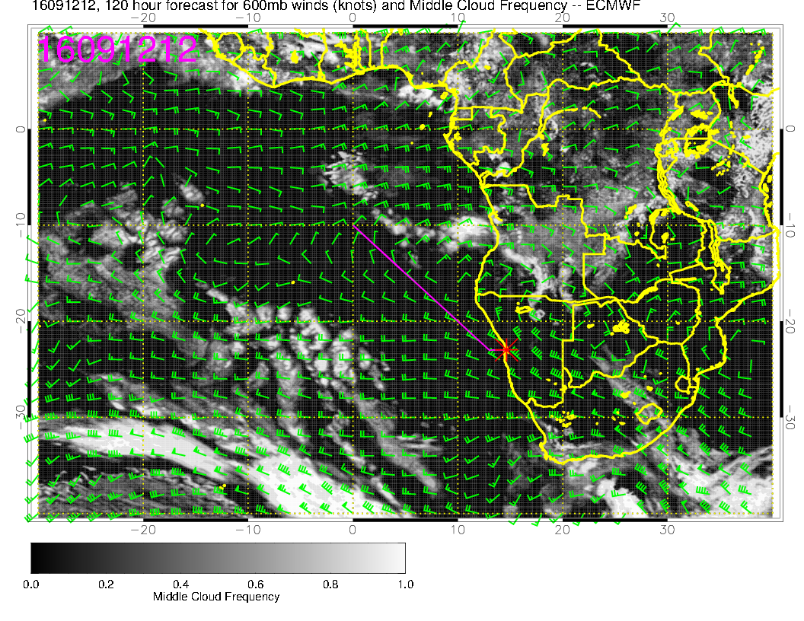
low
9/12 MON, 12Z
high
RF
mid

Slide 13
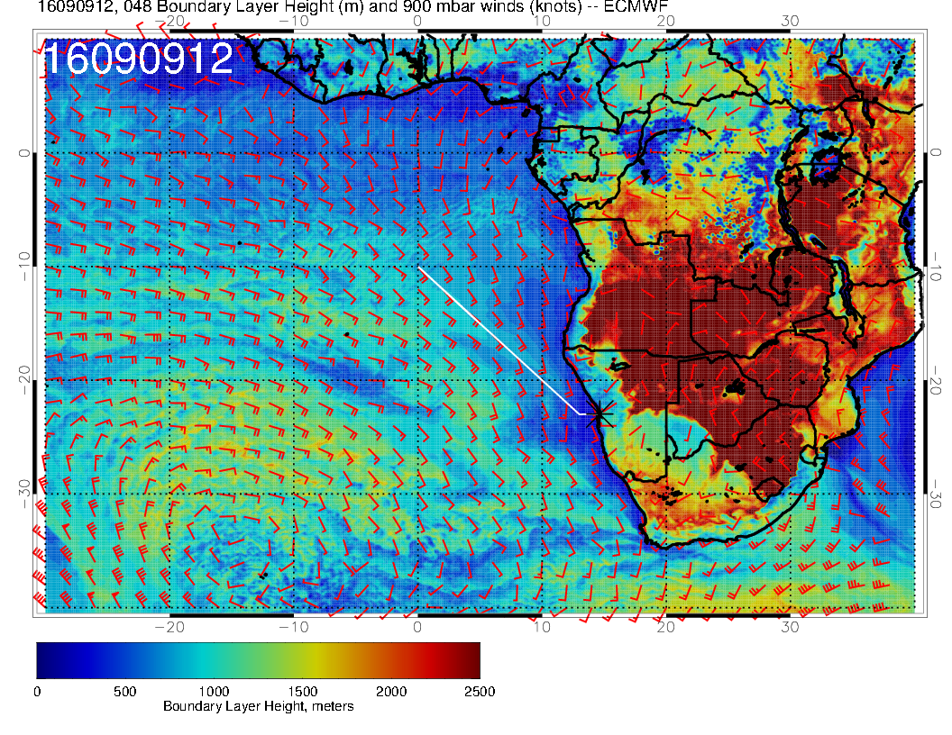
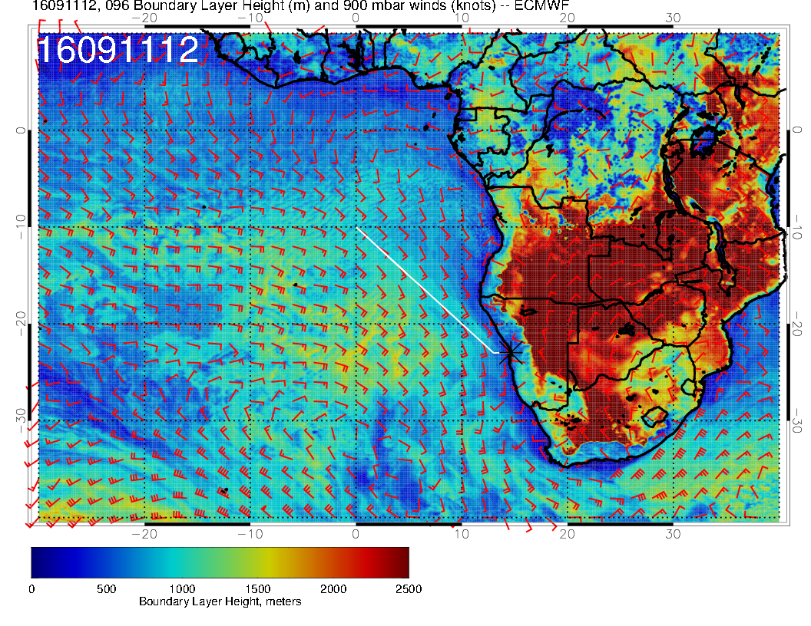
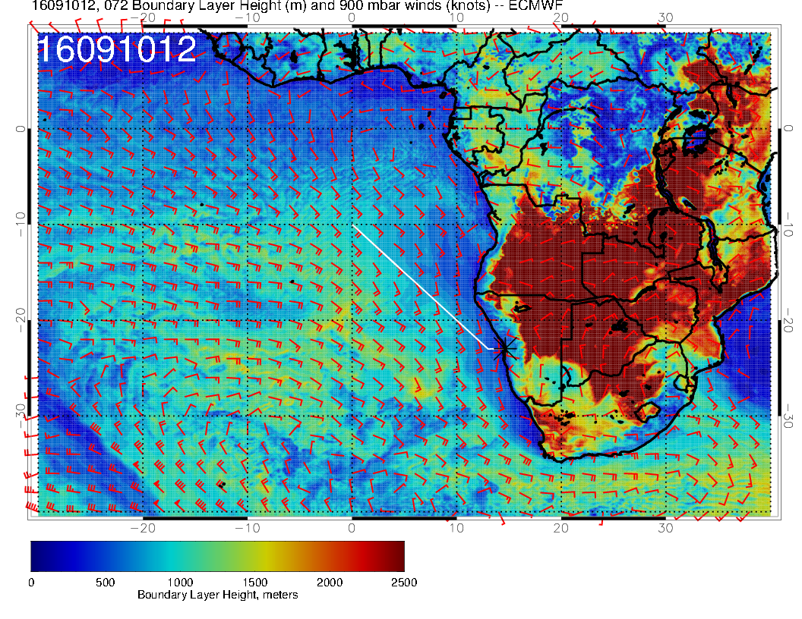
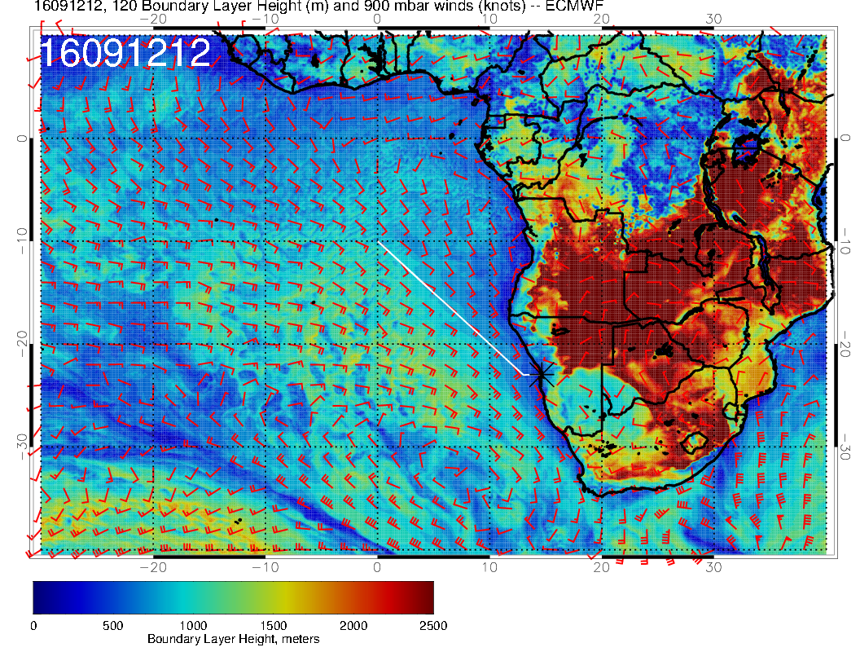
9/9 FRI, 12Z
PBL
9/11 SUN, 12Z
9/12 MON, 12Z
9/10 SAT, 12Z
RF
OF

Slide 14
Summary Saturday Target Opt Flight, ER-2?
Low Ci cover, but right above WVB
No significant mid level clouds
Low cloud decks includes clear sky areas. Less pronounced in UK model.
PBL and Cloud lower over ‘the gap’, but more stratiform PBL at 5E northern of 18S.
Rethink flight plan?
70 hPa OK to fly the ER-2, maximum winds below 20 knots

Slide 15
Summary Sunday Back-up Target Opt Flight, ER-2
No Ci predicted
Stronger development of moist convection outflow from Angola, thus mid level clouds
Larger Sc cover (compared to Sat)
70 hPa seem OK to fly the ER-2, maximum winds below 20 knots
Sunday good alternative!!
Stronger convection over the continent (Congo) – some precipitation in Northern Angola – impact on smoke emission strength and height?

Slide 16
Summary Monday Routine Flight
Low Ci cover
Mid level clouds, associated with convective outflow from Angola further intensify.
Broken Sc field, open skies off the Namibian coast. (UK and EC agree)
High pressure system is passing trough Southern part of our region.
Stronger convection over the continent (Congo) – some precipitation in Northern Angola – impact on smoke emission strength and height?

Slide 17
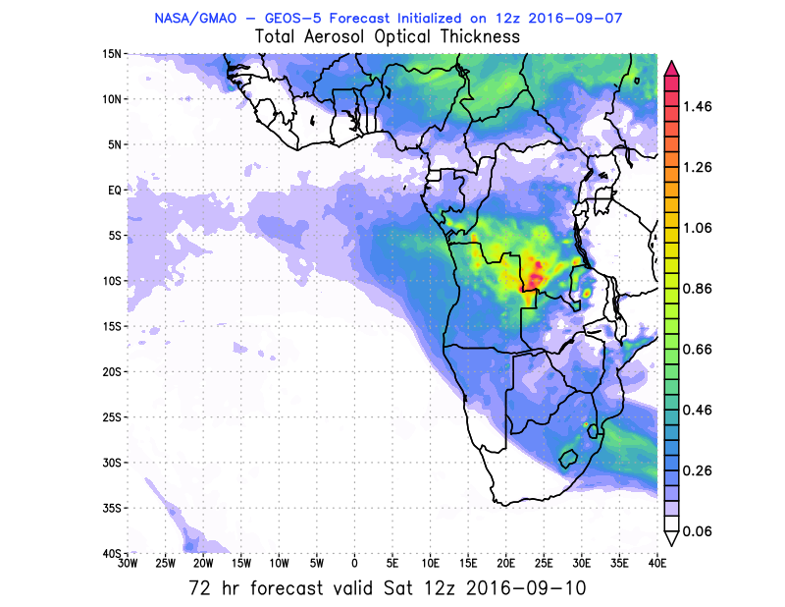
Saturday 9/10

Slide 18
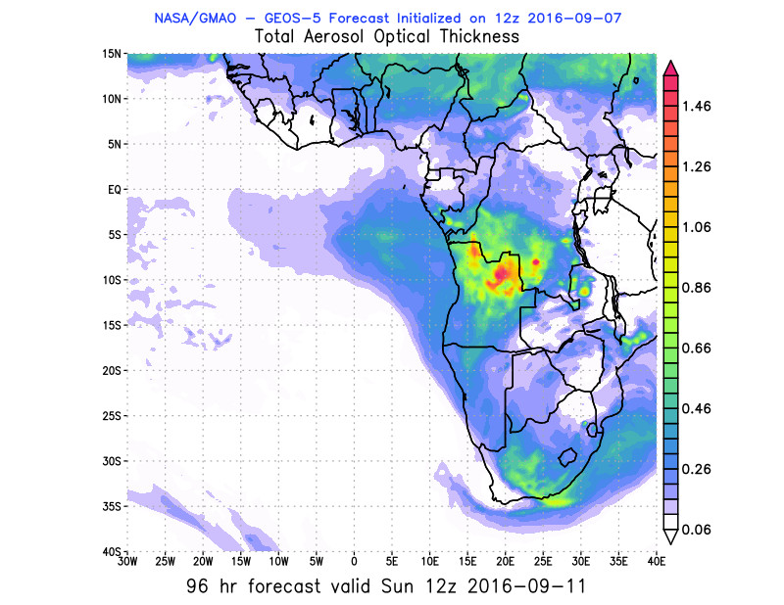
Sunday 9/11

Slide 19
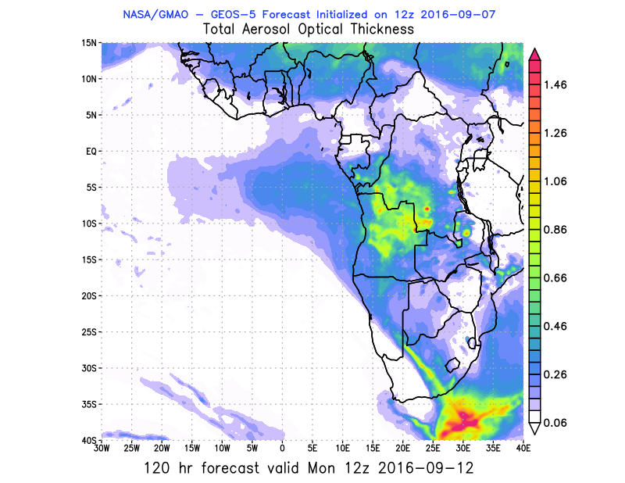
Monday 9/12

Slide 20
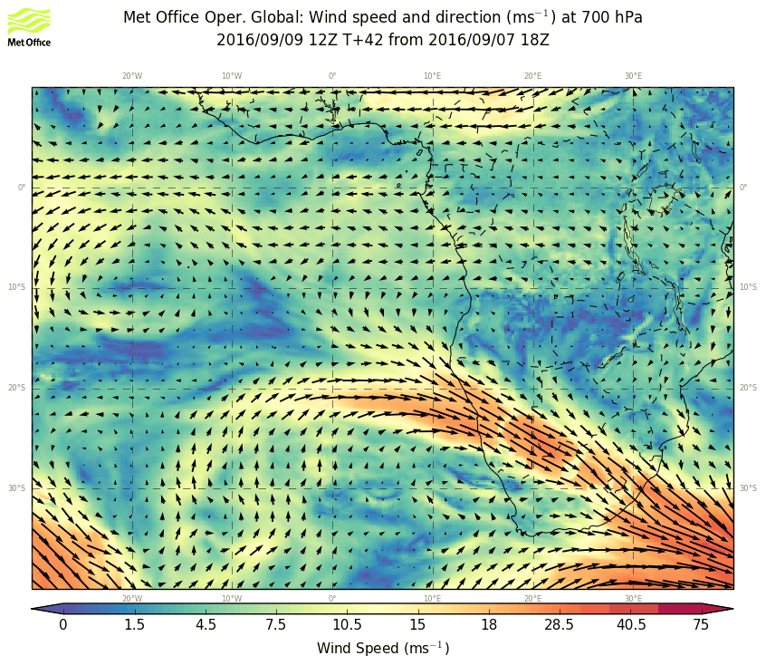
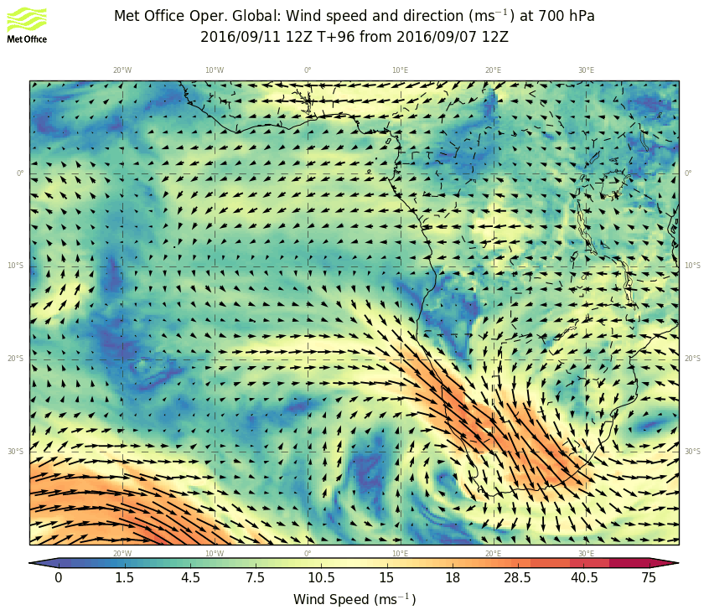
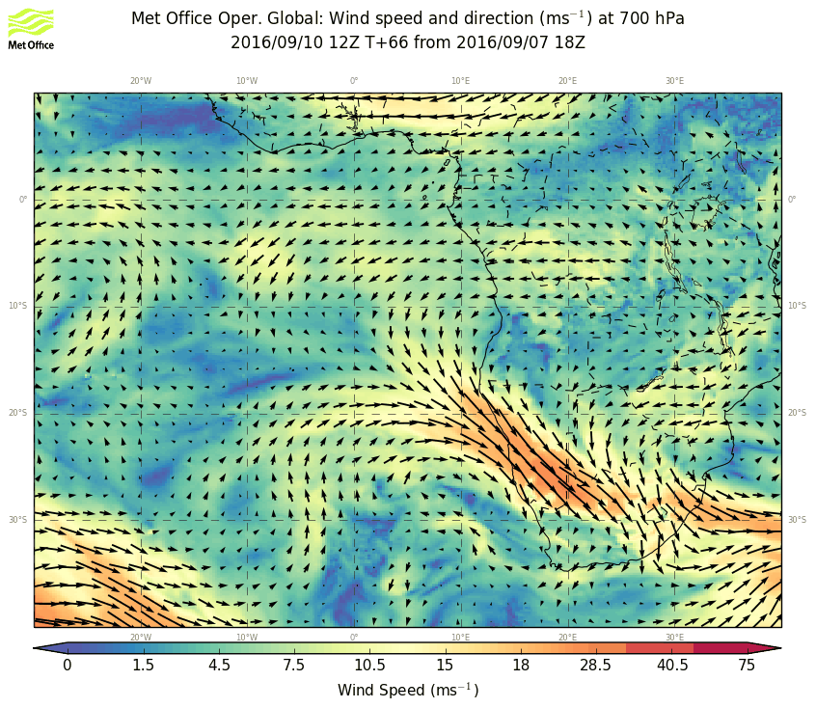

9/9 FRI, 12Z
700 hPa
9/11 SUN, 12Z
9/10 SAT, 12Z
9/12 MON, 12Z
OF
RF

