Slide 1

DC-8
QNC Flight Clearance Process

Slide 2
Introduction
The DC-8 is a US government Public Aircraft and only individuals classified as mission essential Qualified Non-Crewmembers (QNCs) are authorized. To become a QNC, you must complete the requirements in this presentation.

Slide 3
Requirements to Fly on DC-8
Flight Medical Clearance (slide 4)
  Multi-part process, but starts with communication with entering information in ESPO database
Submit the following to Jasmine Tabla (jasmine.tabla@nasa.gov)
  Medical chart information (slide 4) if no ESPO database
  Let Jasmine know if you have flown on a NASA aircraft before
    If yes, which aircraft and NASA Center
  AFRC 70176b, Rev. 1.9 (slides 5-7)
  Proof of Vaccination (slide 8)
  Noise Exposure Warning (slide 9)
Egress Training (slide 10)
  Will be complete onsite – slide for awareness

Slide 4
Flight Medical Clearance Process
Submit personal information to Jasmine Tabla (in a secured way for PII). Information required for creation of medical chart:
  FULL NAME, EMPLOYER, STREET ADDRESS, DATE OF BIRTH, PHONE NUMBER, EMAIL ADDRESS (must be a non-gmail account), BIOLOGICAL SEX (not gender identity, although that additional information is welcome)
  Most campaigns utilize the ESPO database for this purpose
Let Jasmine Tabla know if you have flown in a NASA aircraft before.
  If yes, which aircraft, NASA Center, and when. If you have flown on multiple aircraft, please let us know only the last time you flew and if you have flown on DC-8.
Once the AFRC medical office creates your chart from the above information, they will send a link for the Aviation Questionnaire (medical form).
Complete QNC course for aviation physiological training (don’t need a medical chart to do so):
  https://nhosted-content.s3.amazonaws.com/SMA-HQ-WBT-225_public/index.html
    If you are internal to NASA, please complete on SATERN: SMA-HQ-WBT-225
  Complete the course, and print/download the certificate of completion as a .pdf.
  Submit this certificate of completion to the Jasmine Tabla (jasmine.tabla@nasa.gov)
Once the AFRC Medical Office receives your QNC Certificate and Aviation Questionnaire, they will notify the doctor for review.

Slide 5
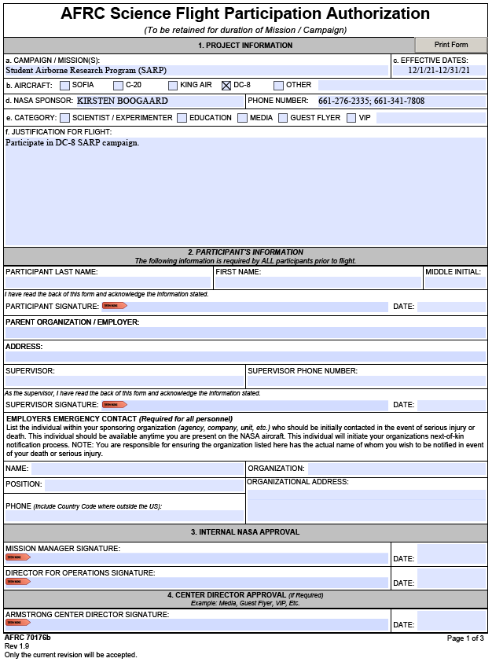
AFRC 70176b
Section 1: Project Information
e. Check the most appropriate box
SCIENTIST/EXPERIMENTER: Non-AFRC personnel flying and have a direct role on the aircraft as part of the science instrument teams.
EDUCATION: Non-AFRC teacher or students over 18 who are invited to fly.
MEDIA: Non-AFRC personnel who are part of the media and are guests of AFRC or the project.
GUEST FLYER: Personnel flying a familiarization flight as AFRC or the Project.
VIP: Non-AFRC personnel flying considered to be distinguished guests of AFRC or the Project.
a-d: Do not modify. Should be specific to your campaign.
f. Provide a short justification of why this person is flying on the aircraft. Examples below.
SCIENTIST/EXPERIMENTER: Operating FLYER instrument on the DC-8 for the SARP Campaign.
EDUCATION: Teacher from UC Irvine observing on the DC-8 SARP Campaign.
MEDIA: ABC News reporter invited to observe the DC-8 flight operation.
GUEST FLYER: Familiarization flight for LaRC weather forecaster supporting SARP Campaign
VIP: NASA Deputy Administrator

Slide 6
AFRC 70176b
Section 2: Participant’s Information
Fully complete parent organization/employer and address. If you are participating as a student, this is your school.
Fully complete participant section and sign. Electronic signatures are accepted and preferred. Hand signed/ scanned copies must be legible.
Fully complete emergency contact information. This is not your next of kin. This is the person responsible for notifying your next of kin in a work-related incident. This is usually someone in your Human Resources or Personnel Department . If you are participating as a student as part of a program, this can be your program manager. Example: for SARP, this is Brenna Biggs.
Fully complete supervisor information. If you are participating as a student as part of a program, this can be your program manager. Example: for SARP, this is Brenna Biggs.

Slide 7
AFRC 70176b
Section 3: Internal NASA Approval
Scan or photograph COMPLETED form (sections 1 and 2 fully filled out) as a .pdf and submit electronically to Jasmine Tabla (jasmine.tabla@nasa.gov) to route for NASA approval

Slide 8
Proof of Vaccination
It is a requirement to be fully vaccinated for COVID (all shots + two weeks) to fly on NASA aircraft
  This does not include booster shots
Please sign the Certificate of Vaccination form and submit to Jasmine Table (jasmine.tabla@nasa.gov)
In addition, AFRC’s current COVID guidance was included as an attachment for informational purposes. This information is subject to change as your campaign gets closer and is required to be followed by all people who come on NASA property (to include the aircraft on deployments).

Slide 9
Noise Exposure Warning
Please read and sign noise exposure acknowledgement document to document receipt and understanding.
Send document to Jasmine Tabla (jasmine.tabla@nasa.gov) and direct questions regarding the contents of this document to Dr. Dwight Peake at the NASA AFRC Health Unit dwight.peake-1@nasa.gov.
NOTE: If you are a NASA Civil Servant, you will need to enroll in the Hearing Conservation Program at your Center.

Slide 10
Aircraft Egress Training
This will be conducted when you arrive at the aircraft location prior to flight.

