Slide 1

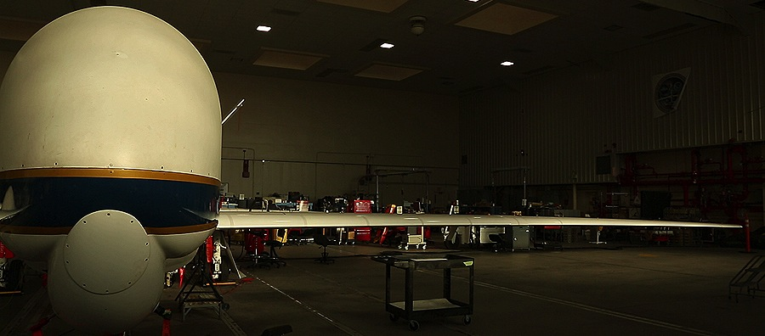
Education & Public Outreach
2013 Campaign

Slide 2
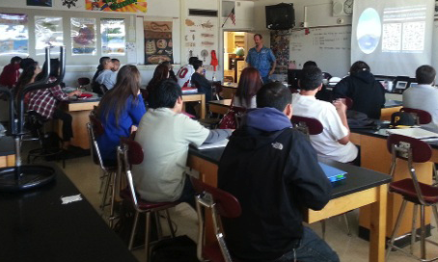

Direct Interaction with Students
Classroom presentation series
Science demos:
  Cloud chamber
  Pressure
  Convection

Slide 3
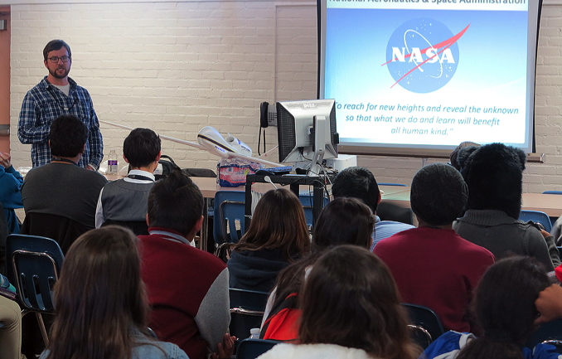
Notes:
Nov & Dec 2012
764 Students reached

Slide 4


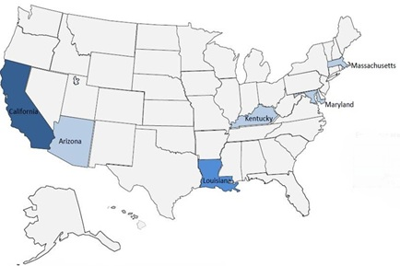
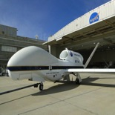
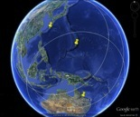
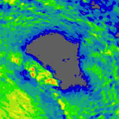
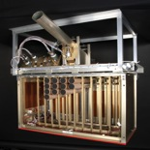
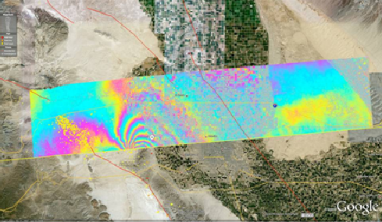
Airborne Research Experience for Educators
Hurricane and Severe Storm Sentinel
Airborne Tropical TRopopause Experiment
Dryden Flight Research Center • Palmdale, CA • July 15-25, 2013
Educator Objectives
Increase scientific knowledge
Engage in NASA-unique research experience
Align STEM resources with NASA missions
Student Objectives
Engage in real-world science
Interpret real-data
STEM Career Awareness
Educator Inputs:
HS3, ATTREX PI-led science briefs
10-day Institute
Master Educators as Trainers
Outputs:
Educators as Citizen Scientists
Online Mission-related Curriculum
Intro. Industry Eng. Design Model
Outcomes:
12 educator (gr. 4-12) ambassadors
Classroom Curriculum Fall Pilot
Implement Computer Science in K-12
Educators per State
(Impact determined by color depth)
4
Educator flight immersion model
(clockwise from top left: mission science; operations; data collection; analysis and presenting results
Shaun Smith
shaun.smith@nasa.gov

Slide 5
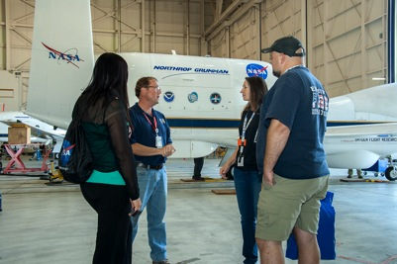
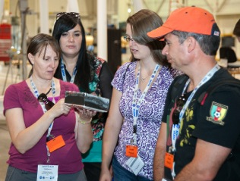
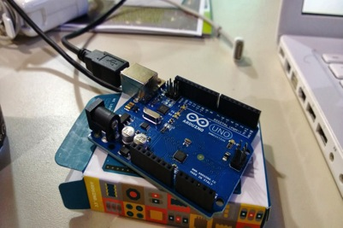
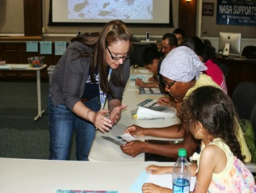
Involve NASA at all levels
Multiple roles for NASA Scientists and Engineers
Flight Mission Immersion
HS3 PI Dr. Scott Braun science brief
ATTREX Deputy PI Leonhard Pfister science brief
DFRC and DAOF site visits
Interaction with Dr. Jeff Halverson and other mission personnel
10-day Academy
Engaged 12 educators as citizen scientist w/ Globe
Investigated the Mission Tools Suite
Explored industry-standard engineering design models
Utilized Arduino microcontroller to simulate mission data calibration/validation
Translation to Classroom
Educators pilot mission-based S,T,E.M activities during Fall school year
Curriculum module is revised and adapted into online learning format
Educator ambassadors present their work at schools, districts, conferences

Slide 6
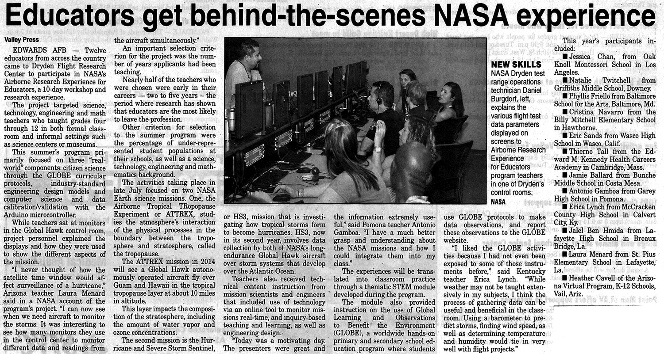

Slide 7
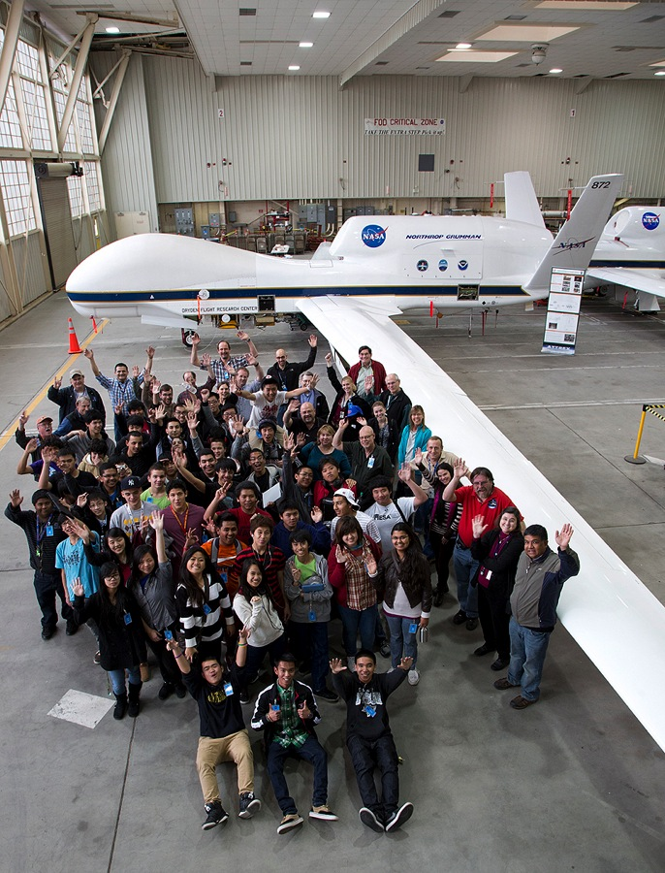
Independence High School
San Jose, CA
45 students
4 teachers.

Slide 8
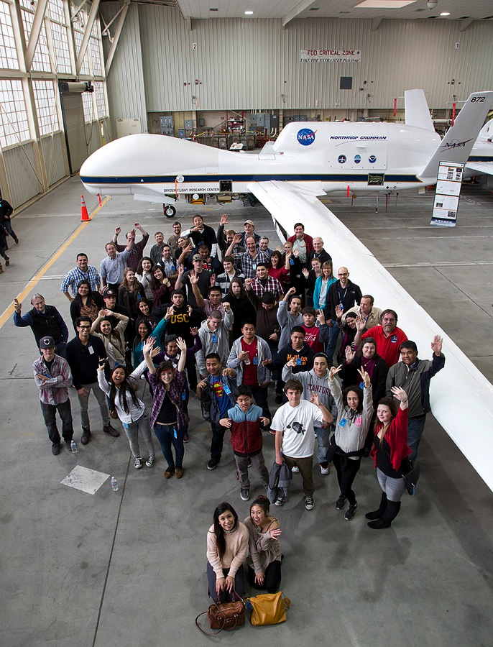
El Camino High School
South San Francisco
40 Students
5 teachers

Slide 9
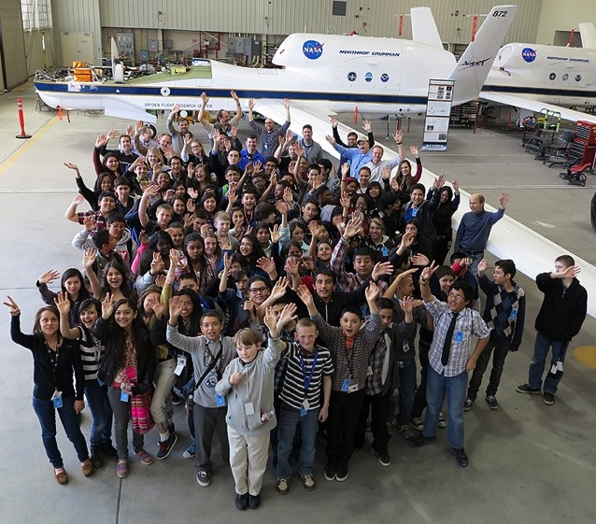
Palmdale Aerospace Academy
99 students
9 teachers
Notes:
Total: 184 Students, 18 teachers

Slide 10
ATTREX Chat
581 Students
  56% High School
  33% Middle School
  11% Elementary School
14 teachers
  42% High School
  42% Middle School
  16% Elementary School
Palmdale
Los Angeles
San Jose
San Francisco
New York
Punta Arenas

Slide 11
Facebook
Page Likes: 246 -> Potential audience of 79,275 (Friends of fans)
486 People were talking about ATTREX on FB during the same week (people that have created a story about the Page).
12,078 People reached during the last week of the project (unique visitors) (we went viral this week: as it is defined by reaching more than 10K people within a certain period of time)

Slide 12
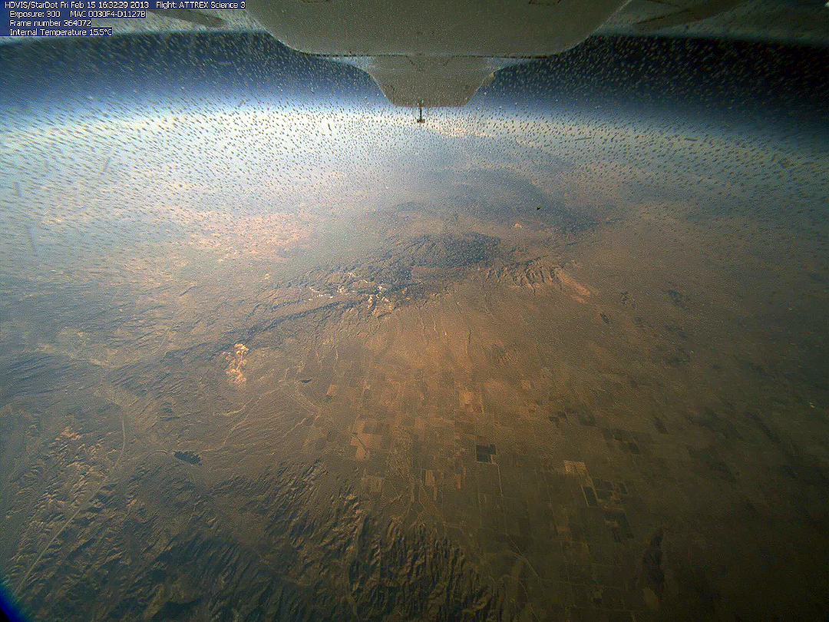

Slide 13
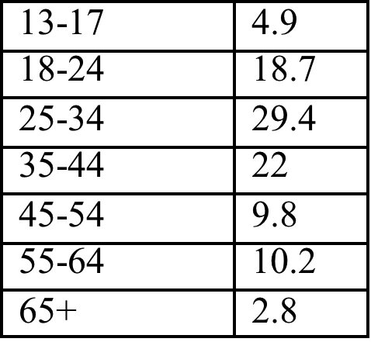
OUTREACH
25.3% Female
72.7% Male
20 countries including: Spain, India, Peru, Germany, Brazil, Canada, Italy, Greece, Bulgaria, Mexico, Philippines, Tunisia, UK, Indonesia, France, Sri Lanka, Portugal, Turkey, Israel, and Iran.
20 Languages
AGE GROUP
% Visitors

Slide 14
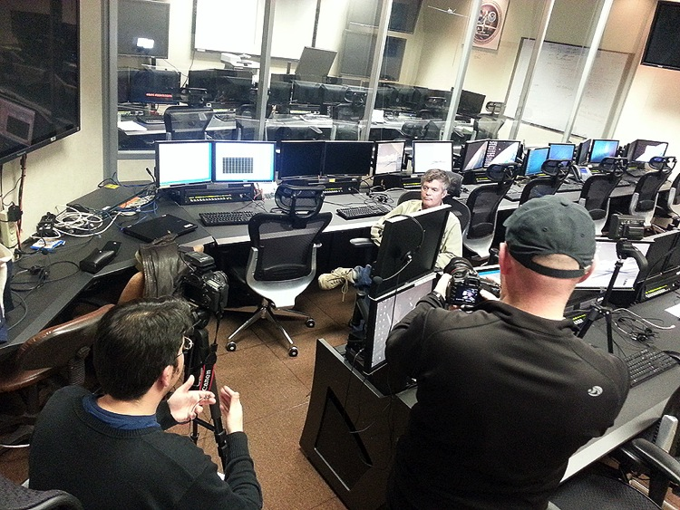
Videos
Videos:
  ATTREX Trailer
  Bay Area High School visits
  Palmdale Middle school visit
  ATTREX video short (altitude)
  Chapter 1: What is ATTREX?
  SciFly Trailer

Slide 15
Websites
https://espo.nasa.gov/missions/attrex-epo
https://www.facebook.com/attrex
http://www.sciflychannel.com
https://www.facebook.com/sciflychannel
http://www.youtube.com/user/sciflychannel

Slide 16
EPO Plans
AAFB Site visit by local schools
Continue web based outreach: Facebook and X-Chat.
ATTREX Airborne Science Camp
  2 Weeks
  NASA Ames Research Center
  Presenters: You
  Participants: TBD (high school, junior undergrads?)
Notes:
Airborne Science display at Ames visitor center

