Slide 1
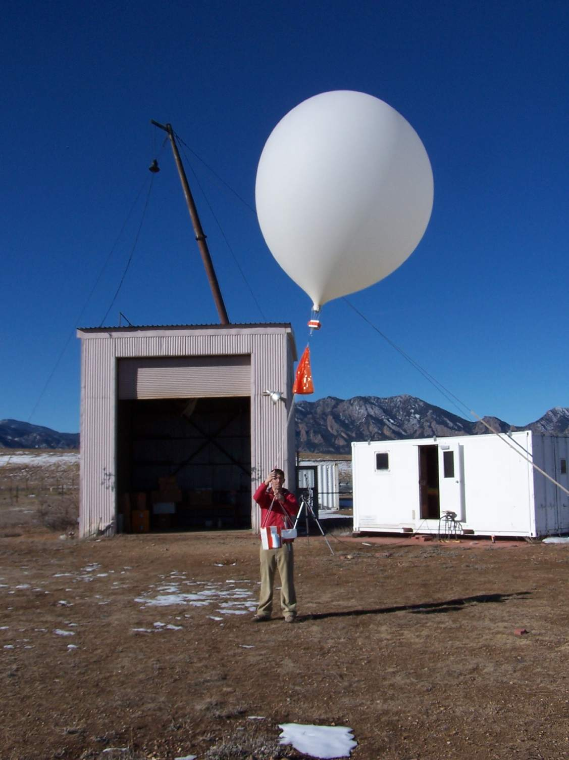
Instrumented Balloon Launches for ATTREX
Dale Hurst, Emrys Hall, Allen Jordan
Global Monitoring Division, NOAA Earth System Research Laboratory
and CIRES, University of Colorado, Boulder
Boulder Balloon Soundings … still going strong after 33 years!

Slide 2
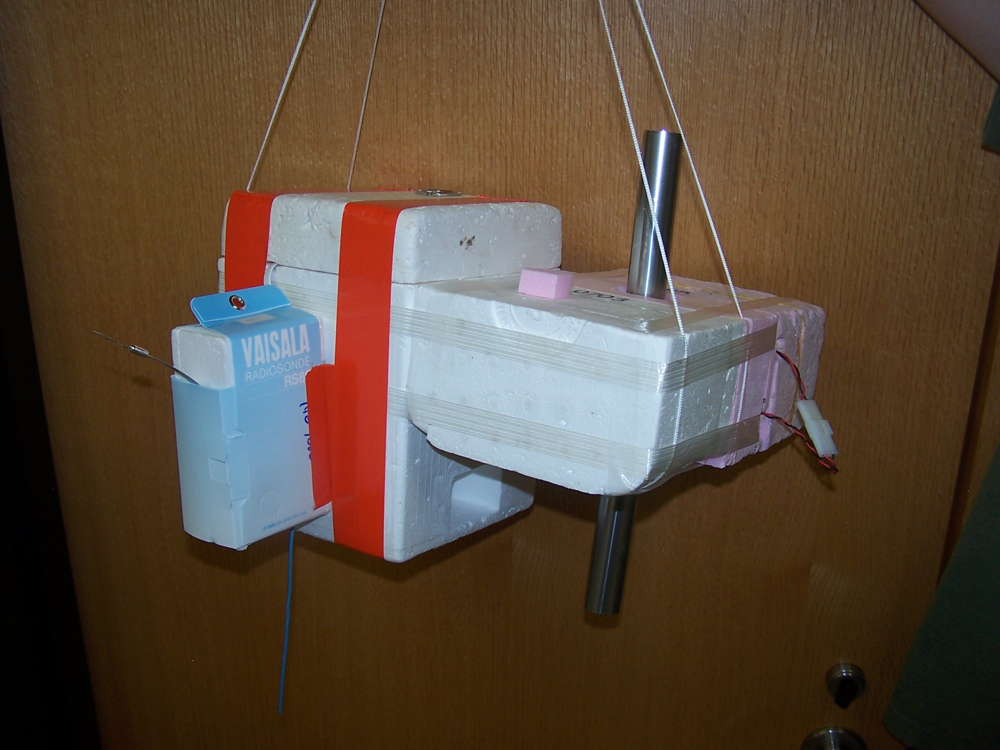
Instrument Payload
Ozonesonde
Air
Intake Tubes
NOAA FPH
Radiosonde
Payload Weight: 2.0 kg (4.4 lb)
Payload Size: 15” x 12” x 8”

Slide 3
Payload Measurements
Primary Data Uncertainty
Instrument Measurement Product (Stratosphere)
NOAA FPH T_{FP} H₂O VMR <±10% (±0.5 ppmv)
(custom)
P
P
Ozonesonde P_{O3} O₃ VMR <±5% (±0.3 ppmv )
(DMT)
Radiosonde T <±0.5° C
(Intermet) P <±0.5 hPa
403 MHz RH NA > 12 km
GPS payload location, horizontal winds

Slide 4
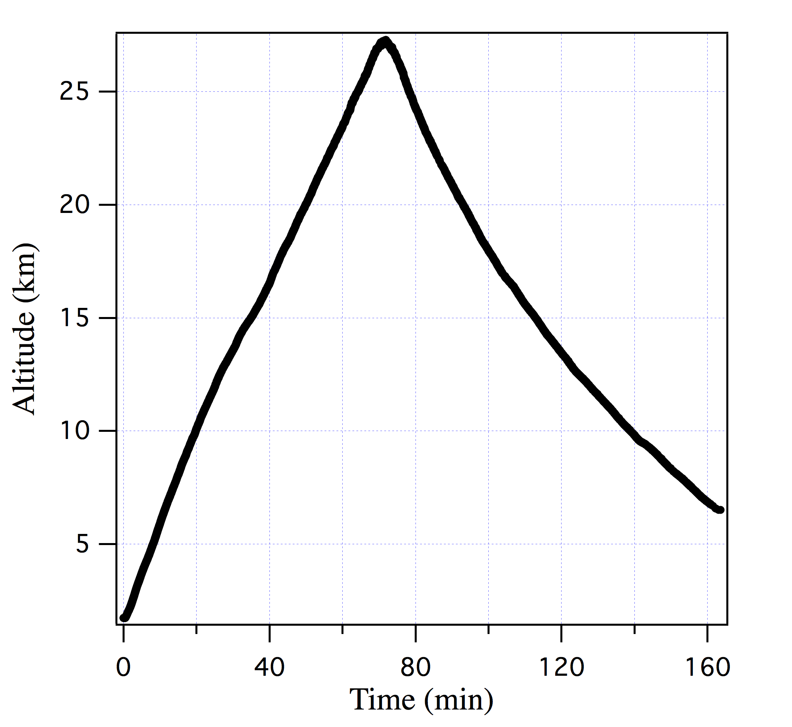
Balloon Flight Profile
Valve opens
~ 70 minutes
Descent Rate
-5 m/s
~ 90 minutes
Ascent Rate
+5 m/s
(1000 ft/s)

Slide 5
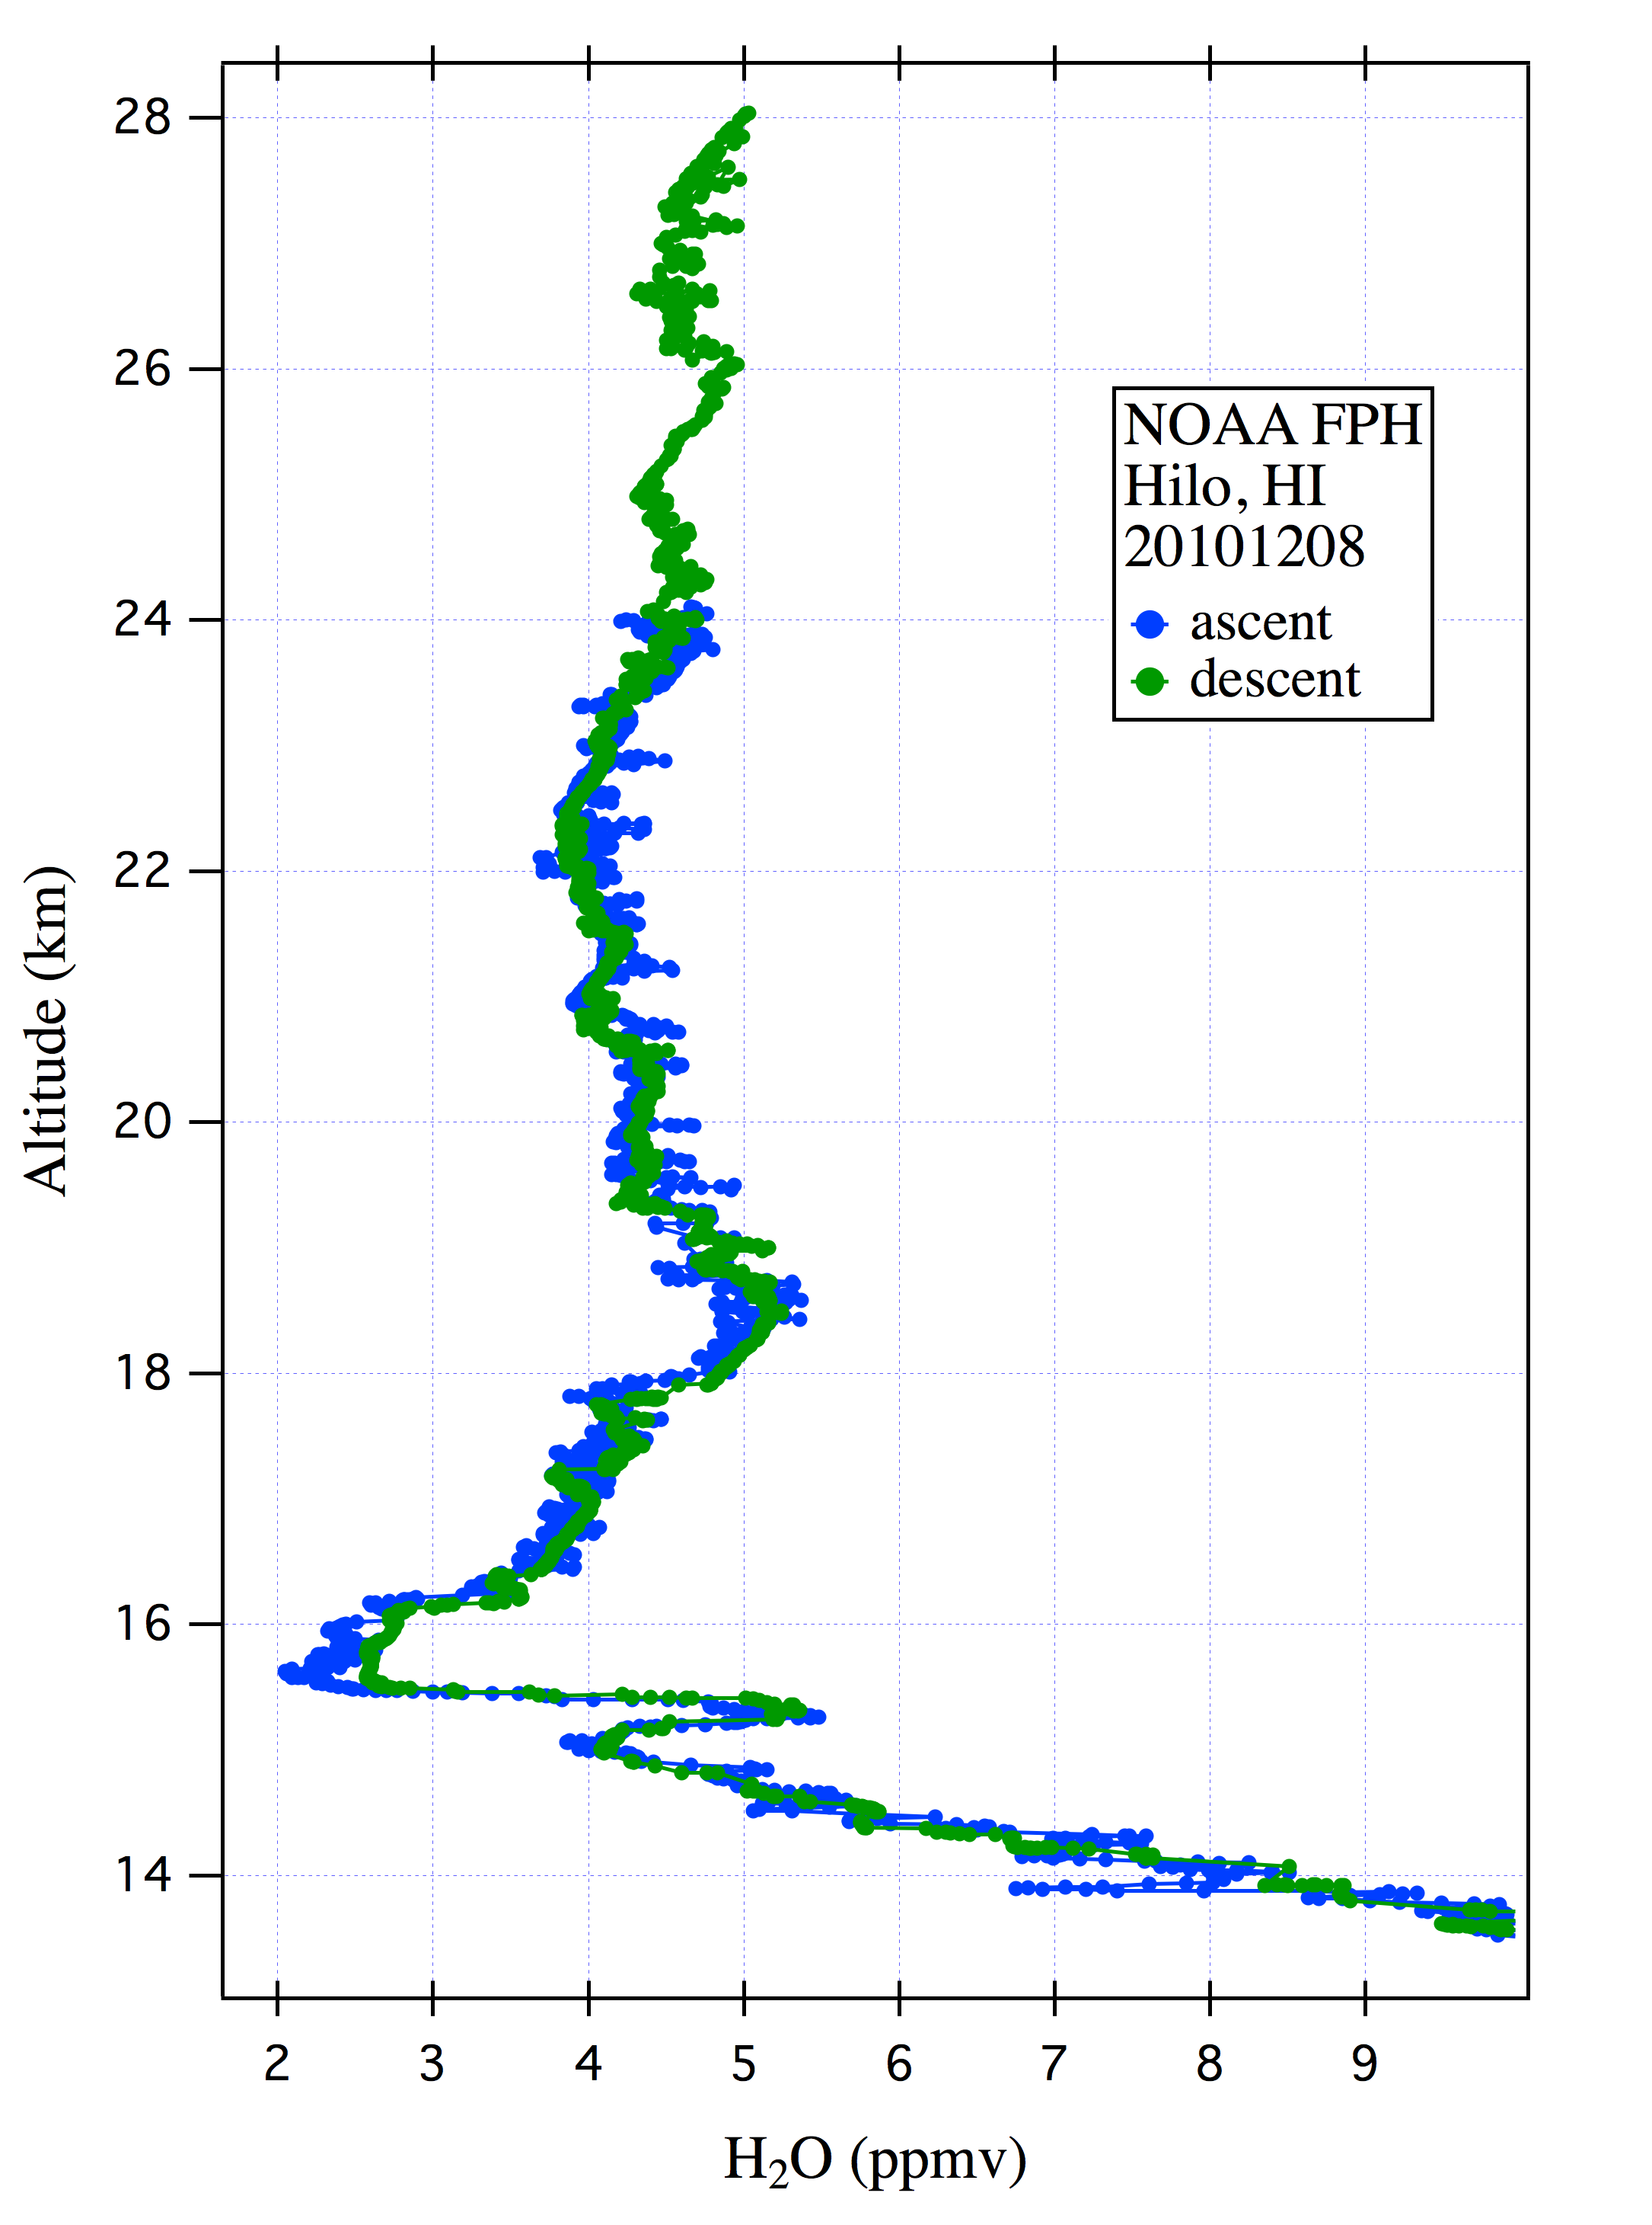
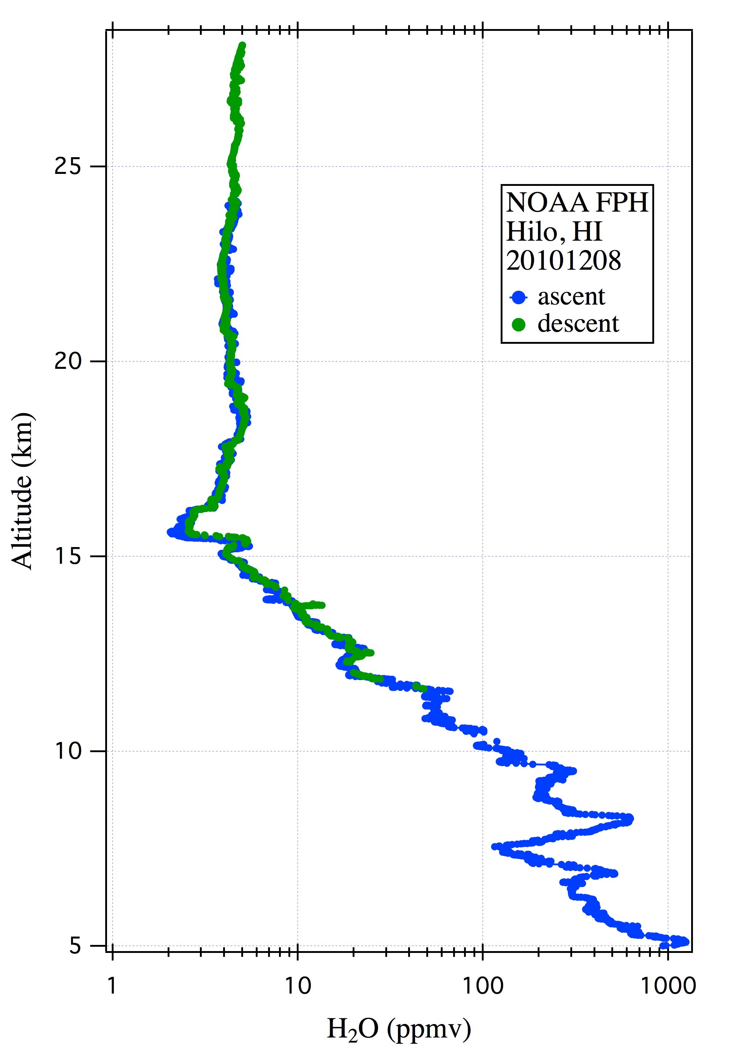

Slide 6
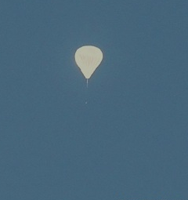
Coordination with GH flights
Ideally …
• 1 balloon launch per GH flight
• 4-6 flights anticipated (4 week window)
• Close spatiotemporal coincidence with GH
• Requires launch timing and trajectory to be
coordinated with GH flight plan

Slide 7
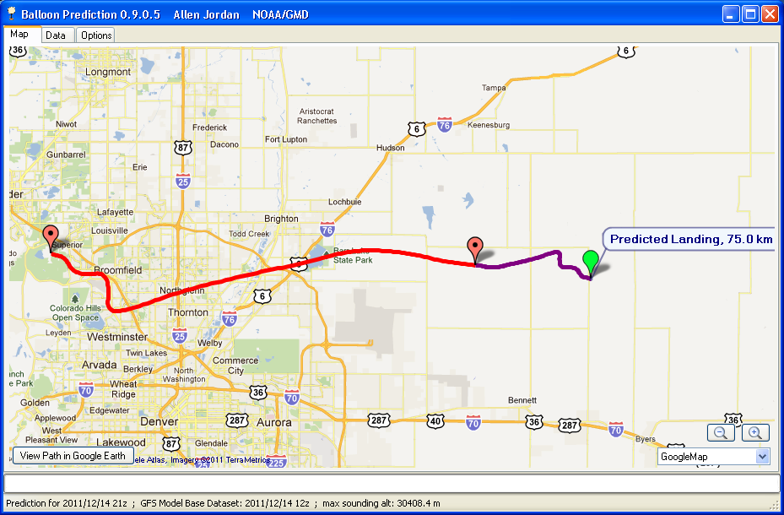
Balloon Trajectory Prediction (2D)

Slide 8
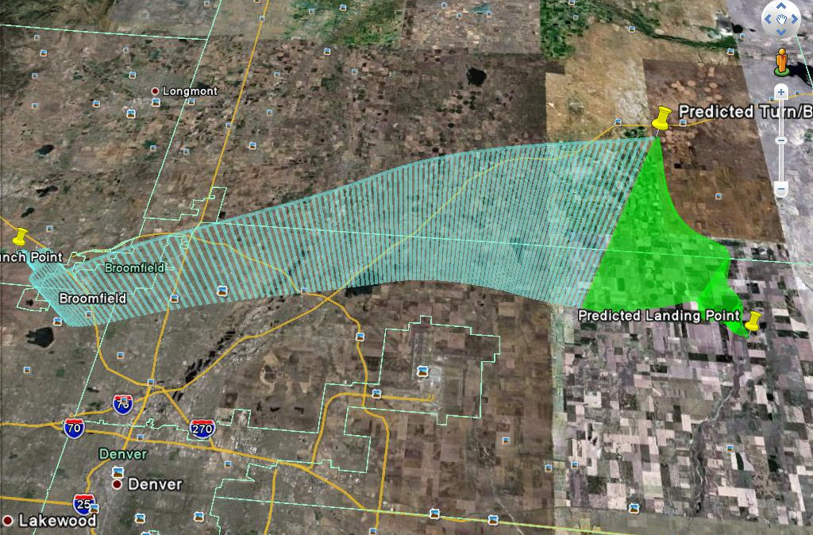
Balloon Trajectory Prediction (3D)

Slide 9
Potential Launch Sites
Andersen
AFB
NWS
Facility

Slide 10
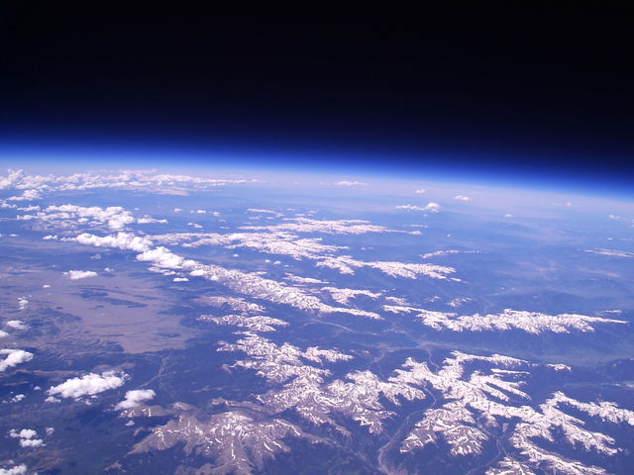
Ballooning over the Rockies

Slide 11
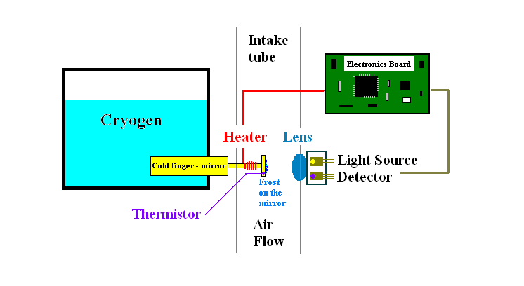
FPH Measurement Technique
PID Temp Controller
Calibrated
NIST scale
Stable Frost Layer =
equilibrium between frost layer and water vapor in air flow
P_{H2O} = f(T_{FP}) Clausius-Clapeyron equation (P_{sat} over ice)
H₂O VMR = P_{H2O} / (P_{air} – P_{H2O})

