Slide 1

Measurements and modeling of water vapor from solar spectral irradiance during ATTREX
Bruce Kindel, Peter Pilewskie, Sebastian Schmidt,
Troy Thornberry, Drew Rollins, Samuel LeBlanc,
and Paul Bui.

Slide 2
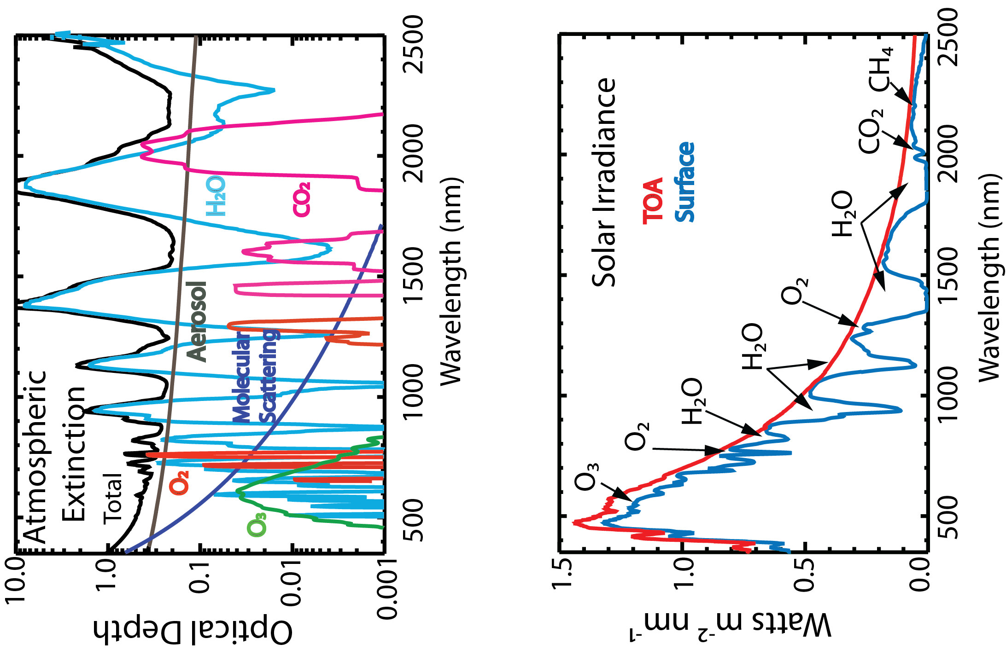
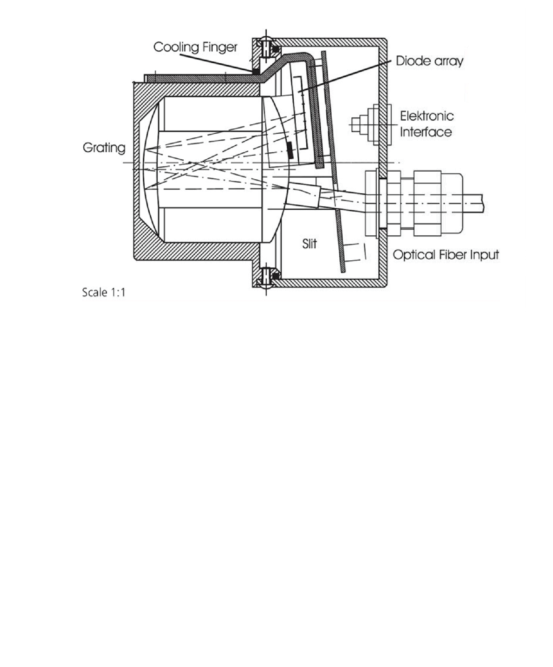
Solar Spectral Flux Radiometer (SSFR)
VIS-NIR: 256 element silicon diode array
260-1090 nm, 3.0 nm sampling, 8 nm FWHM
NIR: 256 element InGaAs array
903-2217 nm, 5.0 nm sampling, 16 nm FWHM
16-bit system
NIST traceable calibration
Integrating sphere for cosine response
Zeiss Monolithic Spectrometer

Slide 3
SSFR Irradiance (Zenith & Nadir 18km)
Water vapor transmittance (0-100 km)
Irradiance m⁻² nm⁻¹ / Transmittance
Wavelength (nm)

Slide 4
SSFR Irradiance (Zenith & Nadir 18km)
Water vapor transmittance (14,18-100 km)
Irradiance W m⁻² nm⁻¹/ Transmittance
Wavelength (nm)

Slide 7
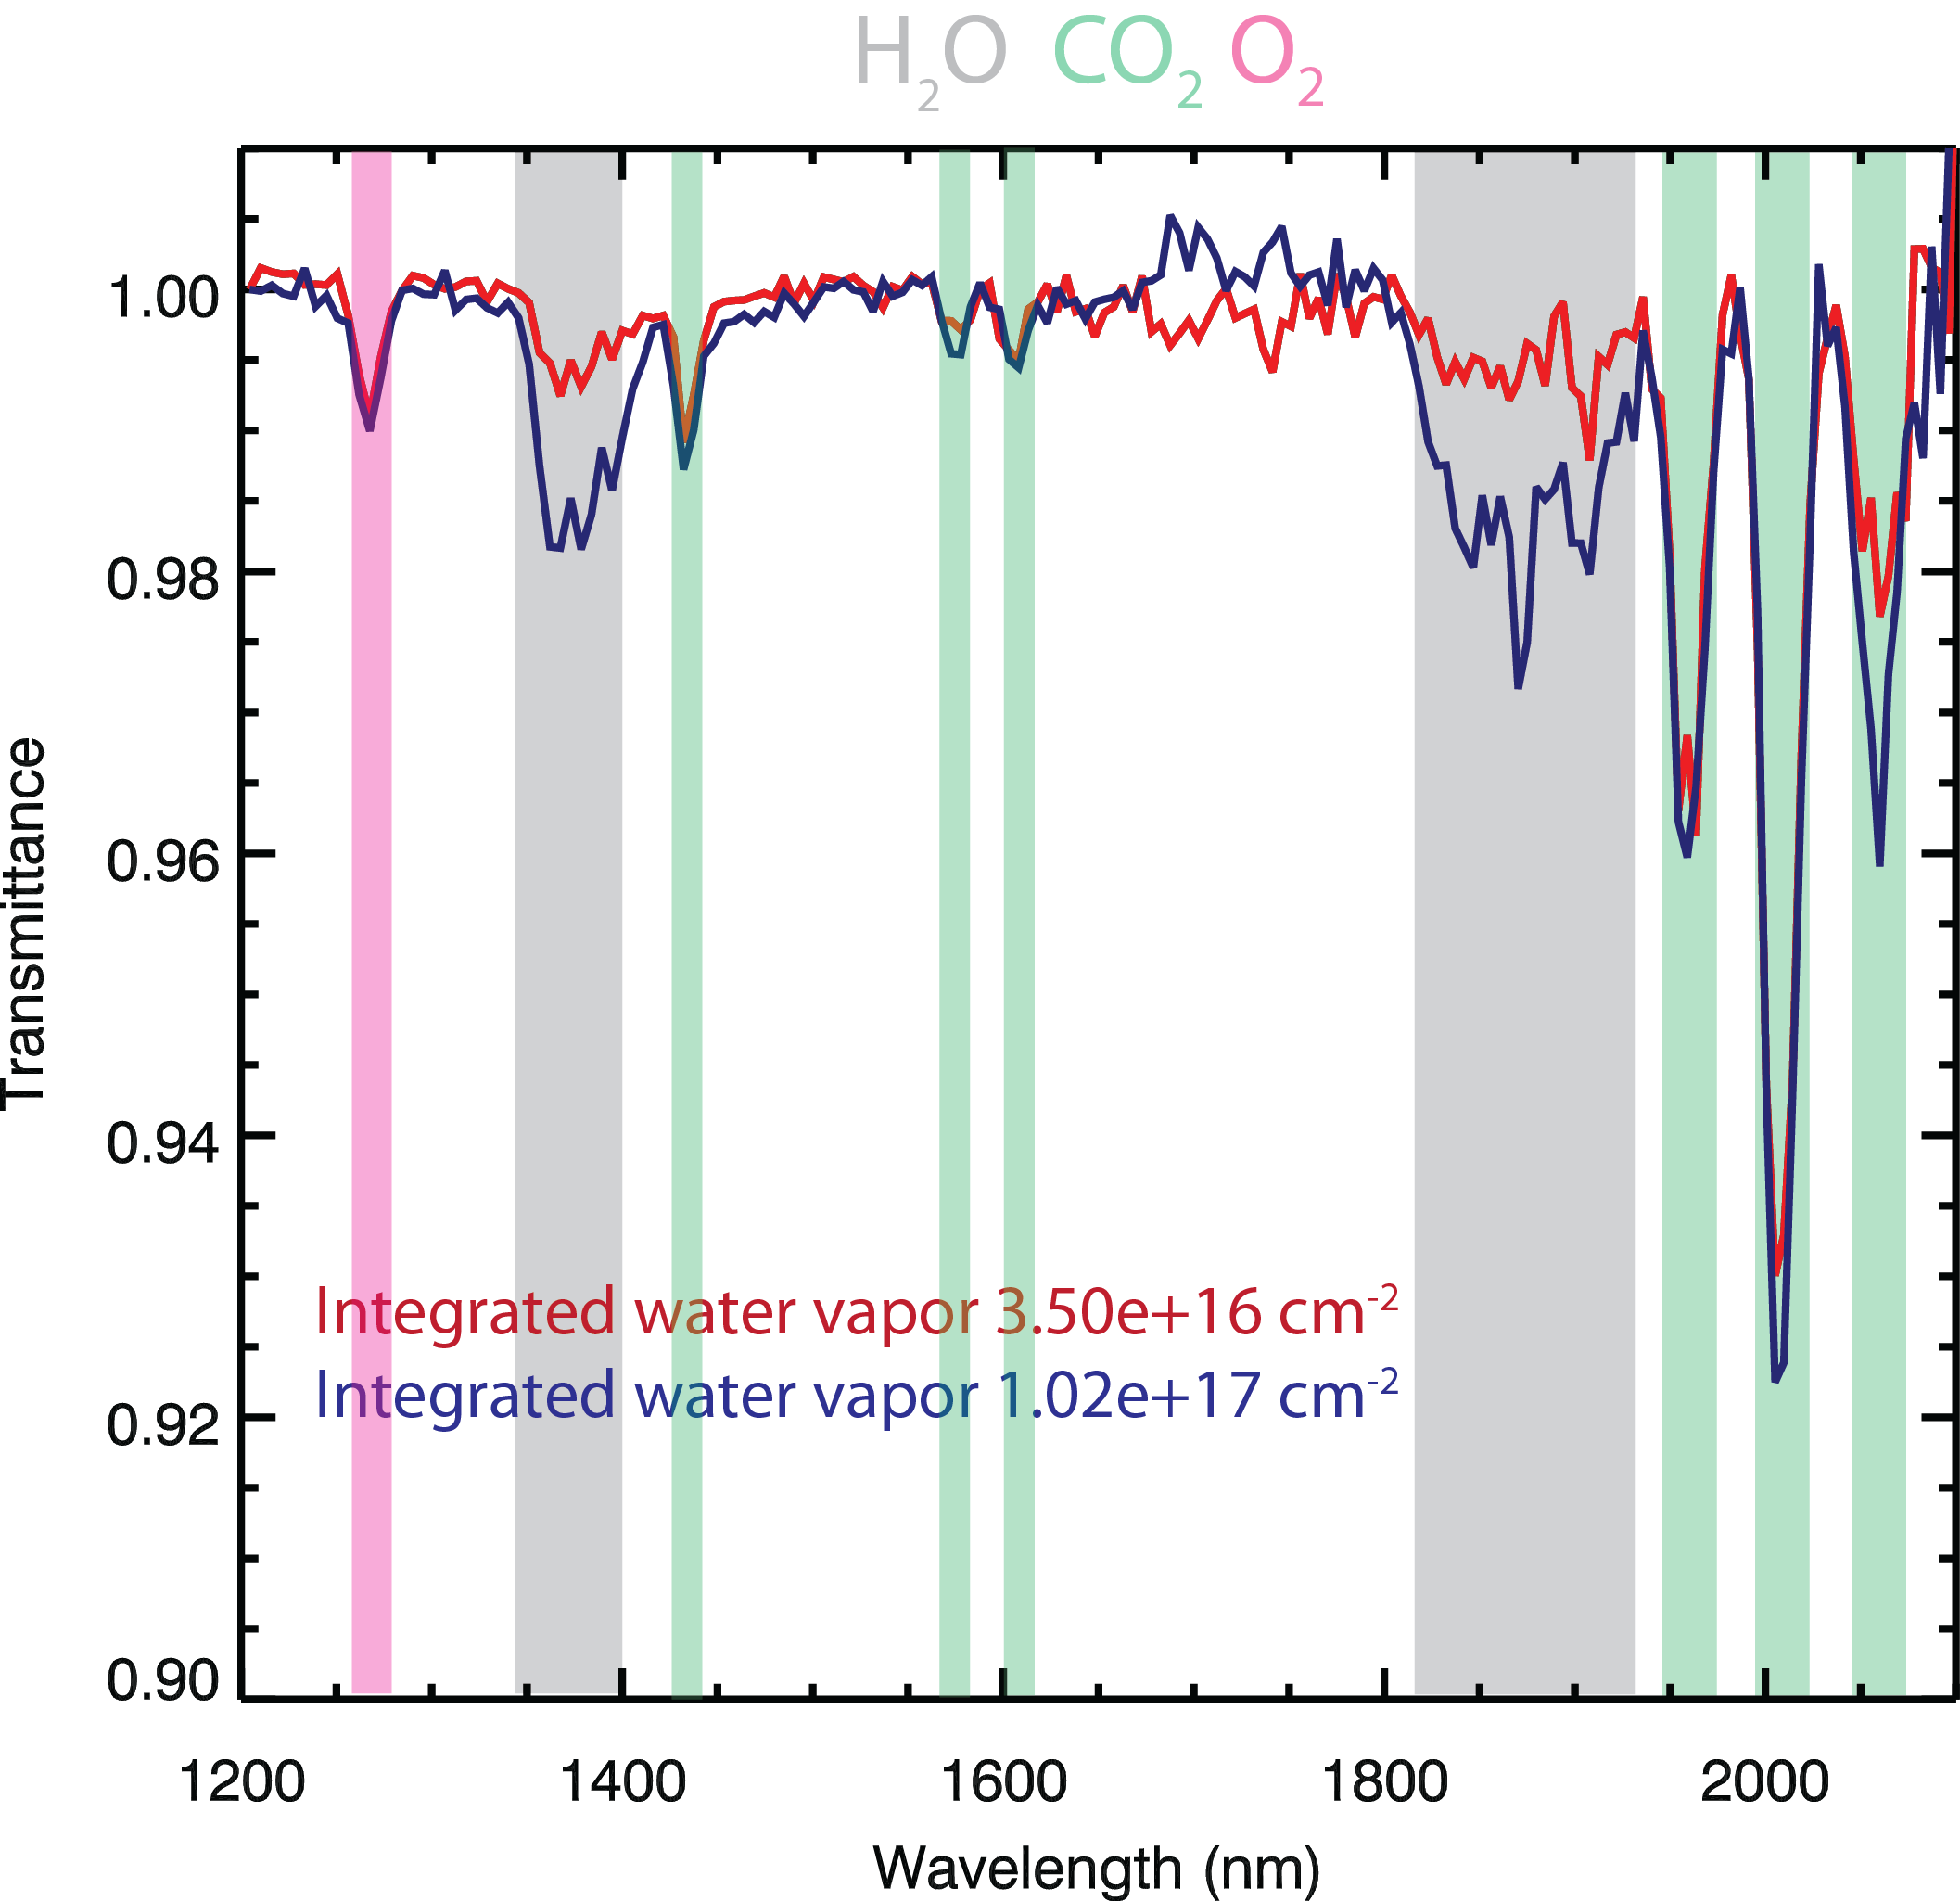
SSFR transmittance spectra SF1
Transmittance = zenith (low alt) / zenith (high alt)

Slide 8
Radiative Transfer Modeling
MODTRAN5.3.2 updated to HITRAN 2008
1 cm⁻¹ sampling 2 cm⁻² resolution convolved
with the SSFR slit function
User defined atmosphere, vertical profile of
water vapor from NOAA, pressure and temperature
from MMS. Default tropical values for other species.
Model vertical resolution of 250 meters, ~14 levels
over the profile

Slide 9
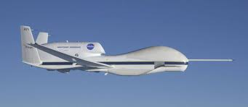
Z = Vertical distance between profile altitudes
H = Solar slant path
Z
H

Slide 15
SSFR-SSFR

Slide 16
MODTRAN-SSFR Mean & Stdev
11 cases
Transmittance Difference (MODTRAN-SSFR)
Wavelength (nm)

Slide 17
Water Vapor Transmittance
Water Vapor Transmittance
SSFR
MODTRAN
SSFR
MODTRAN

Slide 18
TOA Solar Spectrum
20 km
18 km
Irradiance (W m⁻² nm⁻¹)
Transmittance
TOA-20 km
TOA-18 km
Wavelength (nm)
Wavelength (nm)

Slide 19
Summary
First results of measuring UTLS water vapor in the strong water vapor
bands at 1400 and 1900 nm from solar irradiance are encouraging.
SSFR transmittances (absorptances) correlate well with integrated values
from NOAA in situ water vapor profiles.
Comparisons with atmospheric radiative transfer modeling (MODTRAN) using
atmospheric profiles of water vapor, pressure, and temperature display a
consistent bias in the computed transmittances as compared to measurements.
This technique may provide a near real time measure of column integrated water
vapor from aircraft altitude to the top of the atmosphere along the solar slant path.

Slide 20
