Slide 1
Long-Lived Tracers and the Origin of Air in the Tropical Tropopause Layer during ATTREX
Eric Hintsa, Fred Moore, Geoff Dutton, Brad Hall, David Nance, and Jim Elkins
Bruce Daube, Jasna Pittman, Steve Wofsy, Ru-Shan Gao, Andrew Rollins, Troy Thornberry, Laurel Watts, David Fahey, Tao Wang, Andrew Dessler, Paul Bui, M. J. Mahoney, Boon Lim, Cameron Homeyer, and the ATTREX Science Team

Slide 2
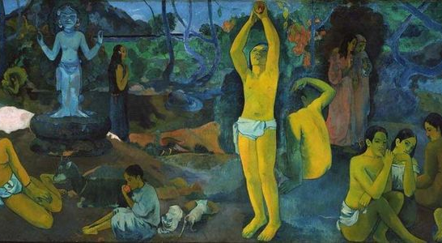
Where Do We Come From? What Are We? Where Are We Going? – P. Gauguin, 1897

Slide 3
Main Points
The parts of the TTL sampled along Global Hawk flight tracks during ATTREX-2 had young and relatively uniform air.
Small variations in tracer mixing ratios show that there was some mixing in of extratropical or older air.

Slide 4
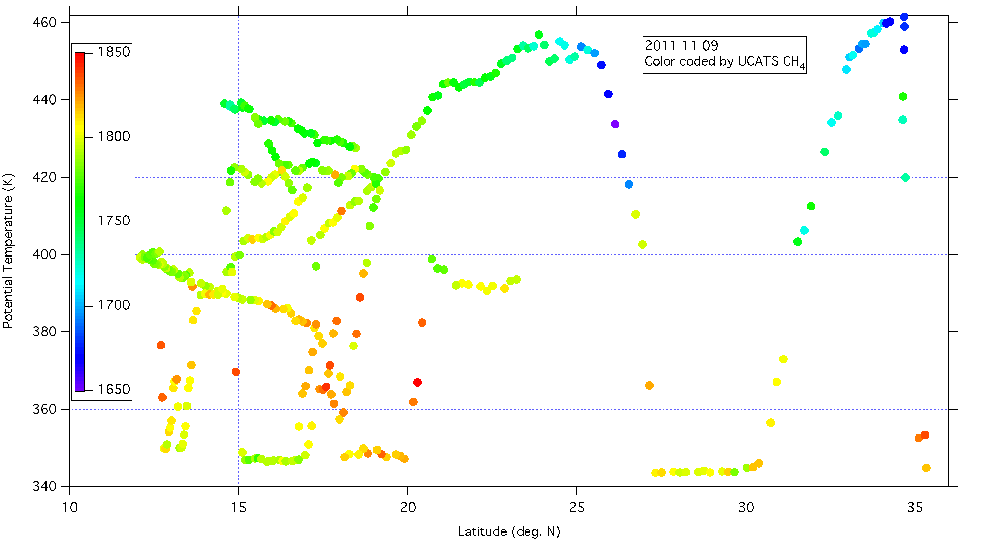
Possible intrusions of extratropical air into the tropical tropopause region
Notes:
Methane ~ 1780-1790 at 12-13 N, 390-400 K; agreement with AWAS (even a little bit lower)
N2O – dips from 321 to 317 ppb, SF6 also drops from 12-14 N
Decrease in methane on dive at 15-17 N may be due to seasonal cycle (agreement with AWAS, but no dips on other trace gases)

Slide 5
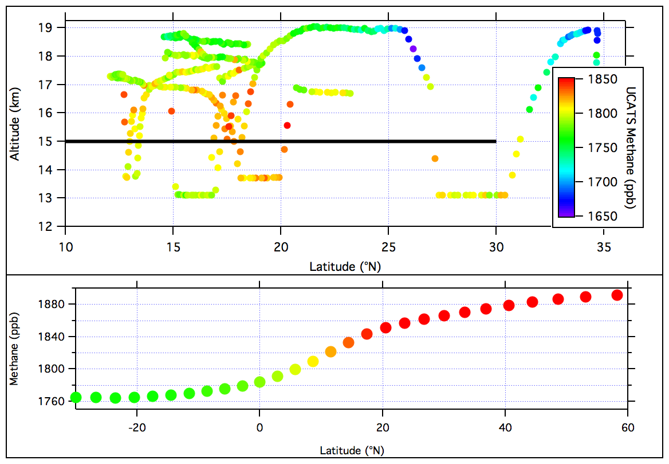
Notes:
November 9, 2011
February 2013 methane distribution – similar average but hemispheric gradient even larger (~150 ppb)

Slide 6
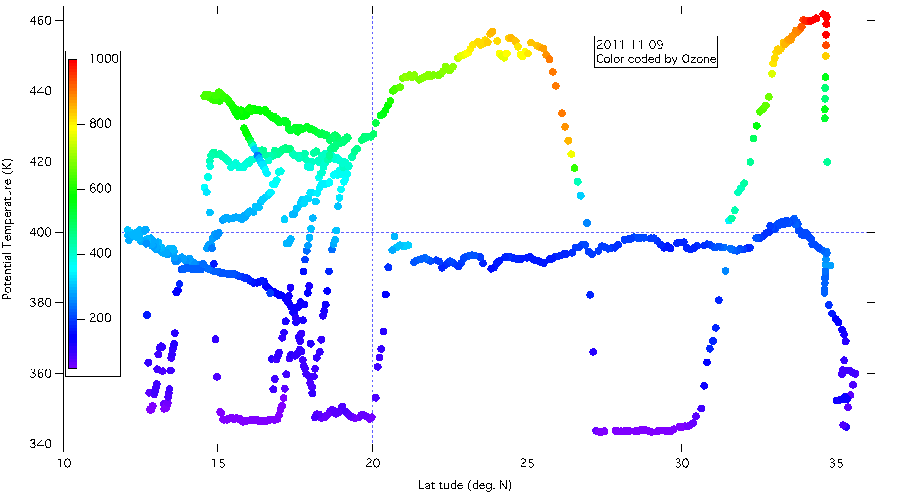
Ozone
Notes:
Ozone distribution relaxed?
What is lifetime of ozone at 380-400 K in tropics and subtropics?

Slide 7
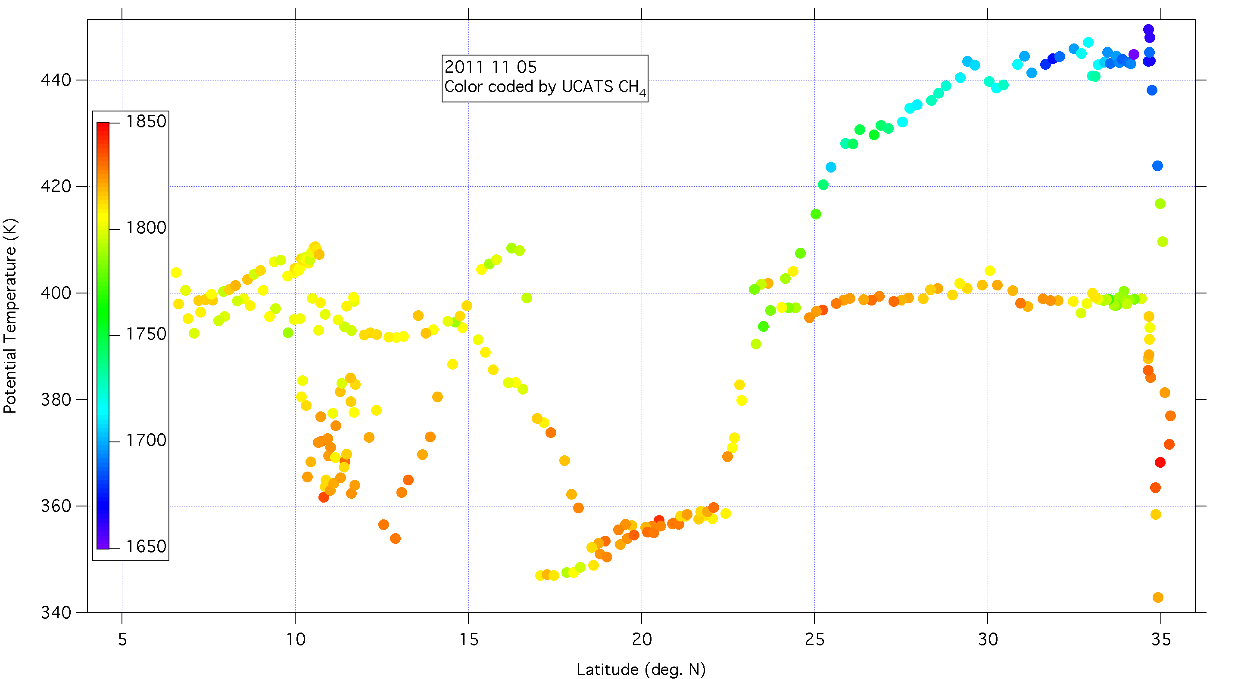
Variations in methane distribution on November 5
Notes:
Just a few points here – 9-10 N, 390 K. Even lower CH4 in AWAS.
N2O dip from 322 to 319 ppb

Slide 8
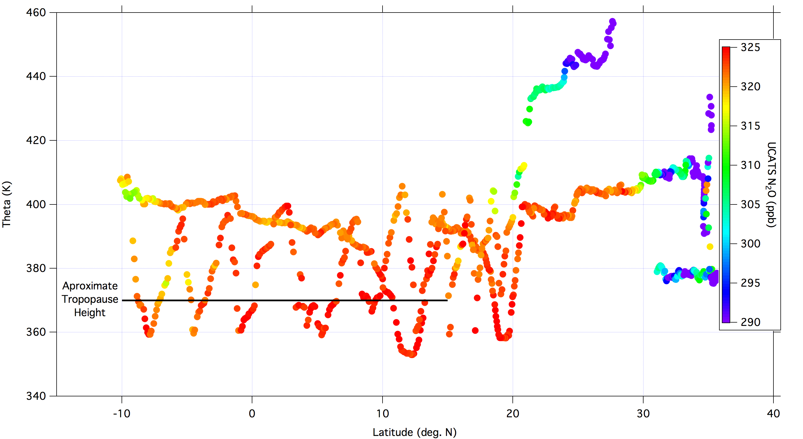
Potential Temperature – Latitude Cross-section, February 9, 2013

Slide 9
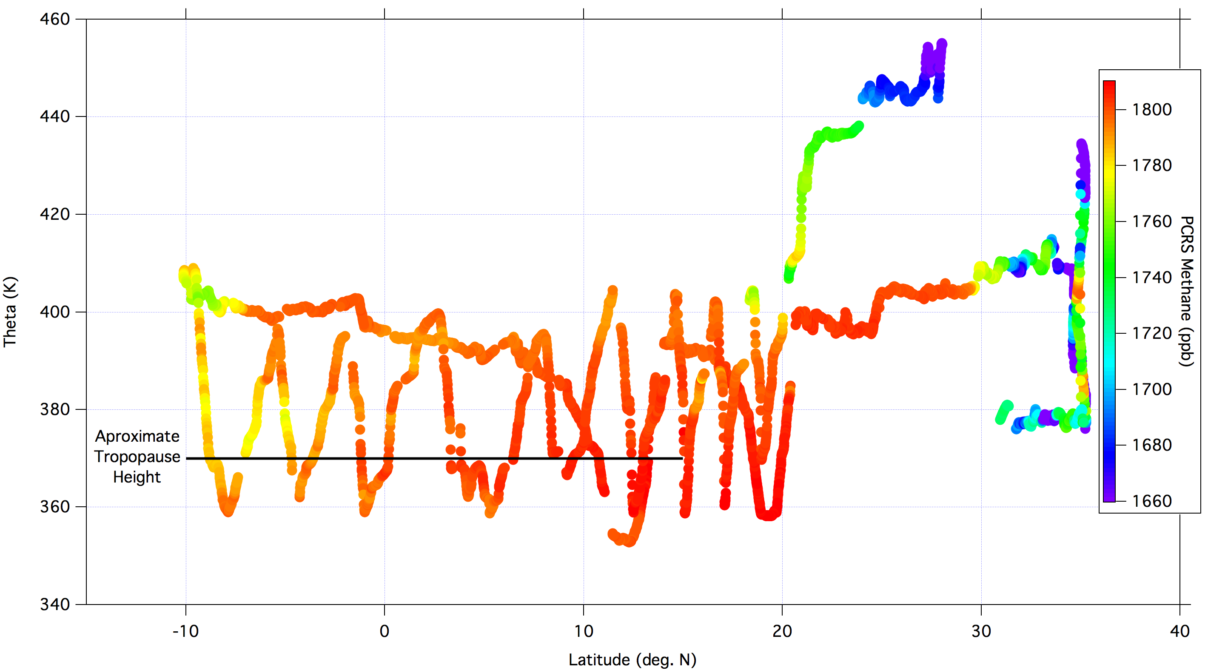
Feb. 9, 2013, Color-coded by Methane

Slide 10
START-08 Data – GV flights in NH midlatitudes
Stratospheric air with
tropical entry
Tropical
pipe
Tropopause
Free Trop.
Boundary layer

Slide 11
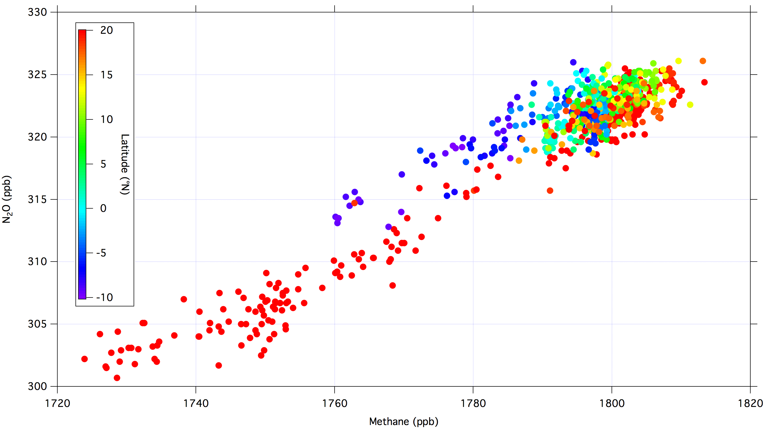
Feb. 9, 2013, Color-coded by Latitude

Slide 12
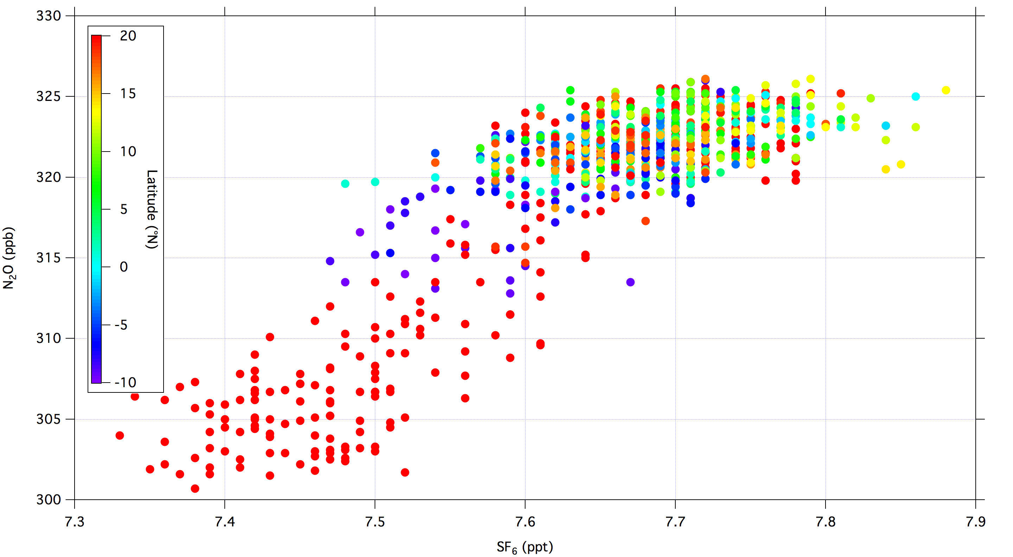
Feb. 9, 2013, Color-coded by Latitude

Slide 13
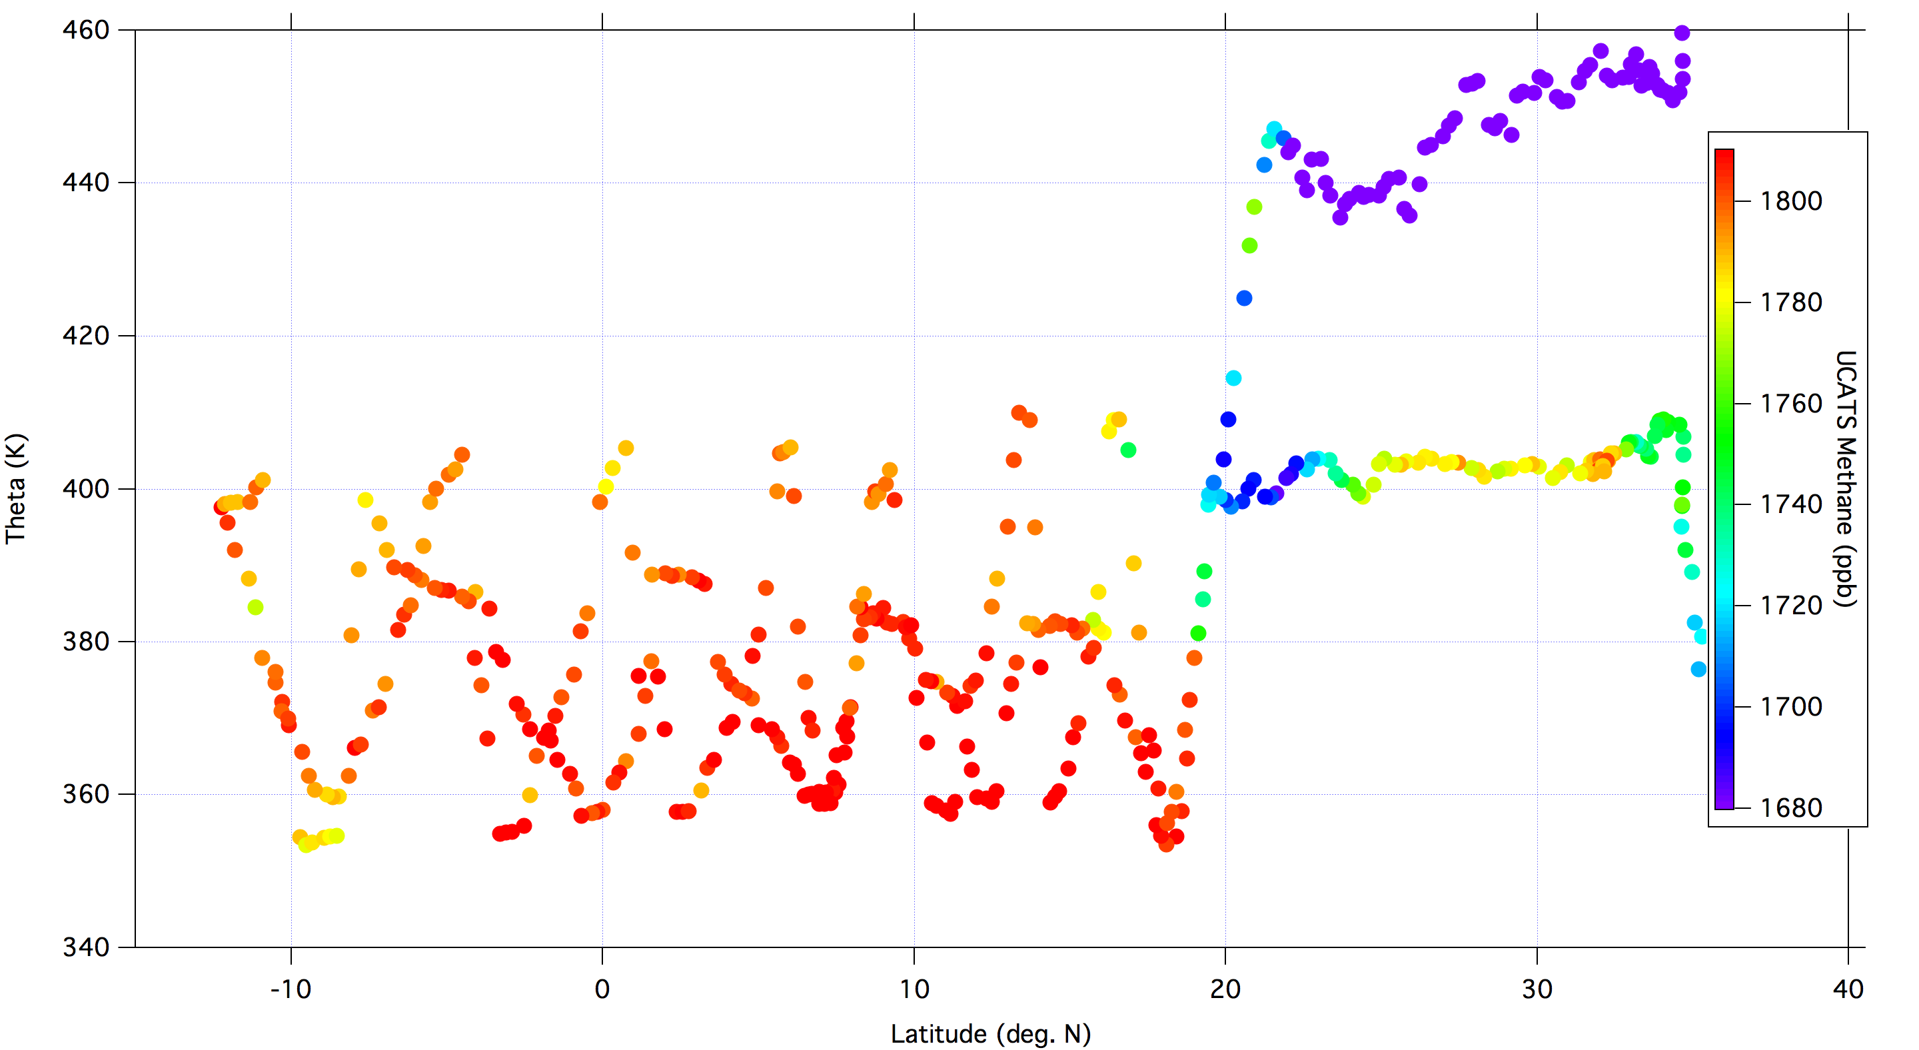
Feb. 21, 2013; UCATS Methane
Notes:
Tropopause height = 375-380 K in tropics

Slide 14
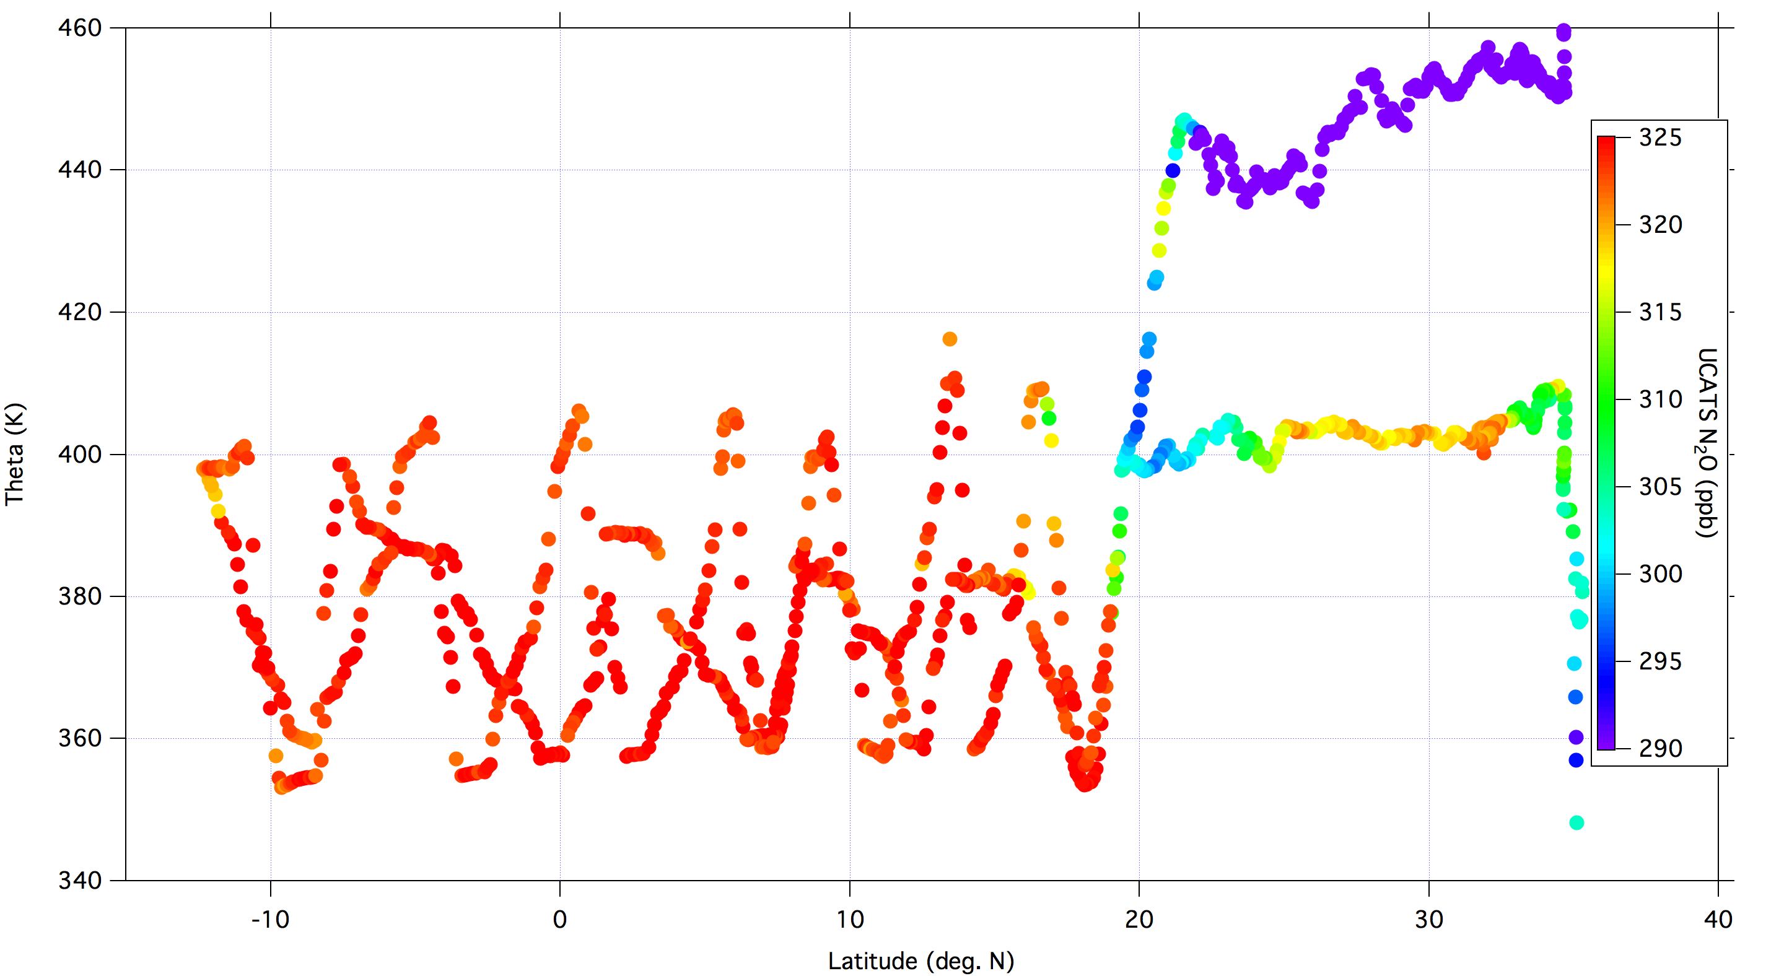
Feb. 21, 2013, Color-coded by N₂O

Slide 15
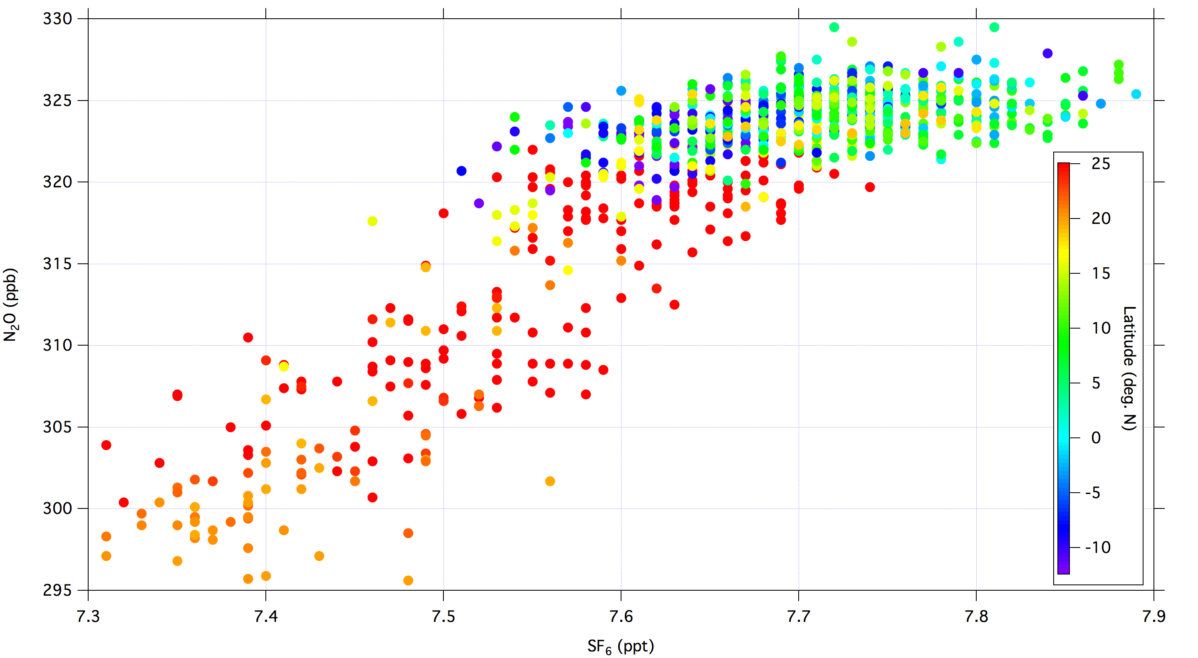
Feb. 21, 2013, Color-coded by Latitude

Slide 16
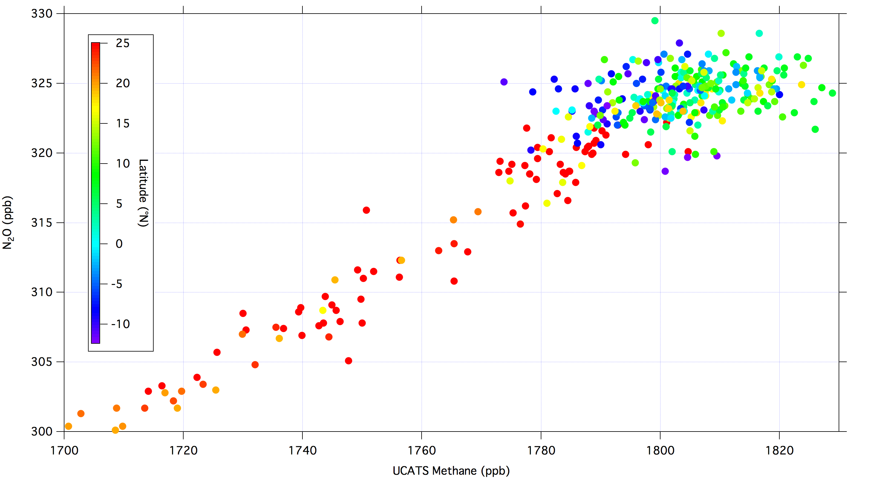
Feb. 21, 2013, Color-coded by Latitude

Slide 17
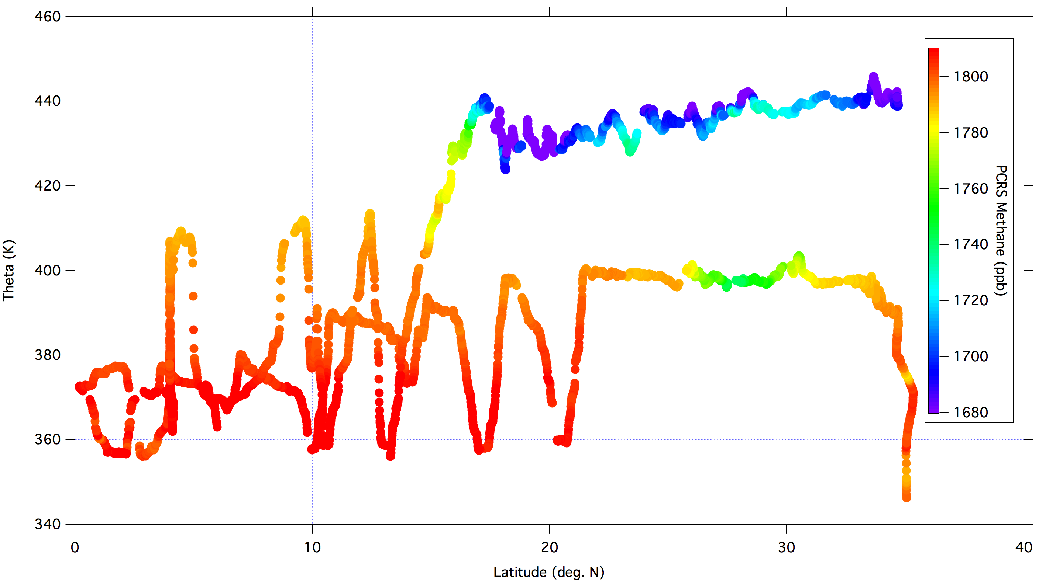
March 1, 2013, Color-coded by Methane
Notes:
Tropopause height ~ 380 K

Slide 18
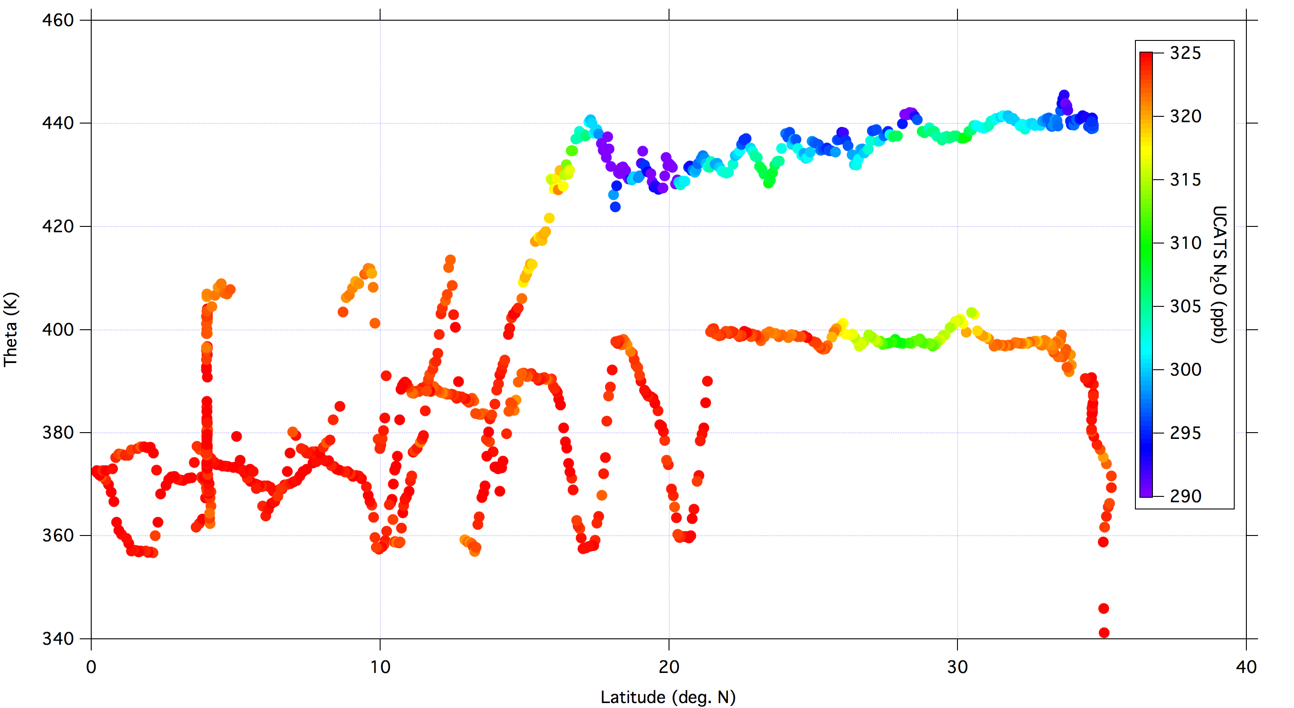
March 1, 2013, Color-coded by N₂O

Slide 20
Summary
Tracer measurements along Global Hawk flight tracks show young and relatively uniform air in the TTL during ATTREX-2.
Small variations in tracer mixing ratios indicate mixing in of extratropical air and the influence of interhemispheric gradients.
Near future: Add in other tracers and PV
Back trajectories from points along flight track

Slide 22
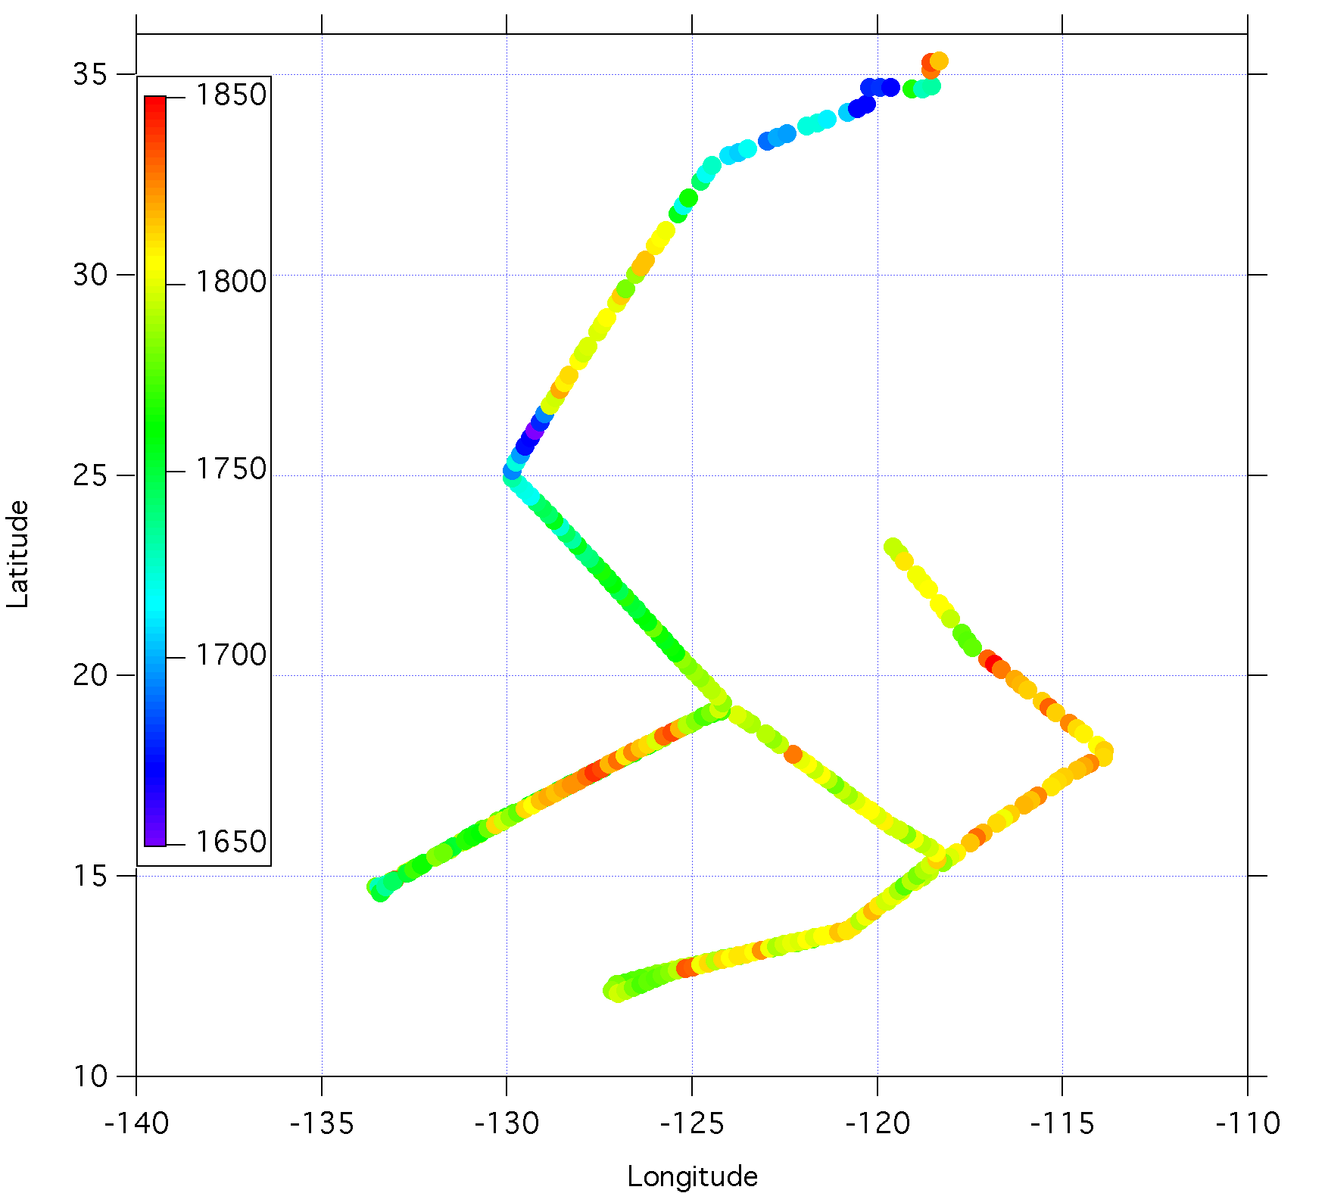
Notes:
November 9th flight track, color-coded by methane

Slide 23
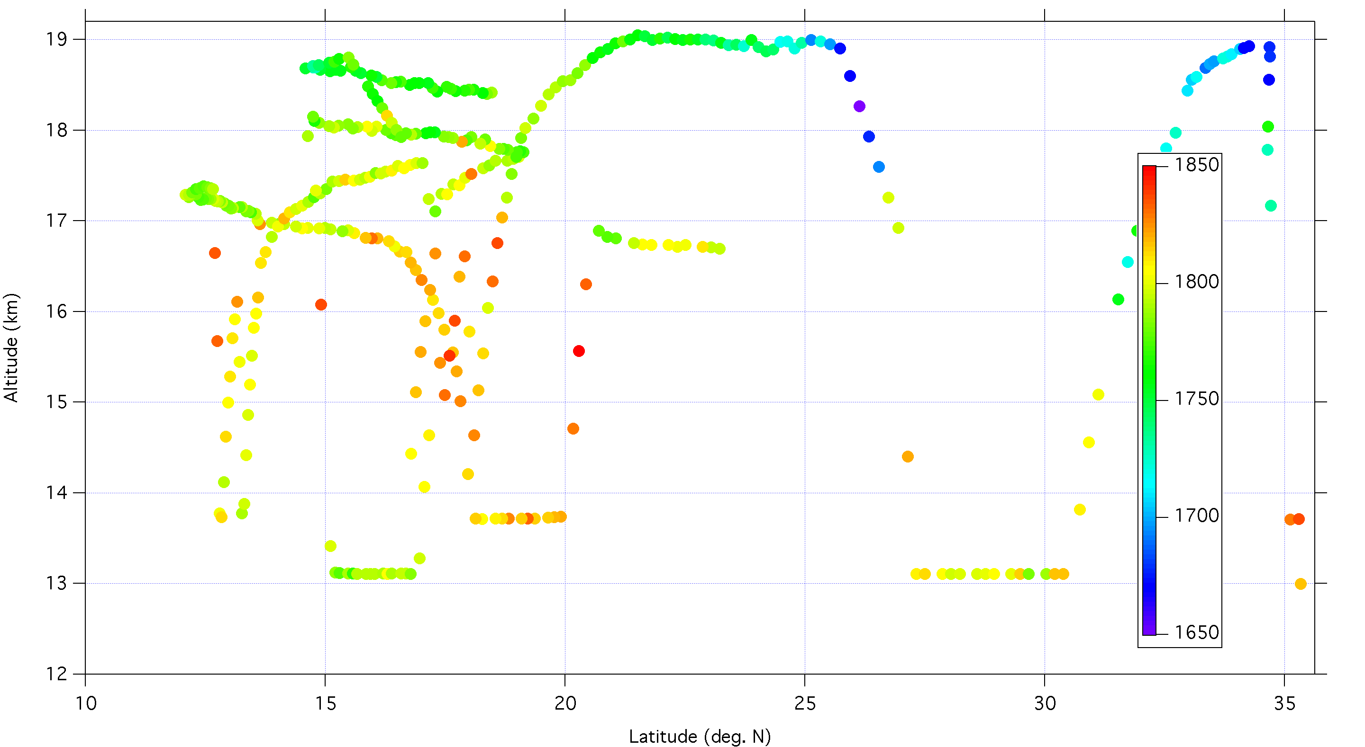
Altitude vs. latitude, color-coded by methane, Nov. 9

Slide 24
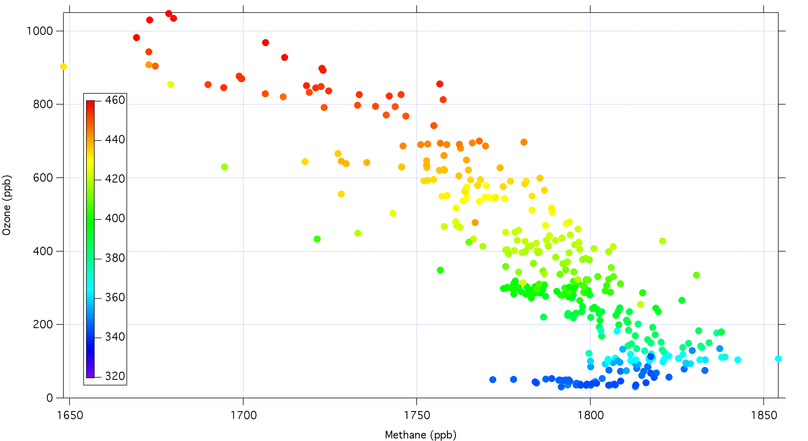
Ozone vs. Methane, binned by theta, November 9, 2011

Slide 25
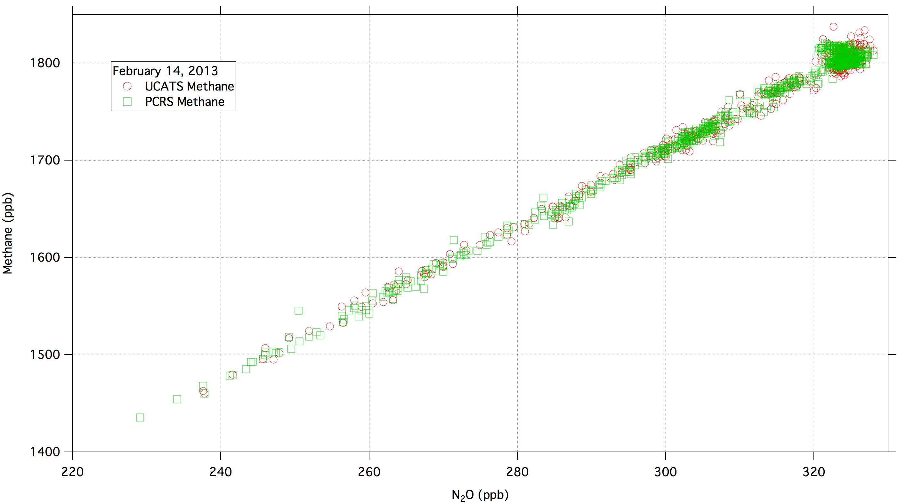
Methane-N₂O Correlation Plot

Slide 26
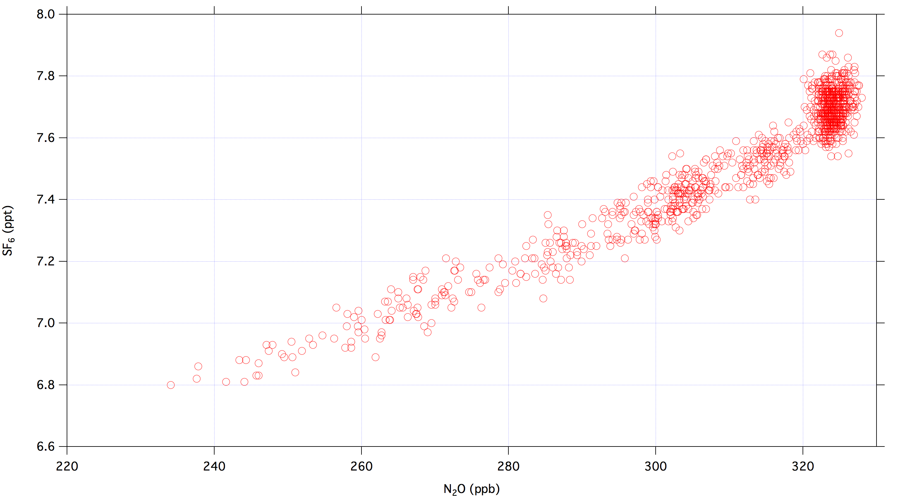
SF₆ vs. N₂O, February 14, 2013

Slide 27
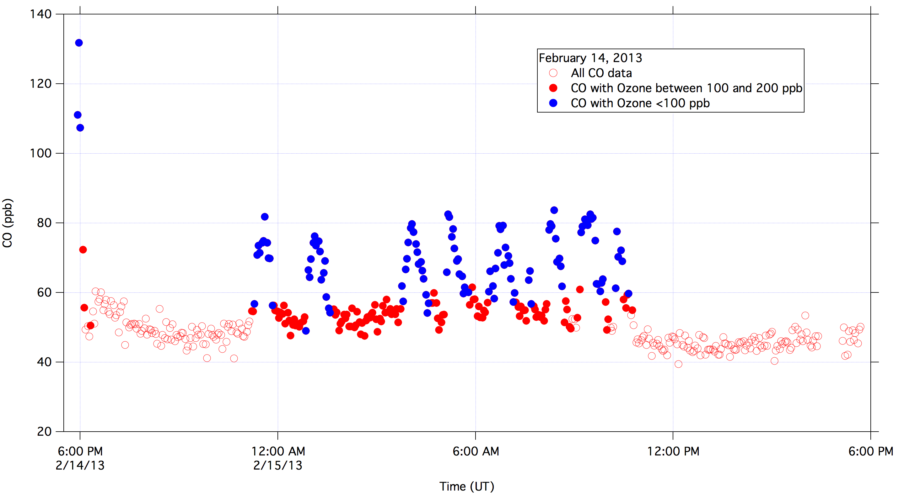
UCATS CO data sorted by Ozone

