Slide 1
Dehydration Patterns During ATTREX 2013 Deployment
M. Schoeberl, STC
L. Pfister, NASA
Dear Leader
Typical Minion

Slide 2
The Cloud Prediction Model
Field version: Ingest NRT MLS water vapor using 2 days of data starting at -2 days from present – generate a water vapor map at 375K. RDF calculation back N days to MLS mapped fields. Dehydrate parcels (GFS met. temp. suppressed by -3K). Add vapor from Pfister convective cloud product.
Analysis version: same as above except use final MLS and GFS Reanalysis met. fields; Pfister cloud product not added. N=2
Report if RH > 100 as clouds. Use last few time steps of trajectory period to report cloud fraction along path and assign to end points.

Slide 3
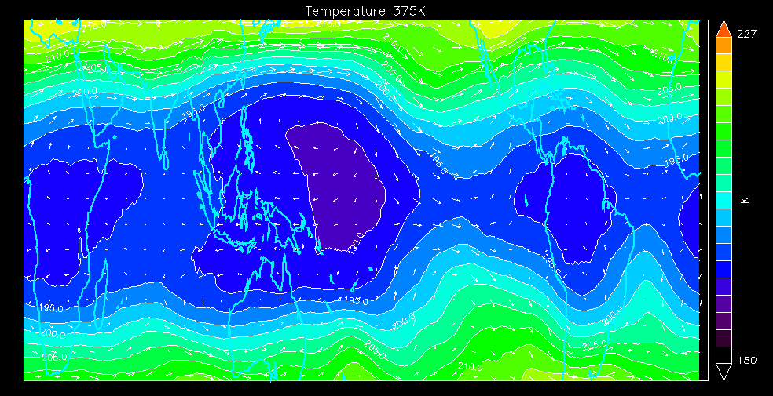
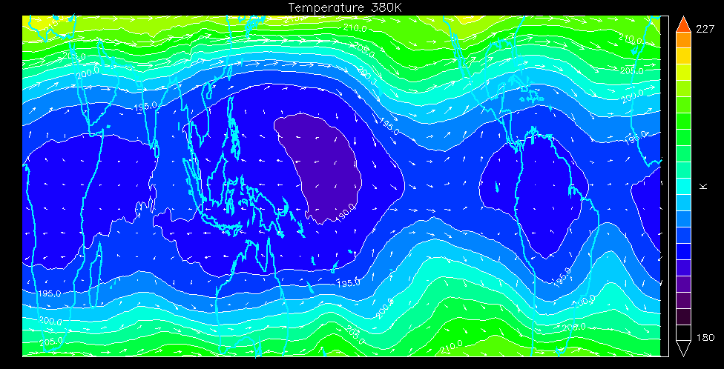
GFS Reanalysis Climatology (Jan 3- March 12)
Temperatures and winds
375K
L
H
L
L
H
H
190K
195K
L
L
H
H
95-100 hPa

Slide 4
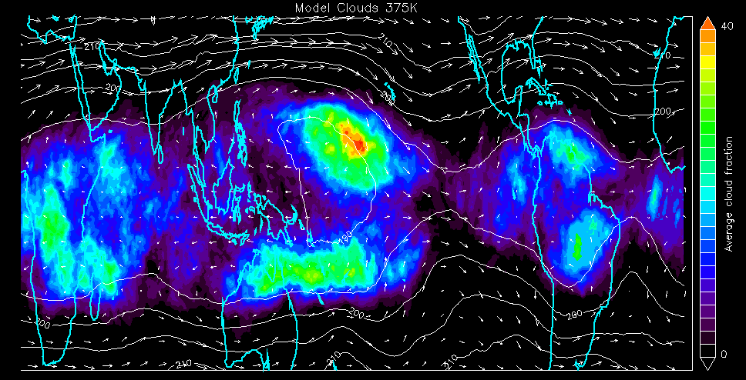
Clouds from Model (Jan 3- March 12)
= Transport
= Processing Zones
375K
L
L
H
L
H
H
L
L
H
H

Slide 5
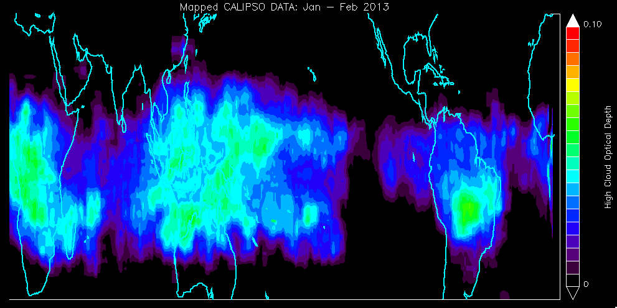
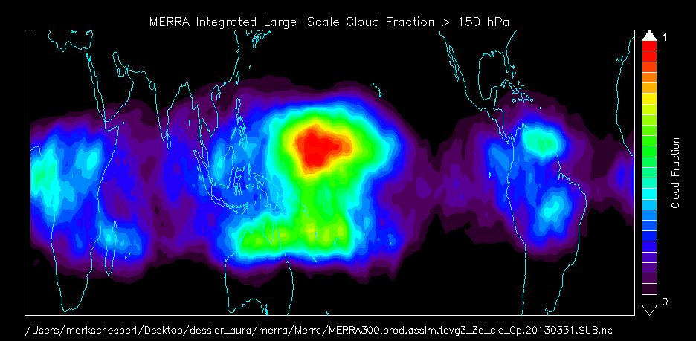
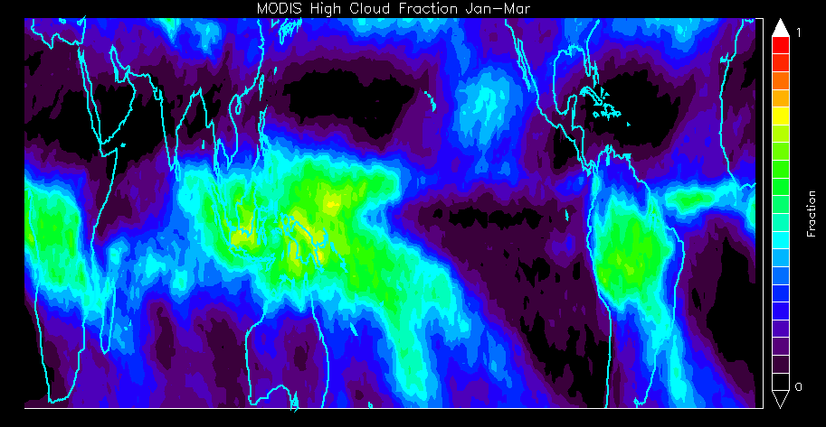
Cloud Models and Observations
Trajectory 375K
CALIPSO
OD < 0.2, P<150
MERRA large scale
P < 150 hPa
MODIS
P < 440 hPa
MERRA Clouds averaged over same period as ATTREX

Slide 6
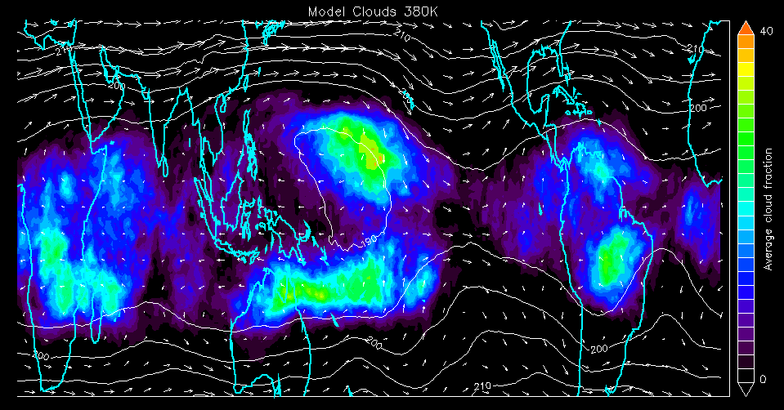
Traj. Model Clouds and CALIPSO
Model
Too few clouds here probably because air is already processed.
CALIPSO Cloud Freq.
Model places more cloud here.
CALIPSO OD < 0.2, P<150

Slide 7
Clouds from Model (Jan 3- March 12)
= Transport
= Conv. source
= Processing Zones
375K
L
L
H
L
H
H
L
L
H
H

Slide 8
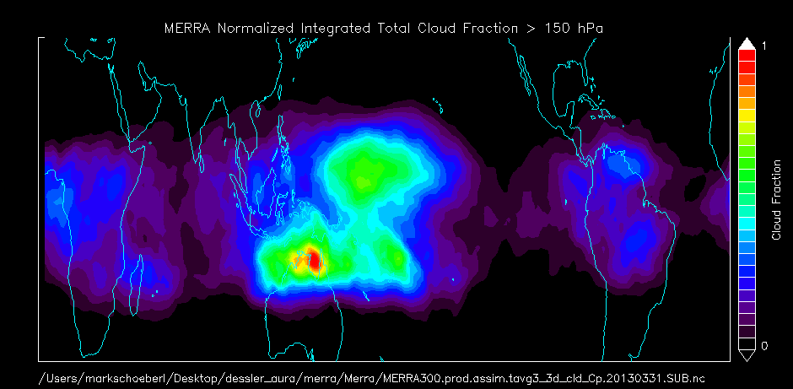
MERRA has similar problem, even with convection
MERRA total cloud fraction (convection + large scale)
MERRA cloud deficit over Indonesia
MERRA: too much convection over Australia
CALIPSO
CALIPSO OD <0.2, P<150

Slide 9
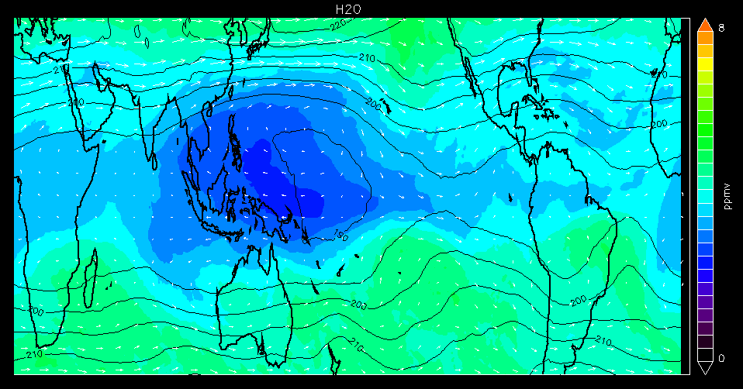
Water Vapor MLS – No Deh.
375K
L
L
H
L
H
H
L
L
H
H

Slide 10
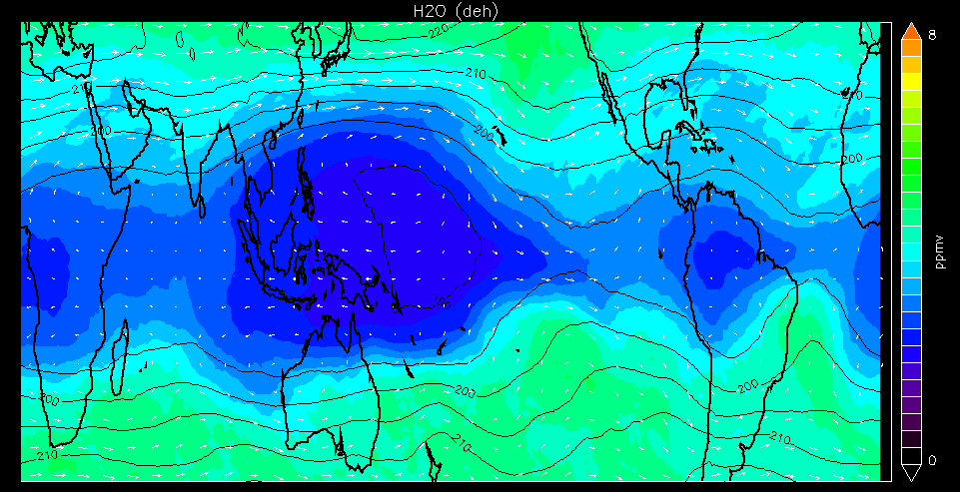
Water Vapor from Model after Dehydration
375K
L
L
H
L
H
H
L
L
H
H

Slide 11
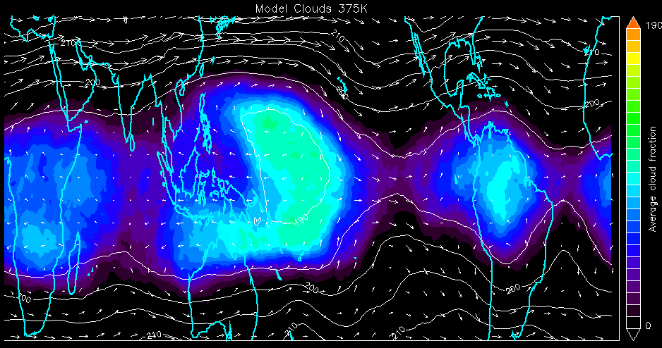
Does Dehydration make a Difference?
Model Clouds No Deh
CALIPSO Cloud Freq.
CALIPSO OD < 0.2, P<150

Slide 12
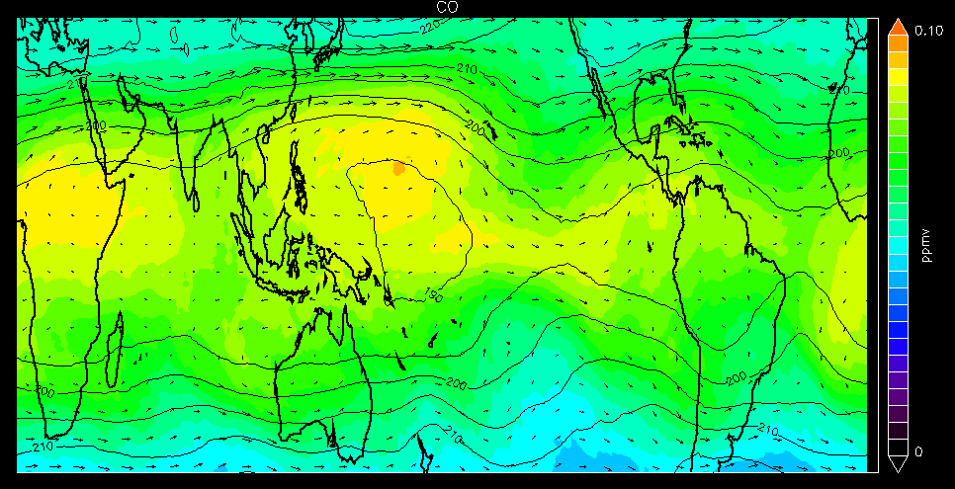
Look at CO
375K
Approximate fire locations

Slide 13
Main Points
Predicted and observed large scale clouds generally agree with CALIPSO and MODIS
Differences provide insights into possible model issues and sources of water…
Cloud deficit over Indonesia in both MERRA and Traj model likely due to lack of convection in Traj model, misplaced convection in MERRA
Important processing zone southwest of Hawaii – air from outside cold pool moves inward and is processed by NE sector of cold zone. The circulation then splits – some air moves eastward to SA and some westward back around the cold pool.
Dehydration creates cloud free region in West Pacific
CO builds up in center of cold pool
Other processing regions include zones over Australia, Africa and Central/South America
Model is trying to dehydrate air more aggressively than is observed – produces fields too dry compared to MLS
Instantaneous dehydration over estimates the change in water (Surprise!!!)
No dehydration - better cloud agreement except over SA
If RH trigger set to higher than 110% then too few clouds - can clouds be used as a test?

Slide 14
Hypothesis Testing for Guam
Air here should be convectively moistened and have high CO, thick cirrus
Model
Air here should be processed
Air here should be convectively moistened and have low CO, thick cirrus
Air here should be processed, amorphous thin +thick cirrus
CALIPSO Cloud Freq.
CALIPSO OD < 0.2, P<150

Slide 15
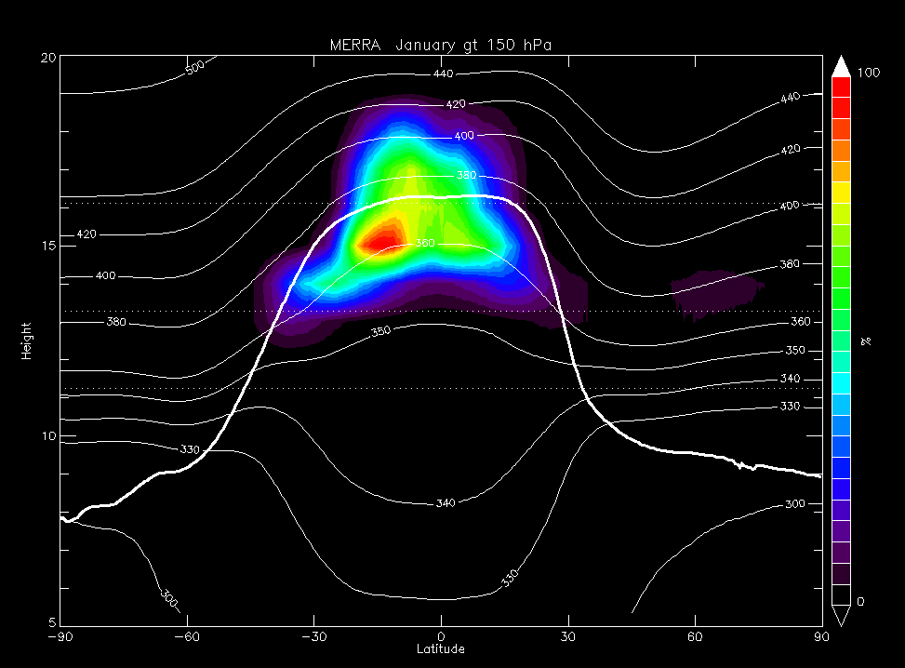
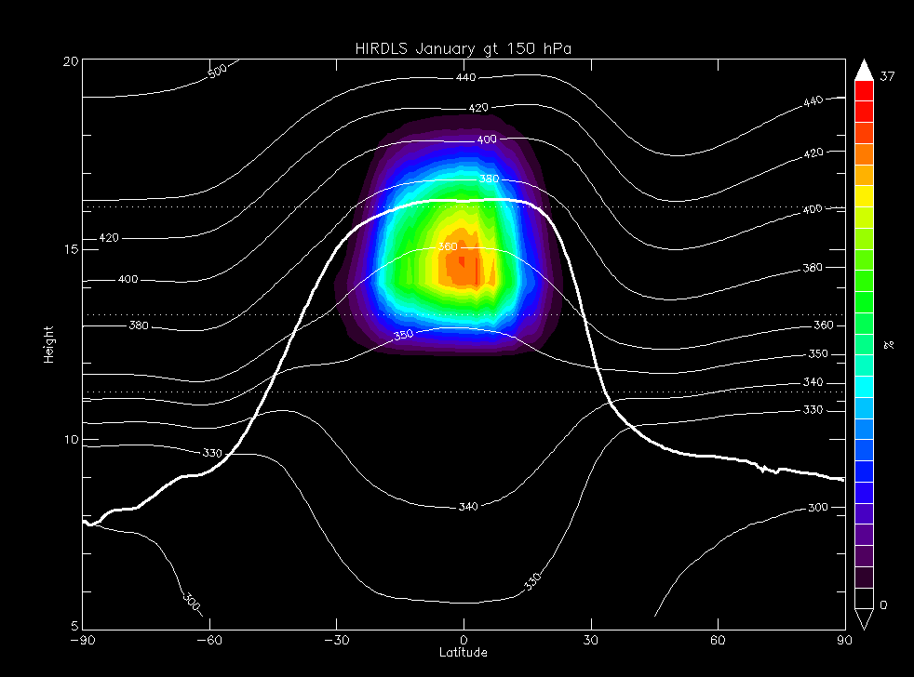
Schoeberl-Dessler Trajectory Model January 2005; MERRA dynamics
Normalized Cloud Frequency (Model)
Normalized Cloud Frequency (Model)
HIRDLS January
(HIRDLS Data from Steve Massie, thank you!)
Normalized Cloud Frequency (HIRDLS)
Normalized Cloud Frequency (HIRDLS)

Slide 16
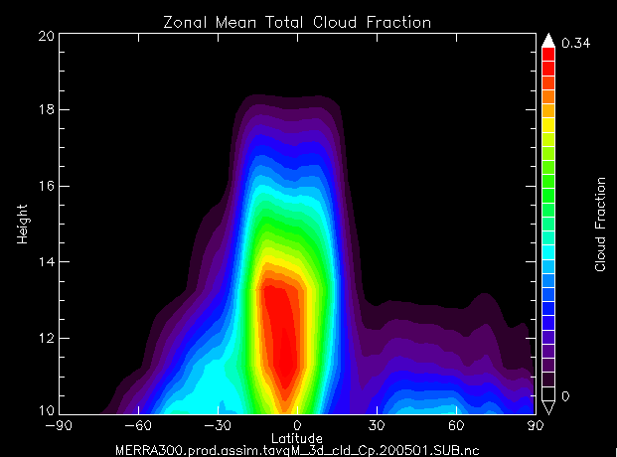
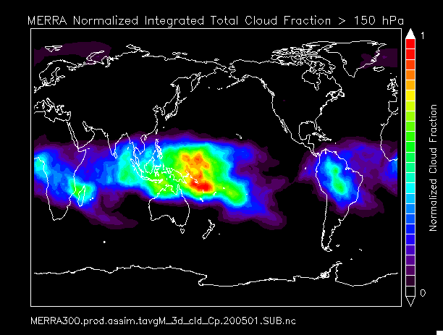
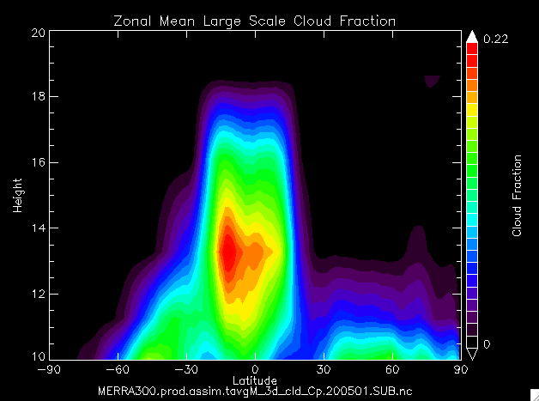
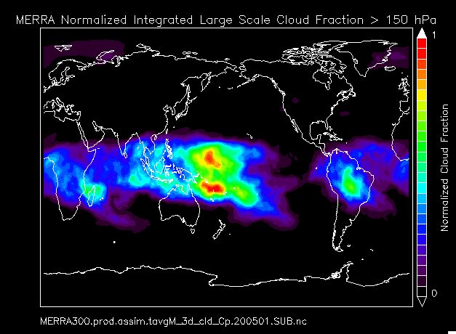
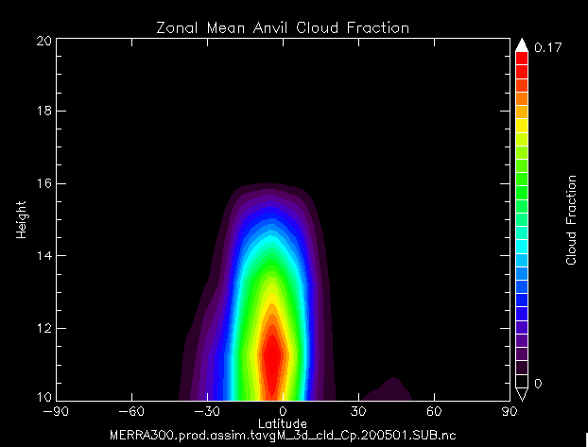
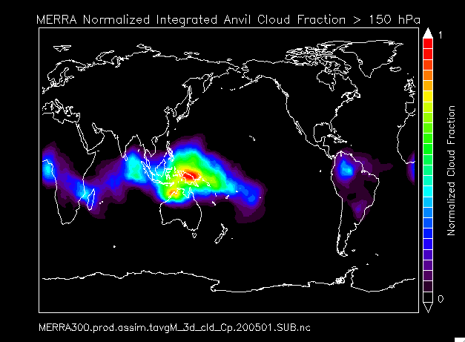
MERRA Jan. 2005
Zonal Mean Cloud Fraction
Integrated Cloud Fraction > 150 hPa
All Clouds
Large Scale
Anvil

Slide 17
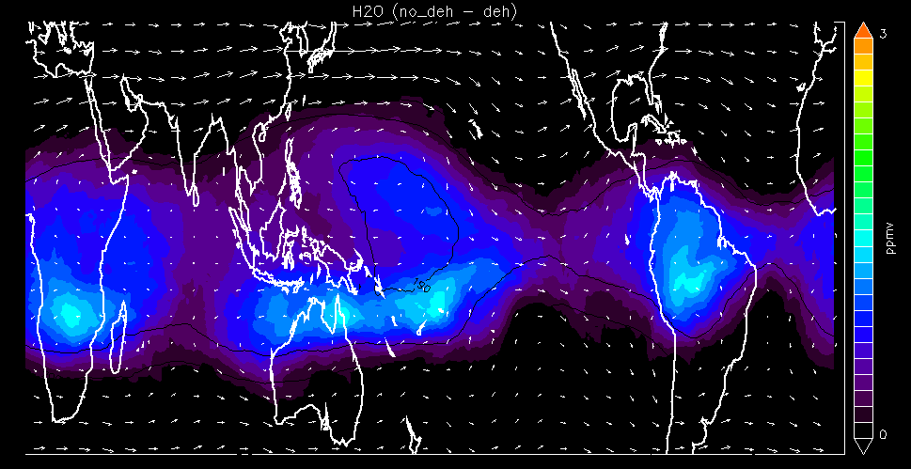
H₂O Difference (no deh – deh)
375K
L
L
H
L
H
H
L
L
H
H

Slide 18
Traj. Model Clouds and MERRA
Model
MERRA Large Scale Clouds (no convection)
Traj & MERRA agree here
MERRA shows this zone dominated
by convection

Slide 19
GFS Reanalysis Climatology (Jan 3- March 12)
Temperatures and winds
380K
L
H
L
L
H
H
190K
195K
L
L
H
H
90-95 hPa
380 and 375 are similar; the cold pool is slightly smaller at 380K

