Slide 1
GWAS Data Status: ATTREX 2013
E. Atlas, M. Navarro, X. Zhu, L. Pope, R. Lueb

Slide 2
Sample Collection
GWAS capacity 90 samples / flight
RF01 Pump Failure about 1/3 into flight
RF02 Electrical failure shutdown system (no samples)
RF03 – RF06: Success (88 - 90)
Total samples: 388

Slide 3
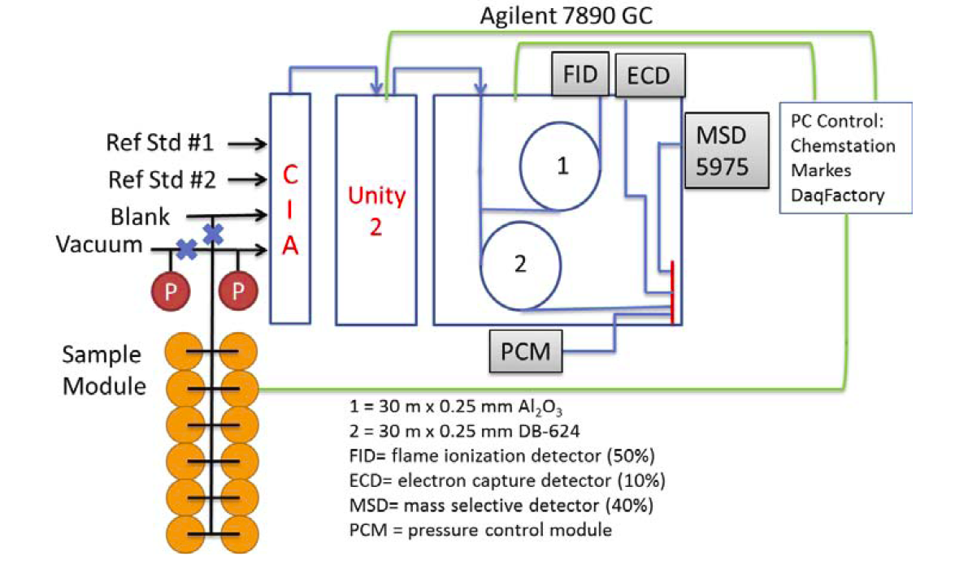
Field Analytical System

Slide 4
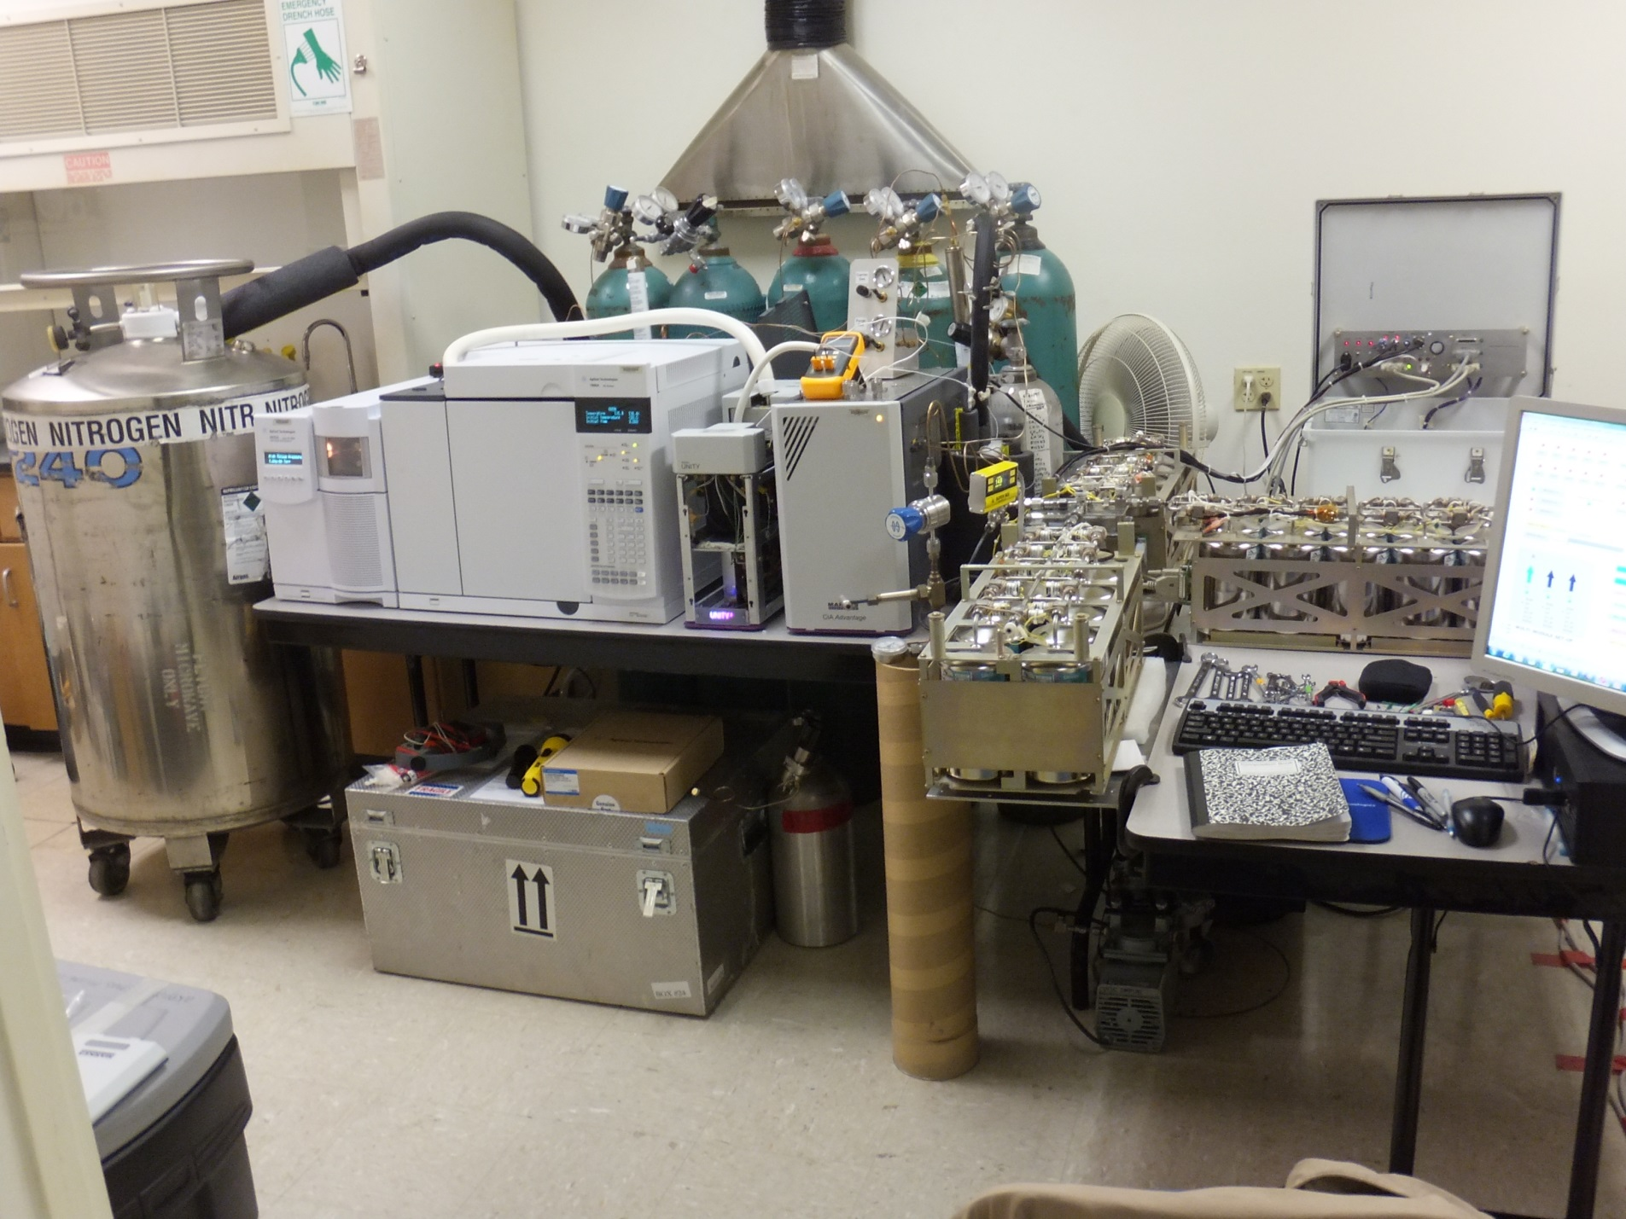

Slide 5
32 gases to be reported to archive
CCl3F_CFC_11 |  |  |  | OCS_Carbonyl_sulfide
CCl2F2_CFC_12
C2Cl3F3_CFC_113 |  |  |  | CBrClF2_Halon_1211
 |  |  |  | C2Br2F4_Halon_2402
CH3CCl3_Methyl_chloroform
CCl4_Carbon_tetrachloride |  |  |  | CH3Cl_Methyl_chloride
 |  |  |  | CH3Br_Methyl_bromide
CHClF2_HCFC_22 |  |  |  | CH3I_Methyl_iodide
CH3CClF2_HCFC_142b
CH3CCl2F_HCFC_141b |  |  |  | C2H6_Ethane
 |  |  |  | C2H2_Ethyne
CH2Cl2_Methylene_chloride |  |  |  | C3H8_Propane
CHCl3_Chloroform |  |  |  | C6H6_Benzene
C2H4Cl2_1_2_Dichloroethane
C2Cl4_Tetrachloroethylene |  |  |  | CH2BrCl_Bromochloromethane
C2HCl3_Trichloroethylene |  |  |  | CH2Br2_Methylene_bromide
C6H5Cl_Chlorobenzene |  |  |  | CHBrCl2_Bromodichloromethane
 |  |  |  | CHBr2Cl_Dibromochloromethane
CH3ONO2_Methyl_nitrate |  |  |  | CHBr3_Bromoform
C2H5ONO2_Ethyl_nitrate
C3H7NO3_Isopropyl nitrate

Slide 6
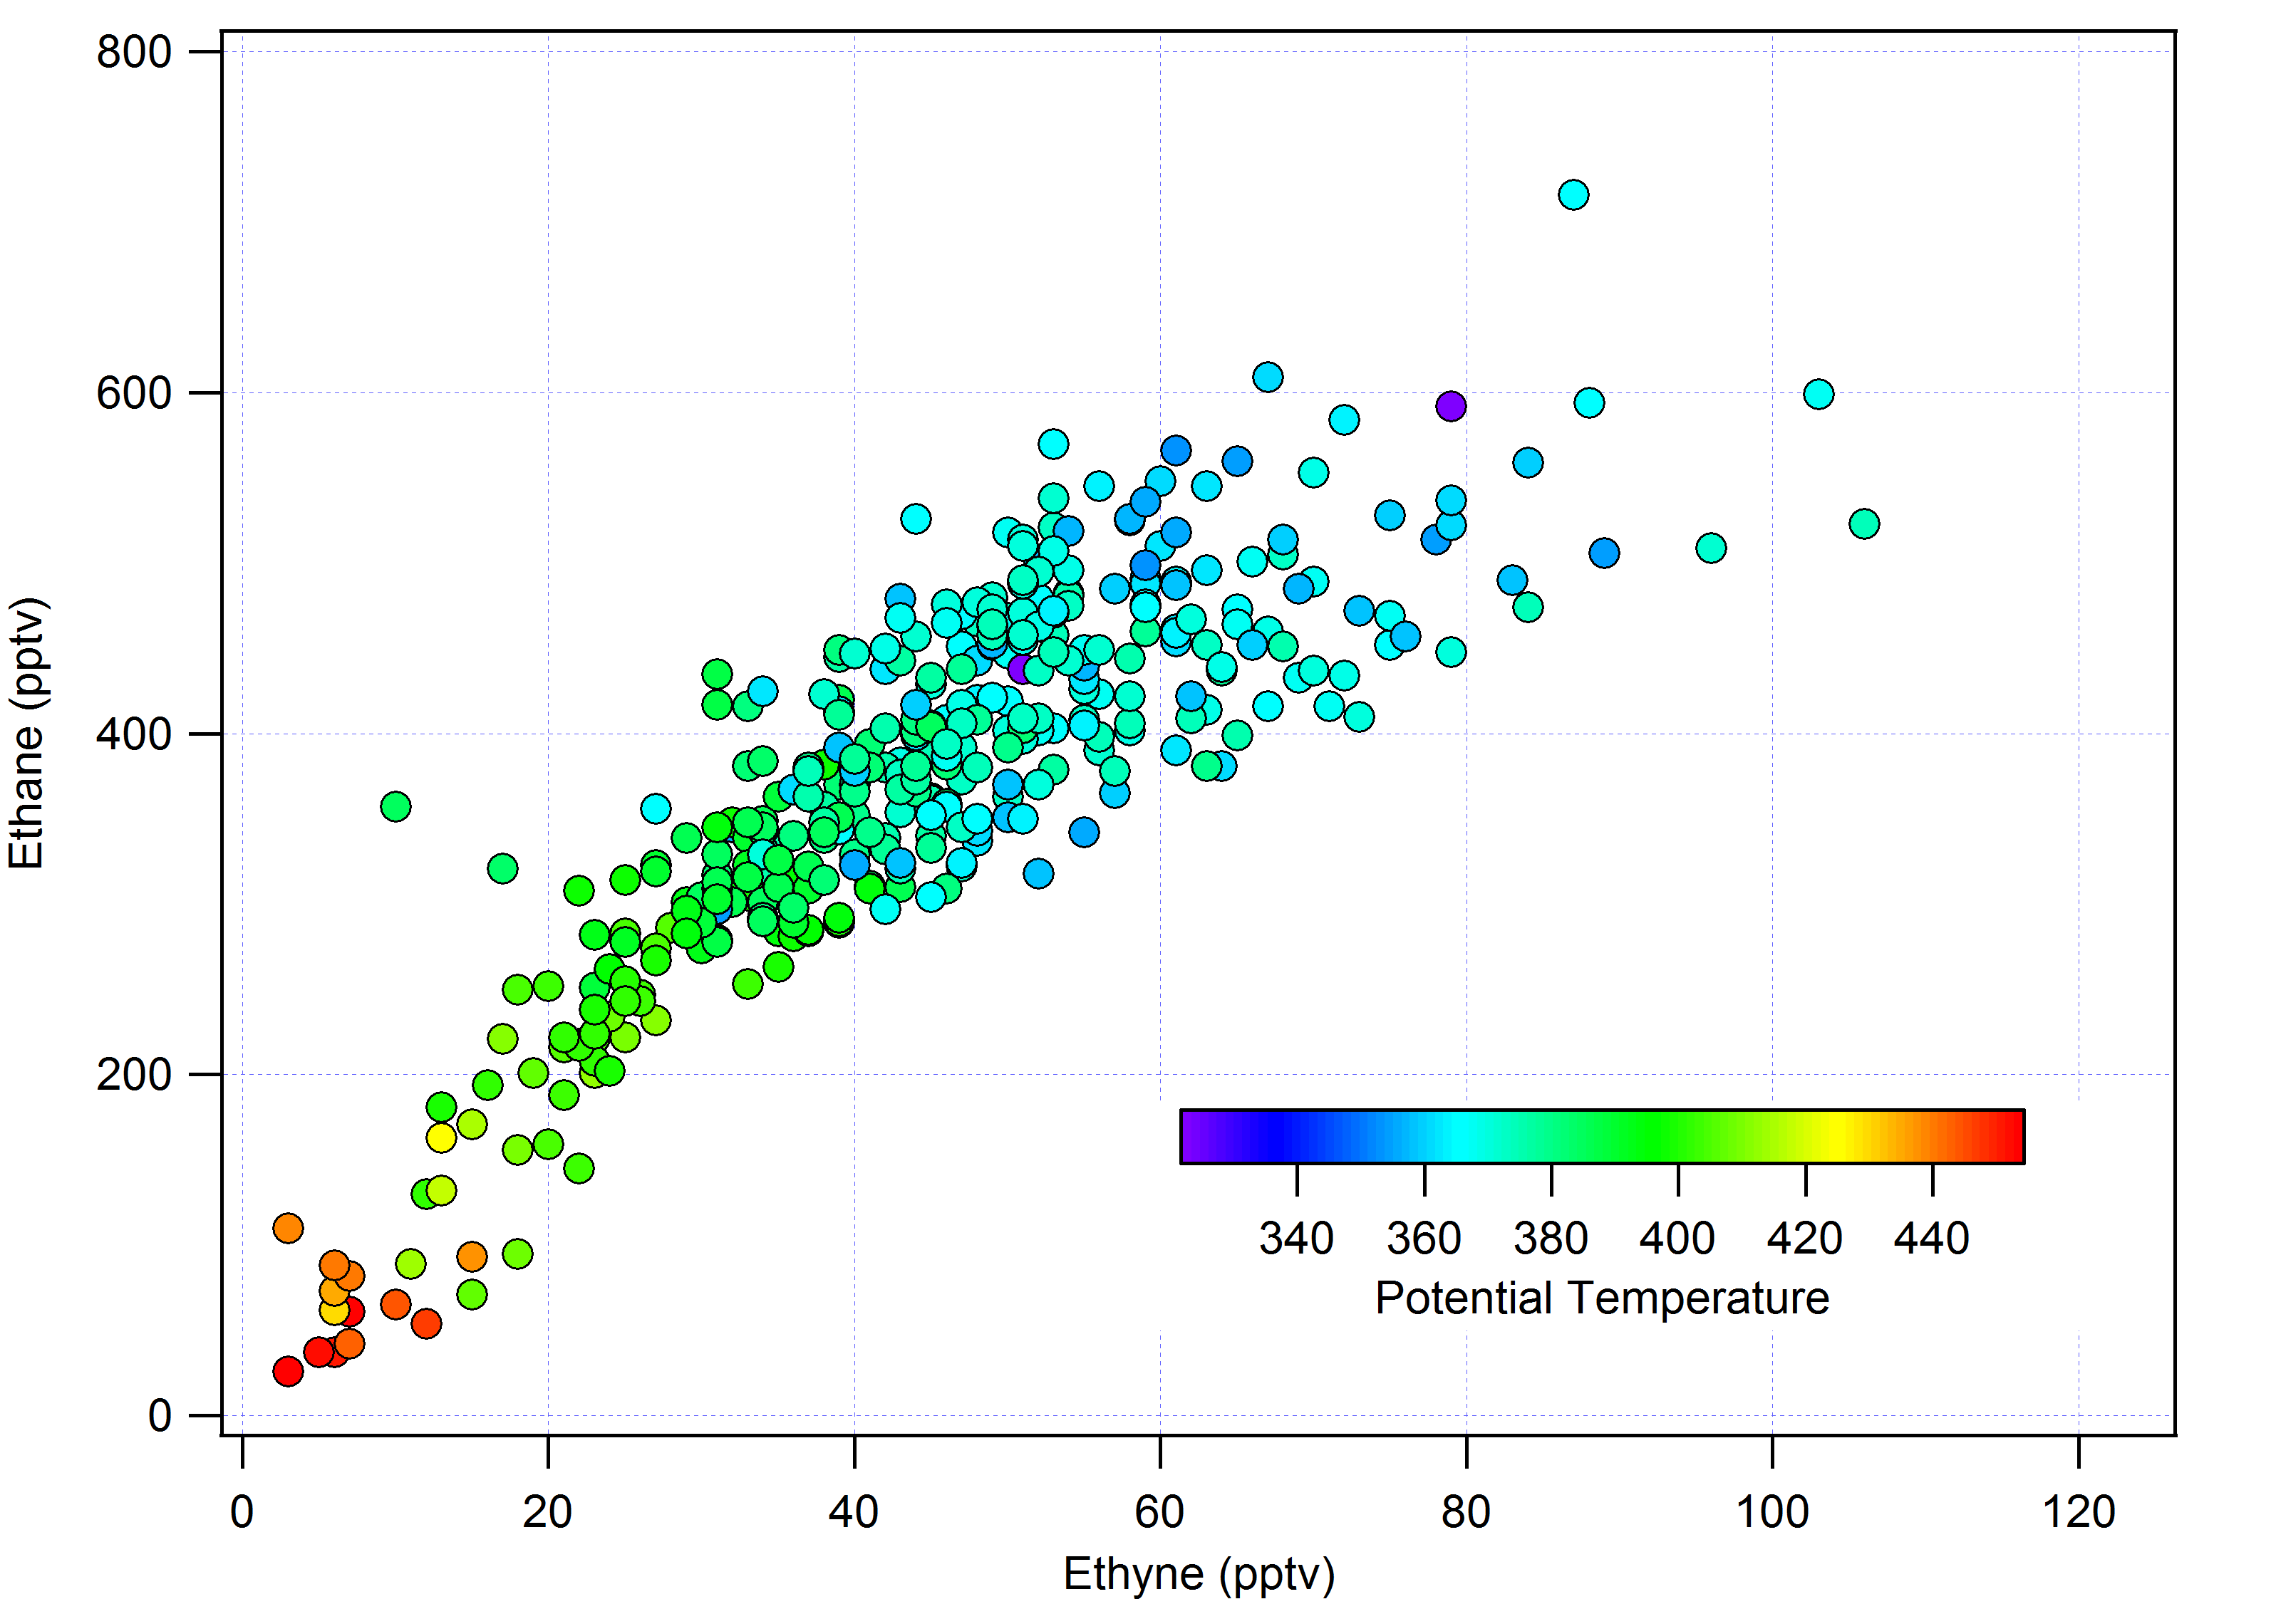
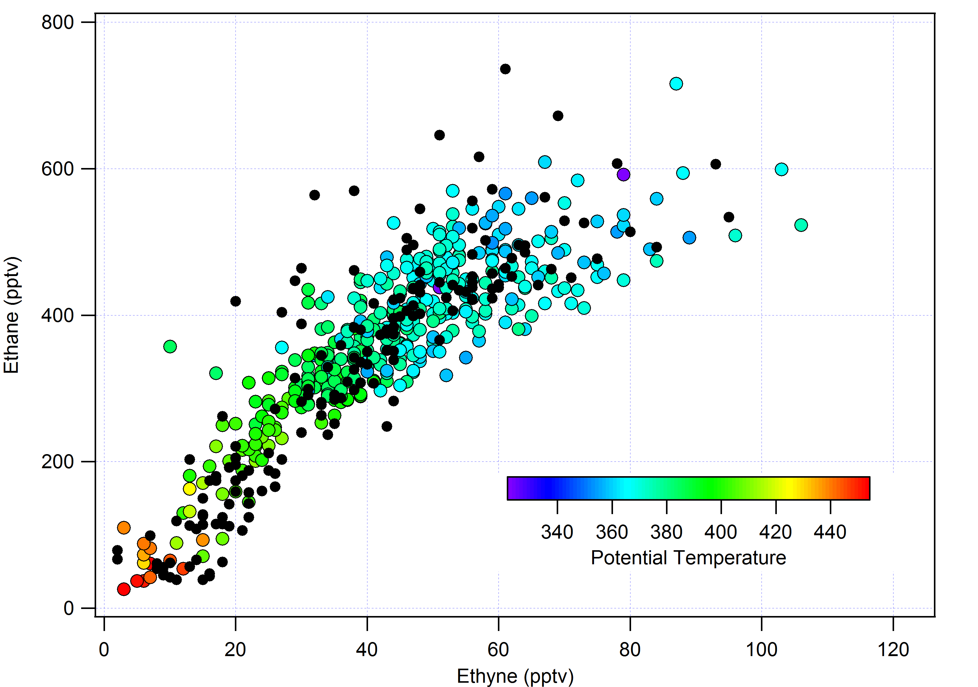
Analytical Issues
Artifact in ethyne: coelution of unidentified CFC/HCFC
  Current version subtracts constant amount (22 pptv)
ATTREX (2013)
+ ATTREX (2011)

Slide 7
Analytical Issues (2)
Moisture related artifact during sample injection
  Sample response different from standard response
  Use long-lived tracer to normalize responses
    CFC114 (lifetime ~ 189 yr)
    Expected variation ~1%/100 – 150 ppb O3
  Results in some loss of samples when CFC114 analytical problem (H2O)
  Effect depends on volatility (GC retention)
    less effect for more volatile than 114
      CFC12, CH3Cl, HFC134a
  Introduces extra imprecision into long-lived tracers; less of an impact for short-lived substances

Slide 8
Example (RF05) : Methyl nitrate

Slide 9
Example (RF05) : Methyl nitrate

Slide 10
Analytical Issues (3)
Original working standard vented during shipment.
  Last minute replacement needed calibration
  Still some standard checks required with primary standards when SEAC4RS analysis complete.

Slide 11
Data to archive after meeting

