Slide 1
Summary of UCATS Performance and Data for ATTREX-2 (January-March 2013)
Eric Hintsa, Fred Moore, Geoff Dutton, Brad Hall, David Nance, Audra McClure, and Jim Elkins
Bruce Daube, Jasna Pittman, Steve Wofsy, Ru-Shan Gao, Andrew Rollins, Troy Thornberry, Laurel Watts, David Fahey, Glenn Diskin, Elliot Atlas, and Maria Navarro
Notes:
Complete list of colleagues

Slide 2
UCATS Summary – ATTREX 2013
Gas Chromatograph
N₂O and SF₆ – good data starting February 9
CH₄ and H₂ – good data starting February 14
CO data probably usable in profiles
Ozone
Second 2B ozone sensor added (2-second response)
Backup for NOAA CSD ozone
Water vapor TDL
Good data on ascent, descent and profiles
High water vapor “short path” calibration completed
GC data reanalyzed and archived
Notes:
N2O, CH4 – 0.25-0.3%; SF6 – 0.5%; H2 – <1%; CO – 2-3%, but has artifact
Ozone – similar to ATTREX 1, but different 2B better at different times. Not finished analysis.
Water – good agreement with DLH on profiles; still preliminary data

Slide 3
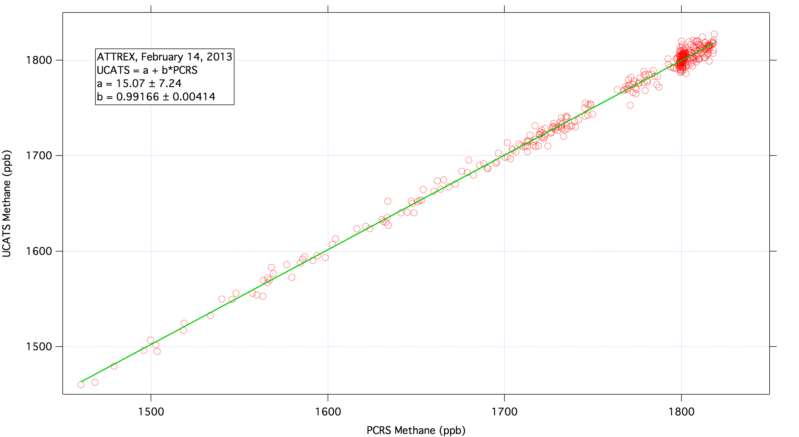
UCATS and Picarro Intercomparison
Notes:
UCATS > PCRS by 3 ppb at 1500; spot on at 1800.
Agreement well within uncertainties

Slide 4
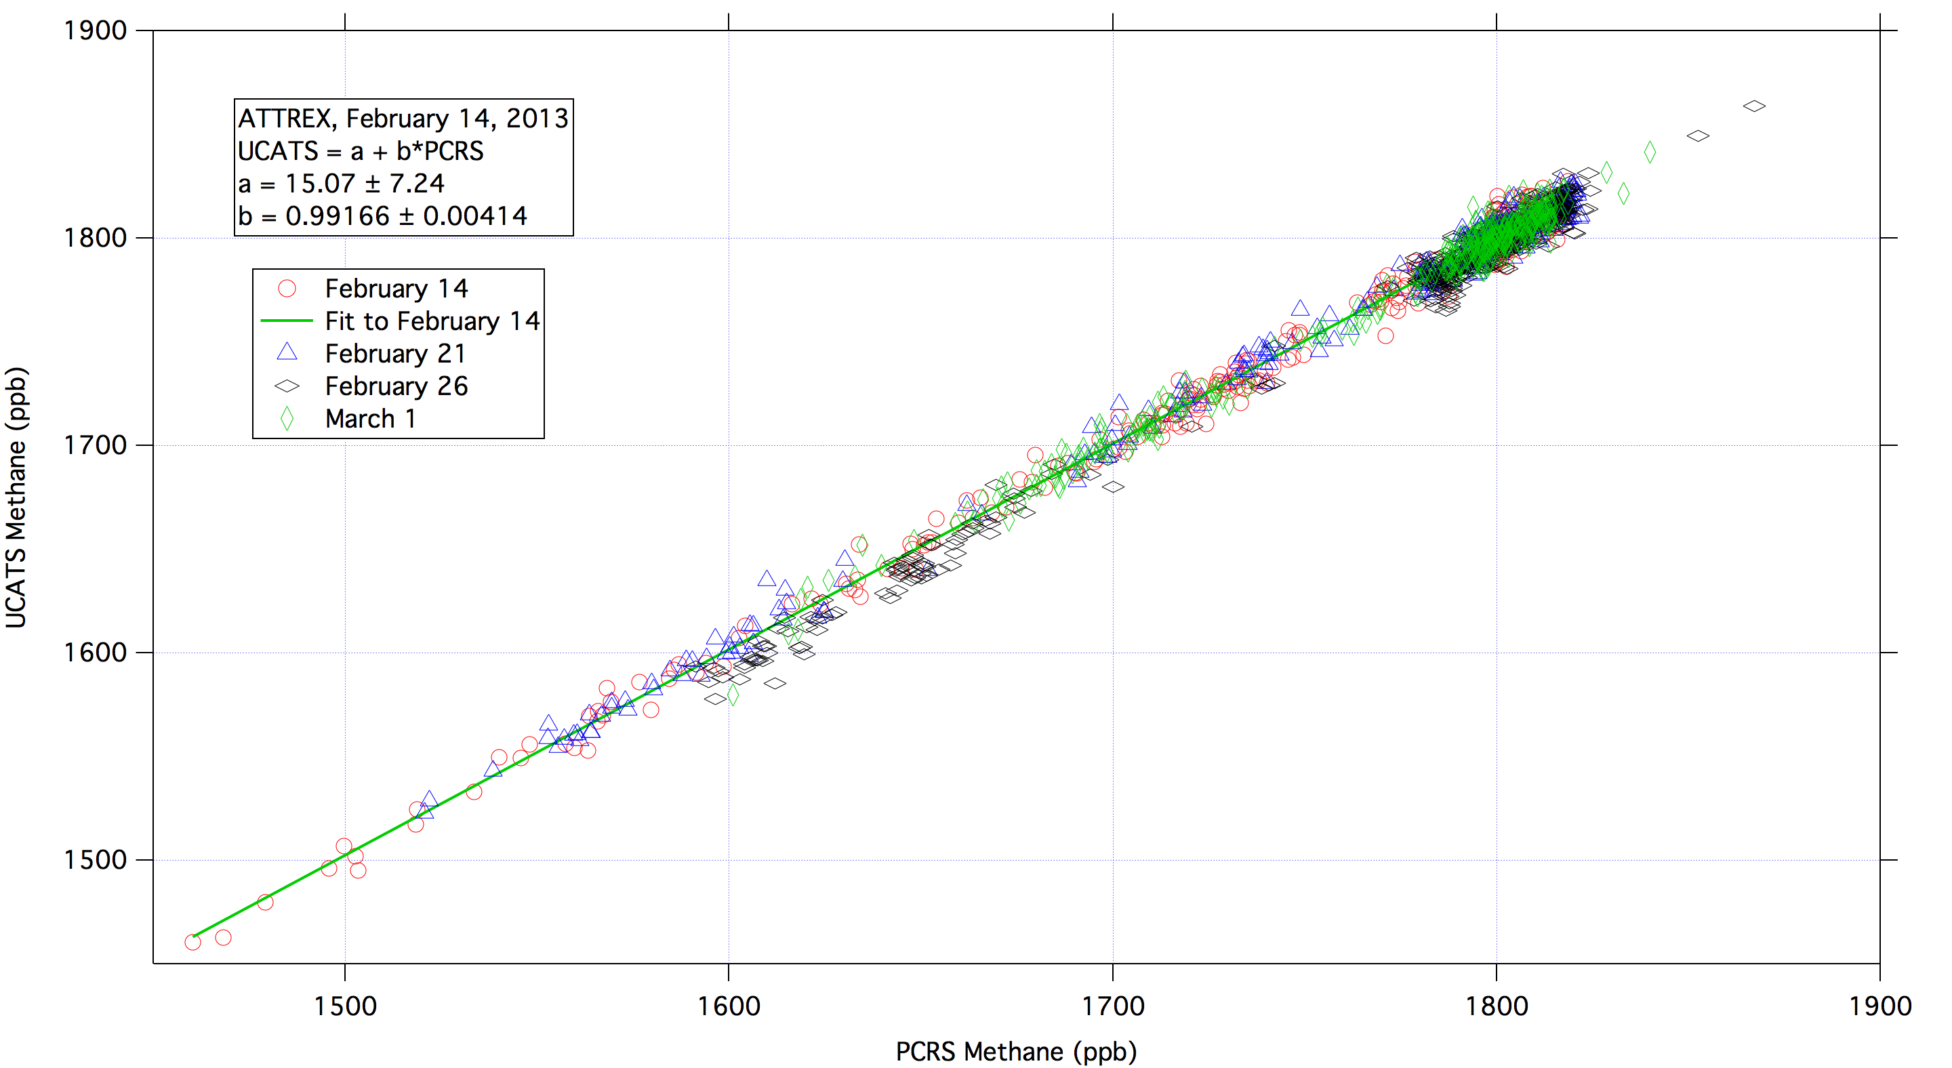
Research Flights 3-6, UCATS & Picarro
Notes:
Basically same as 0214; 0226 may be a little different
Note agreement even in uppermost right corner – ascent data from Dryden

Slide 5
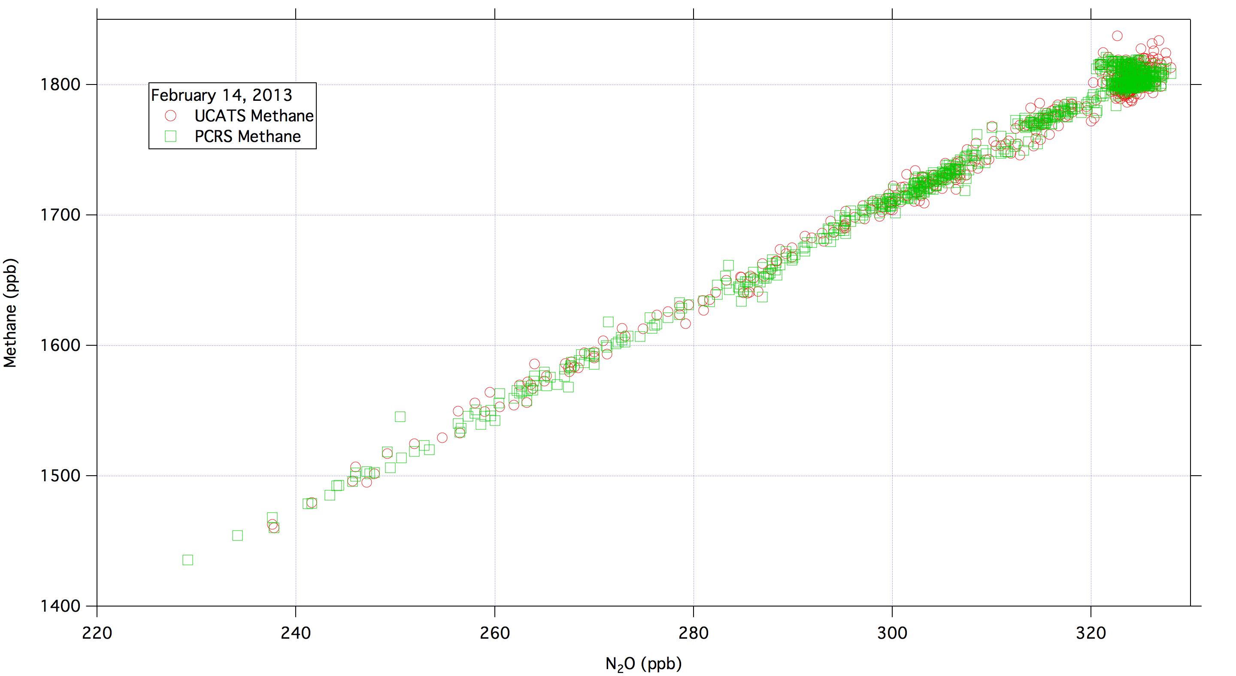
Methane-N₂O Correlation
Notes:
Unfortunately most of interest in ATTREX is in upper right corner

Slide 6
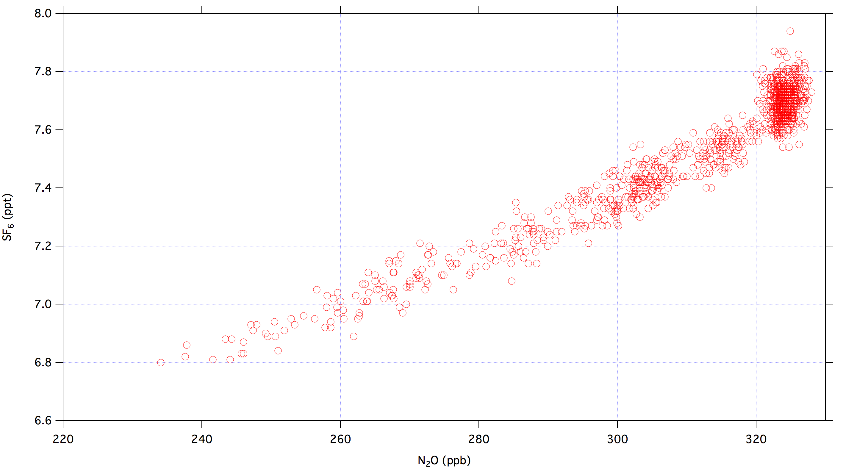
SF₆ vs. N₂O, February 14, 2013
Notes:
Latitude distribution of SF6 at high values

Slide 7
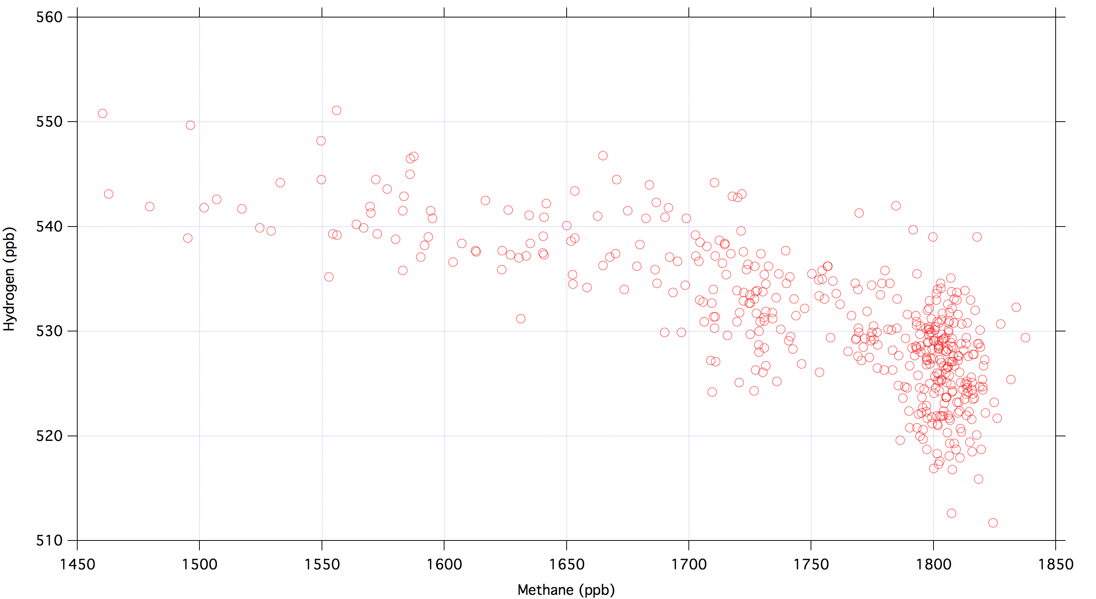
Hydrogen vs. UCATS Methane, February 14, 2013
Notes:
UCATS methane here (PCRS would be just about identical)

Slide 8
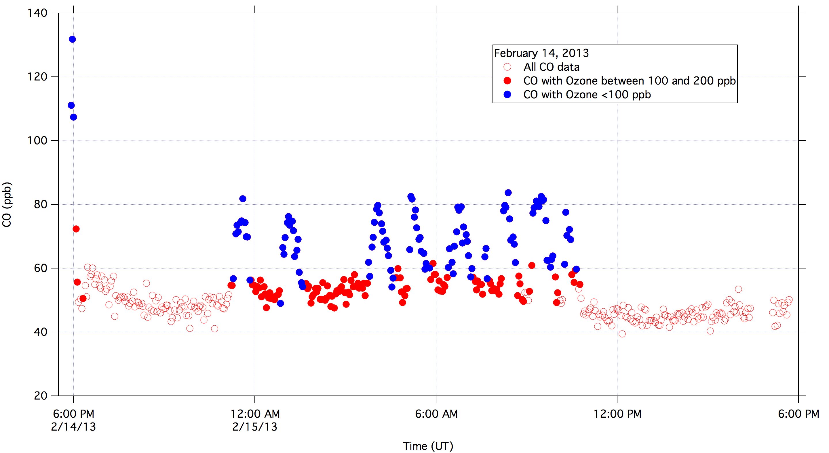
UCATS CO data color-coded by Ozone
Notes:
Artifact associated with pump running, and added ozone.
Blue points probably OK, red solid circles may be OK too.

