Slide 1
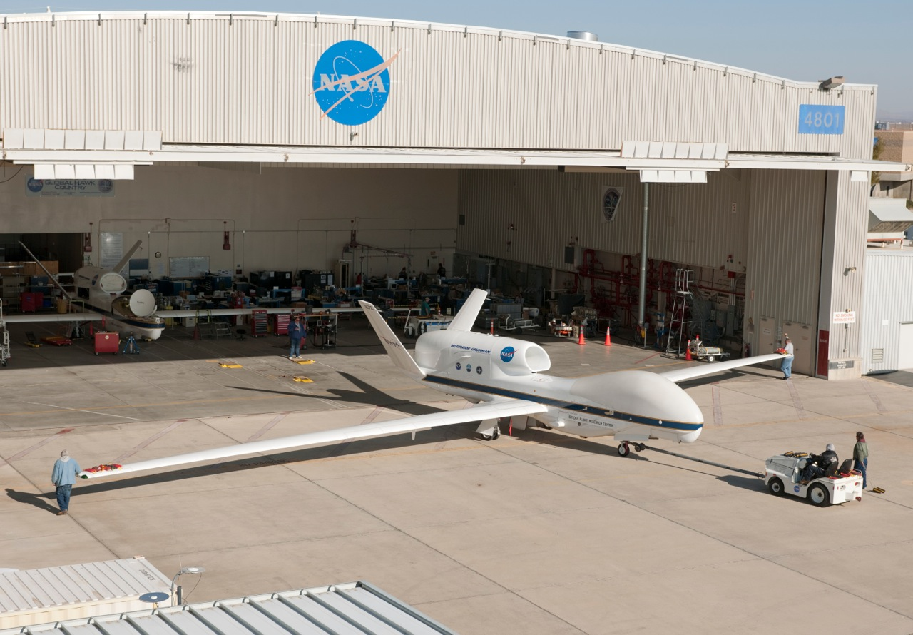
Airborne Tropical Trpopopause EXperiment (ATTREX)
Eric Jensen (NASA Ames Research Center) and ATTREX science team
Outline
ATTREX science objectives
Global Hawk performance and payload
Overview of ATTREX 2011 and 2013 flights
A few examples of interesting measurements
Guam plans

Slide 2
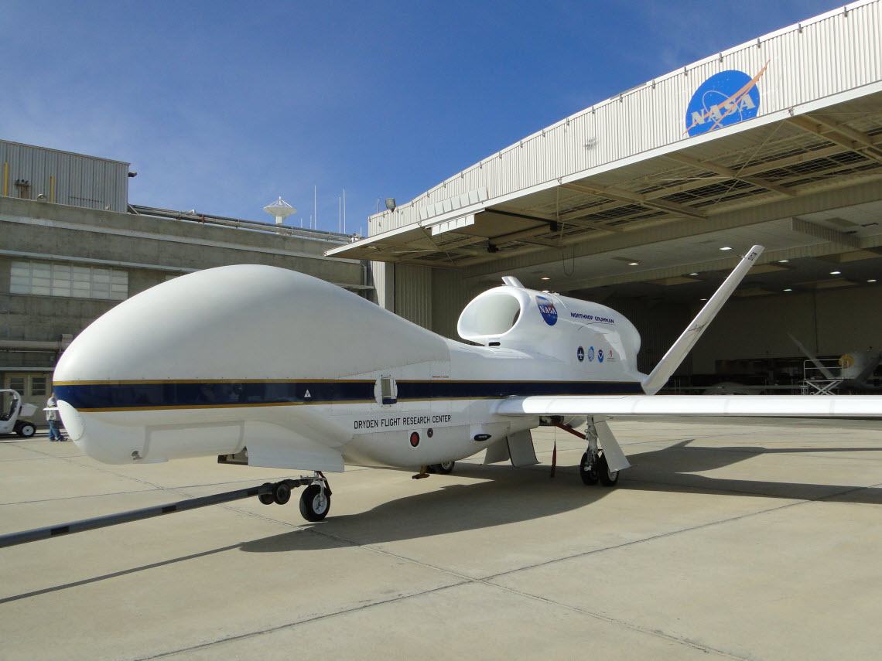
NASA Global Hawk performance
With ATTREX payload, the GH duration is 24–25 hours
  Corresponding range is ~8200 nm
Initial climb out to ~54 kft
Slow cruise climb to over 60 kft late in flight
Vertical profiles down to 43–45 kft

Slide 3
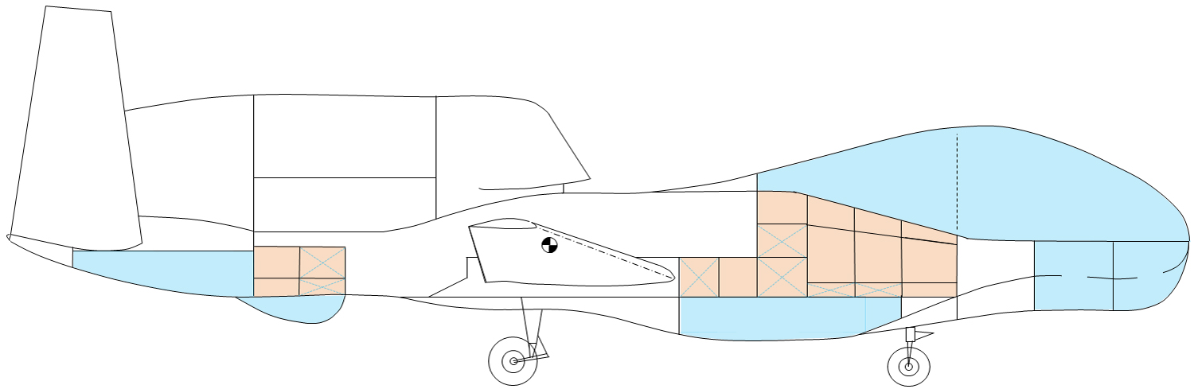
ATTREX Payload
Chromatograph (UCATS)
Radiometers (SSFR)
Temp profiler (MTP)
Ozone
NOAA water vapor
P, T, winds (MMS)
Whole air sampler (GWAS)
Lidar (CPL)
Water vapor (DLH)
IR spectrometer (HUPCRS)
Mini-DOAS
Cloud probe (FCDP)
Pressurized compartments
Unpressurized compartments
Still hope to get Hawkeye on the aircraft for 2014

Slide 4
Fall 2011 flights
Three long flights to the tropics (16–24 hours duration)
Sampling cold TTL regions and downwind of deep convection

Slide 5
Winter 2013 flights
Six long flights to the tropics (~24 hours duration each)
Sampling cold TTL regions, downwind of deep convection, and latitude surveys

Slide 6
TTL vertical profiling
Most of the flight time was spent ascending/descending through the TTL.

Slide 7
TTL tracer profiles
Dependence of vertical gradient on tracer lifetime as expected
Combination of trajectory modeling and tracer measurements to assess convective influence

Slide 8
Cloud and humidity measurements (2011 RF02)
Ice saturation ratio held near unity in cloud with very high ice concentrations; significant supersaturation above and below

Slide 9
Cloud and humidity measurements (2011 RF02)
2.5 ppmv dehydration within high ice-concentration cloud

Slide 10
Cloud and humidity measurements (2013 RF06)
Consistent with 2011 DLH measurements: near ice saturation in high ice concentration cloud and supersaturation above and below

Slide 11
Cloud and humidity measurements (2013 RF05)
Global Hawk sent as far into the western-Pacific cold pool as possible.

Slide 12
Cloud, humidity, and ozone measurements (2013 RF05)
Layer between 16.2 and 17.1 km with considerable ice present (up to 20 ppmv), low ozone (< 40 ppbv) and low H₂O vapor (< 2 ppmv)

Slide 13
Guam flight plans
Sampling cold pool along streamlines, downstream of deep convection, TTL survey flights, etc.
Potential for shorter-duration flights from Guam

Slide 14
Outlook for 2014 Guam deployment
Delays caused by the govmnt shutdown imply that our earliest possible start date is Jan 29.
Risk of further slippage is not insignificant.
Alternative (for ATTREX) would by to delay by 1 year (to Jan/Feb, 2015)
  –Could possibly then have flights from DFRC in Jan-Feb, 2014

