Slide 1
GPS-R Winds/SoOp Winds
HS-3 Science Team Meeting
NASA Research Park, Moffett Field, CA
James L Garrison Purdue University
Stephen J Katzberg, SCSU/NASA
Robert Holloway, ITT-Exelis
George Ganoe, NASA Langey

Slide 2
Signals of Opportunity (SoOps)
Digital satellite signals re-used for sensing winds
First demonstrations used GNSS (GPS) signals
Recent works show techniques can be extended to most all communication satellites
Two instruments proposed for payloads of opportunity:
2013: GPS-DMR (NASA Langley – Extensive flight heritage)
2014: XM-Radio SoOp (Purdue/ITT – Flight prototype in development)

Slide 3
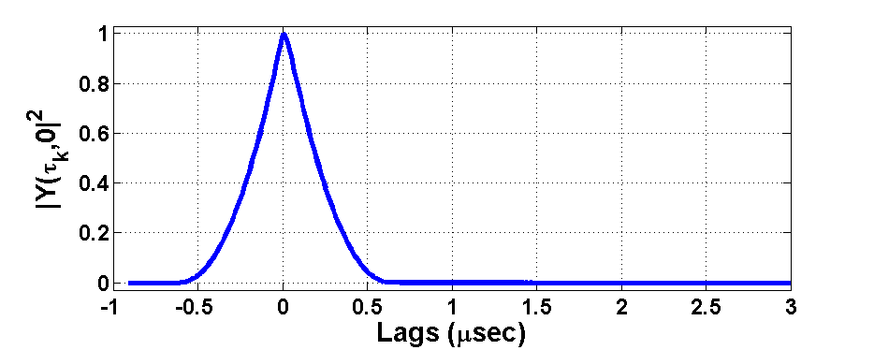
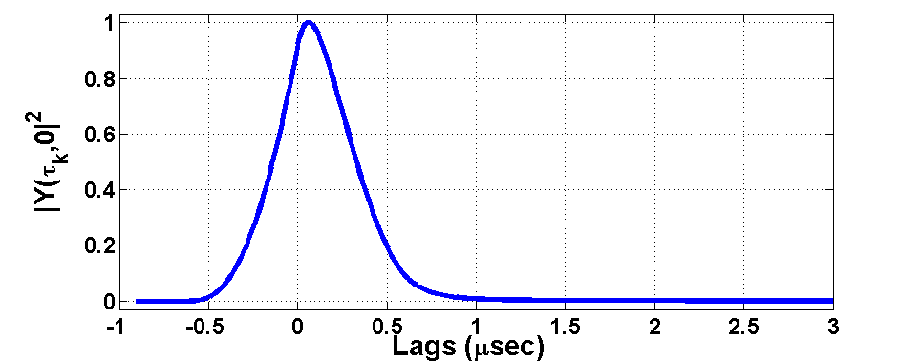
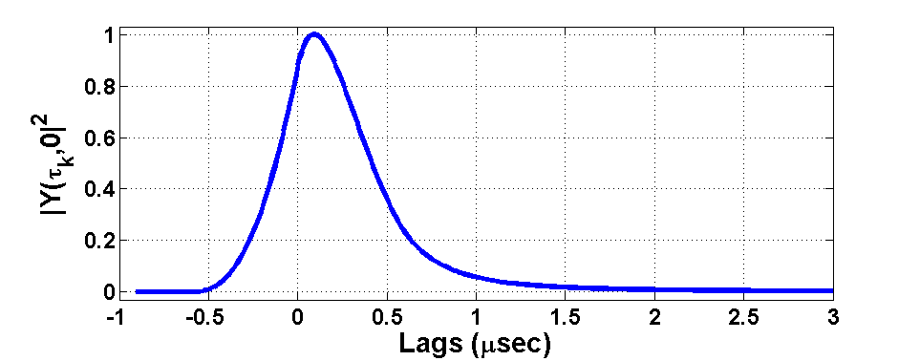
Ocean Roughness/Wind Speed
Fundamental Physics:
Rougher surface = larger distribution in path delays
Receiver
glistening zone
glistening zone

Slide 4
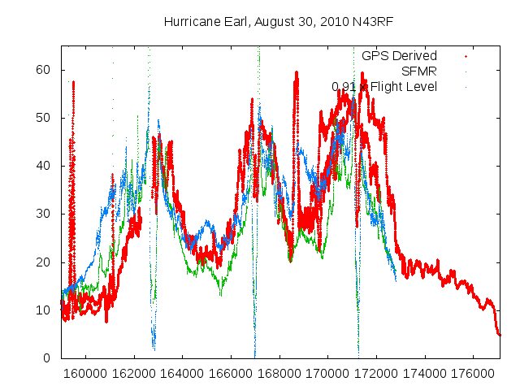
Ocean Roughness/Wind Speed
NOAA Hurricane Hunters
NASA P-3, N. Atlantic
March 2009
Wind Speed
[Garrison, et al]
[S. Katzberg, SCSU]

Slide 5
NASA Langley GPS-DMR
Power: 13 W
Size (cm): 23 x 13 x 17
Box weight: 2.800 Kg
Antenna (1 piece): 0.115 Kg
Typical weight: 3.030 Kg
Stack weight: 0.630 Kg
Antenna (1 piece): 0.115 Kg
Min weight: 0.860 Kg
Langley Research Center – Research and Technology

Slide 6
What about other signals ?
Approximately 400 communication satellites in GEO
High-powered (~30 dB above GNSS) signals
Allocations in most bands used for remote sensing:
L,S, C, Ku/Ka
Designed for data transmission – Not ranging!
Assumption: Compression & Encryption are very efficient at filling available spectrum
Data is nearly random
Direct signal can be used as reference

Slide 7
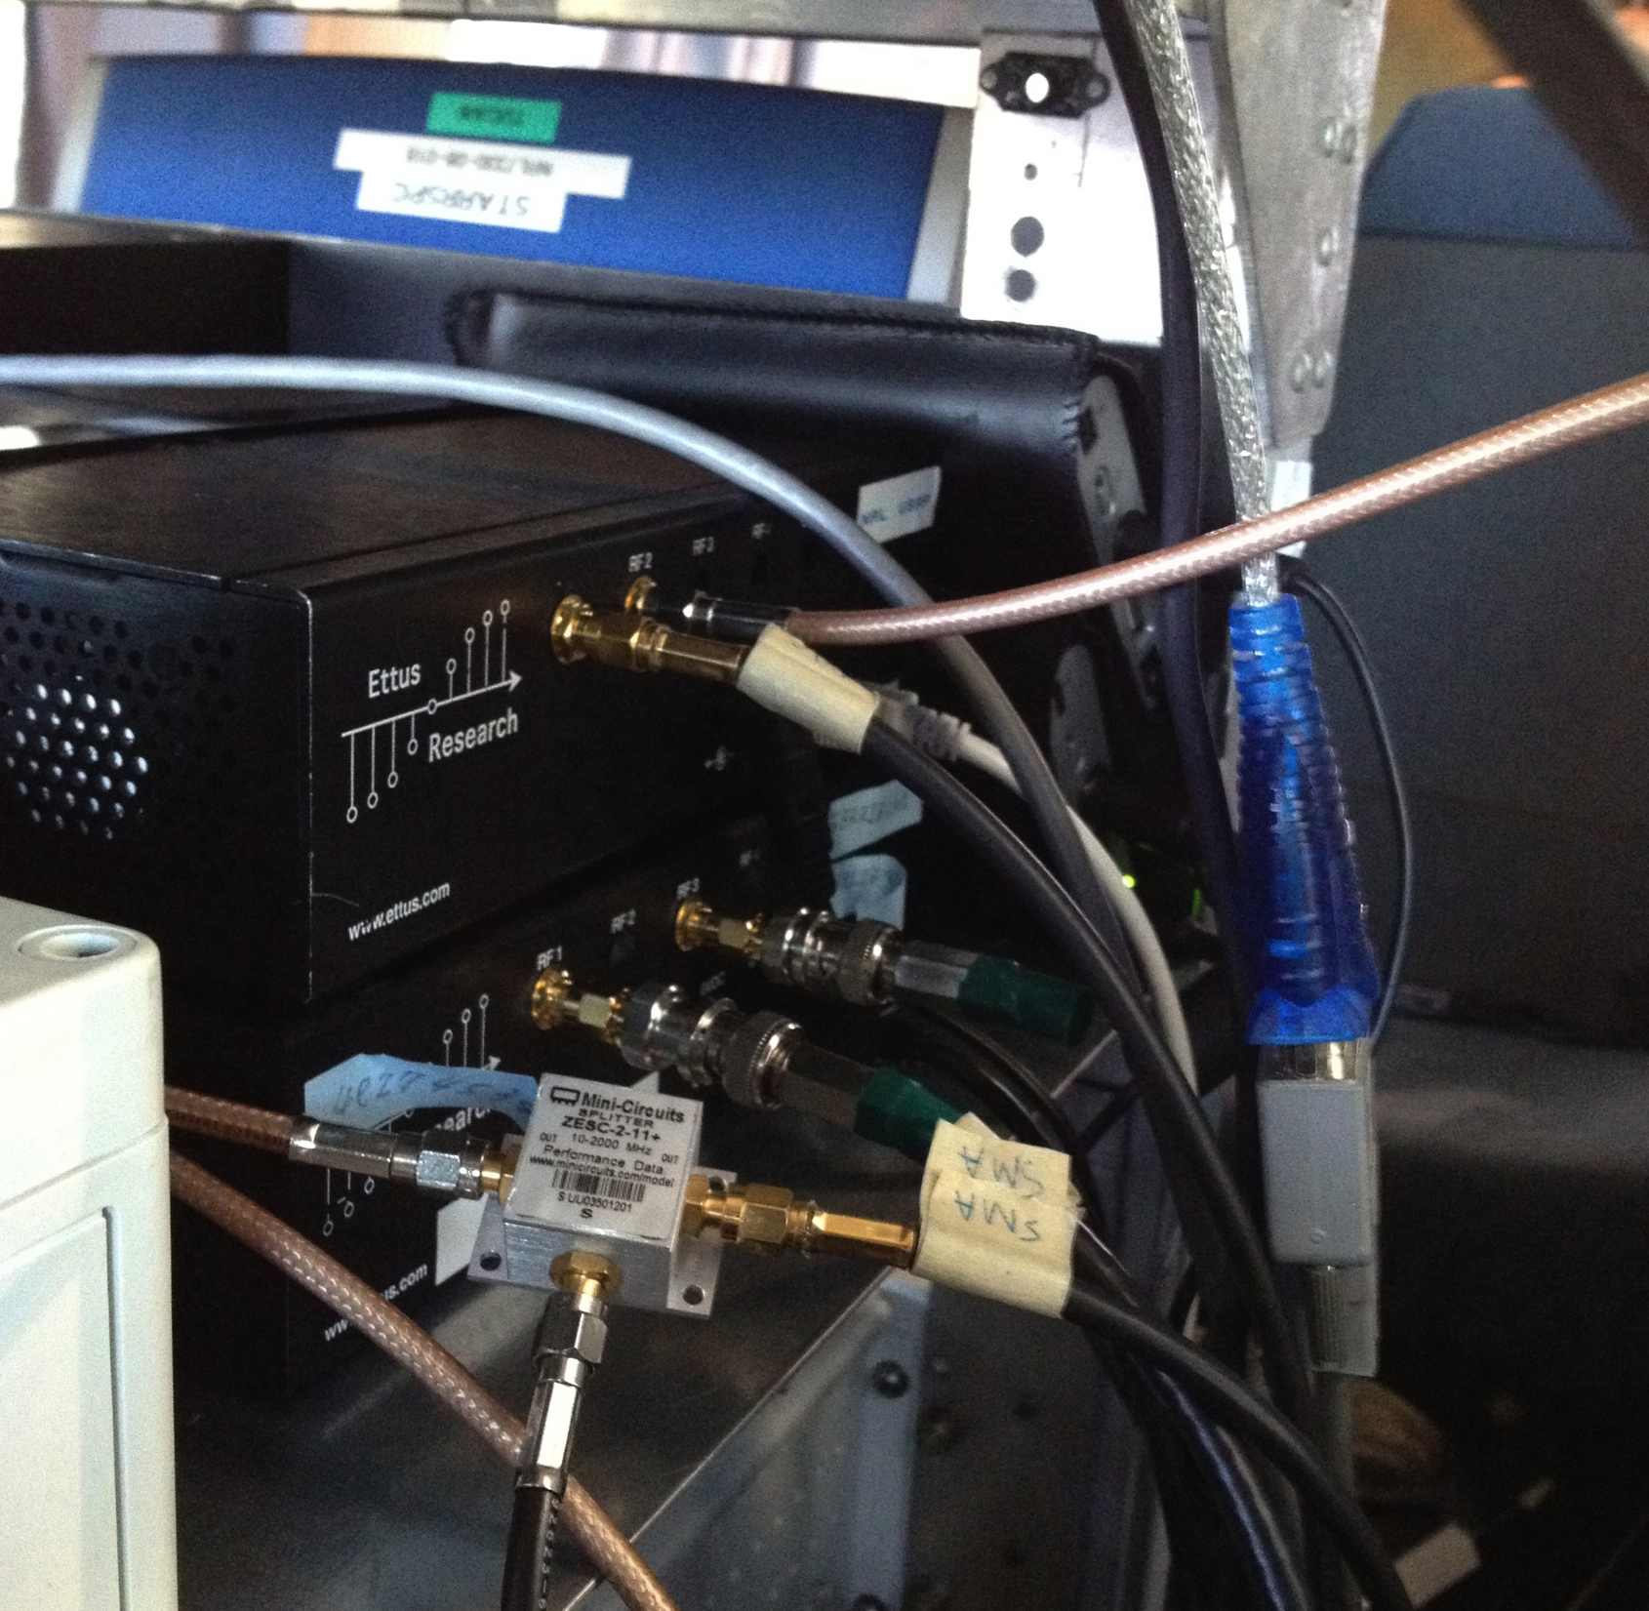
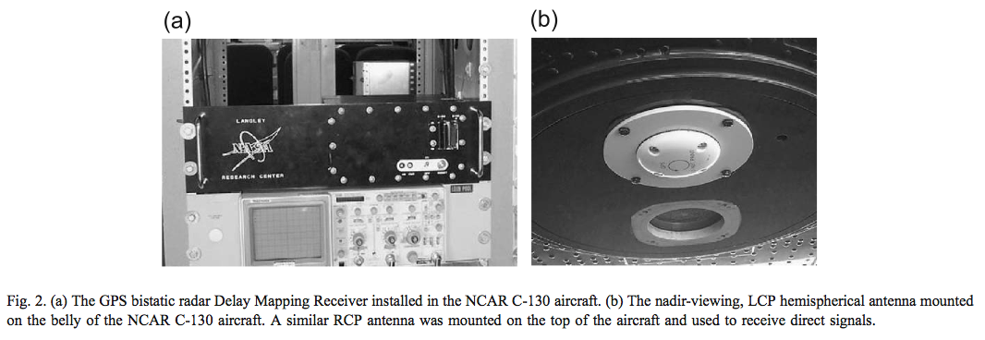
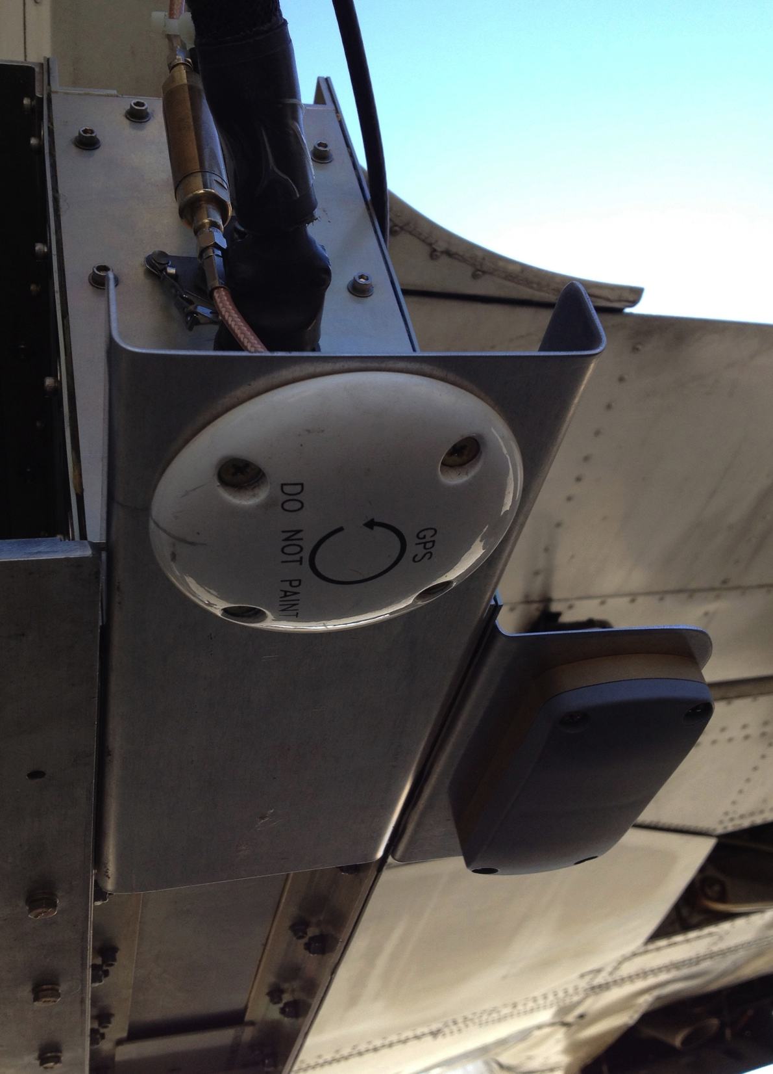
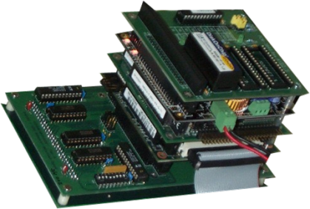
SoOp Reflectometry Instruments
XM Radio
Signal Recorder
GPS Delay-Mapping
Receiver (DMR)
GPS Reflection
Antenna
Reflected GPS
Antenna
Reflected GPS/XM
Antenna

Slide 8
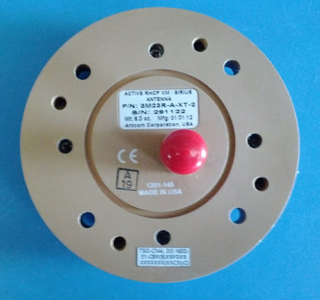
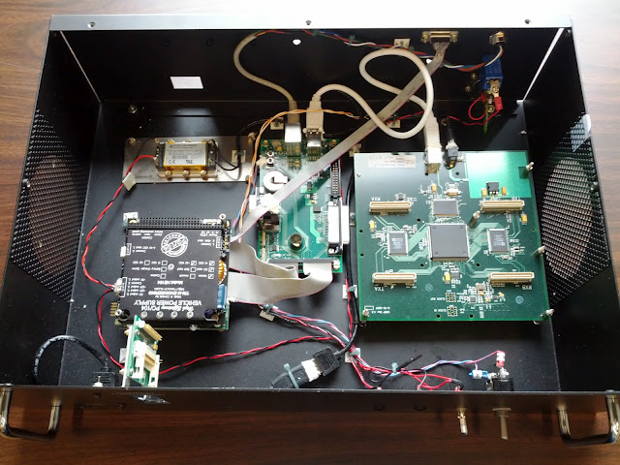
NOAA SoOp Instrument
ANTENNA
USRP
PC-104
AMPLIFIER
19”
3U
FRONT VIEW
BACK VIEW
Notes:
Size

Slide 9
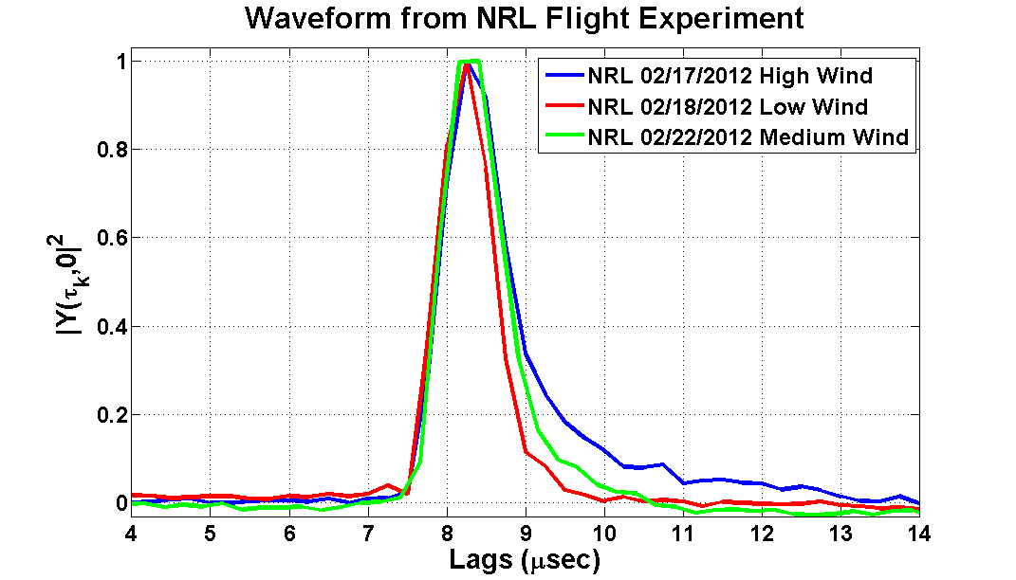
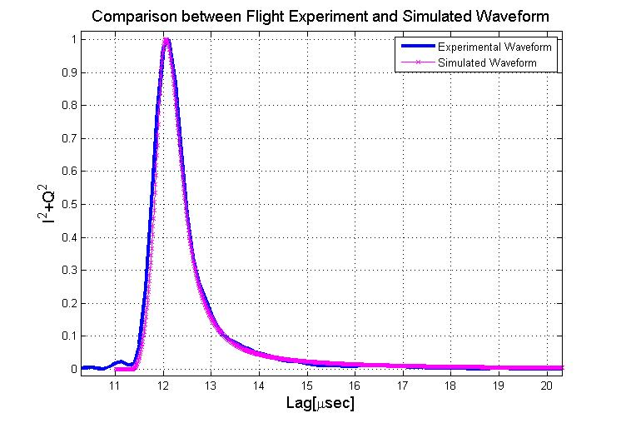
XM Radio (S-band) Reflectometry
Wind Speed Dependence
Comparison with Model

Slide 10
Simulated Wind Speed Retrievals

Slide 11
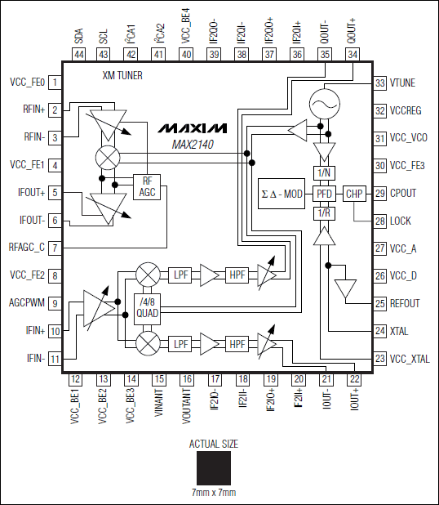
HS-3 SoOp Receiver: FPGA-Based SoOp Processor
FPGA-Based real-time correlators
23x18x8 cm
<7 W
<1 Kg.
Configured for XM radio (S-band)
interchangable front-ends
ITT-Exelis IRAD funding

Slide 12
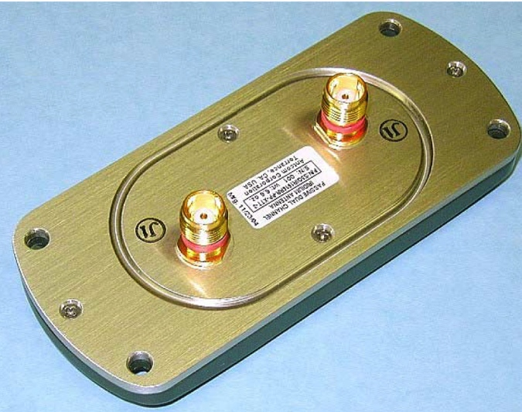
HS-3 SoOp Receiver: Combined GPS/XM Antenna

Slide 13
Status
GPS-DMR: Receiver ready to go – seeking integration funds
HS-3 SoOp Receiver
FPGA working with stored digital data
June 2013 – Planned demo with live sky signals
Summer 2013 – test flight on light A/C
Dec. 2013 – Flight unit delivery.
Seeking integration funds

Slide 14
Backups and Extras

Slide 15
Advantages of SoOp for UAVs
Strong, coherent signal provide for free, hence:
Passive
Very small antennas (usually low-gain patches)
Very small, low power receiver
Resistance to RFI
Use of non-protected frequencies
Some measurements require little power calibration
Basic observation: signal correlation function, not scattering coefficient
Direct signal available for relative power measurement

Slide 16
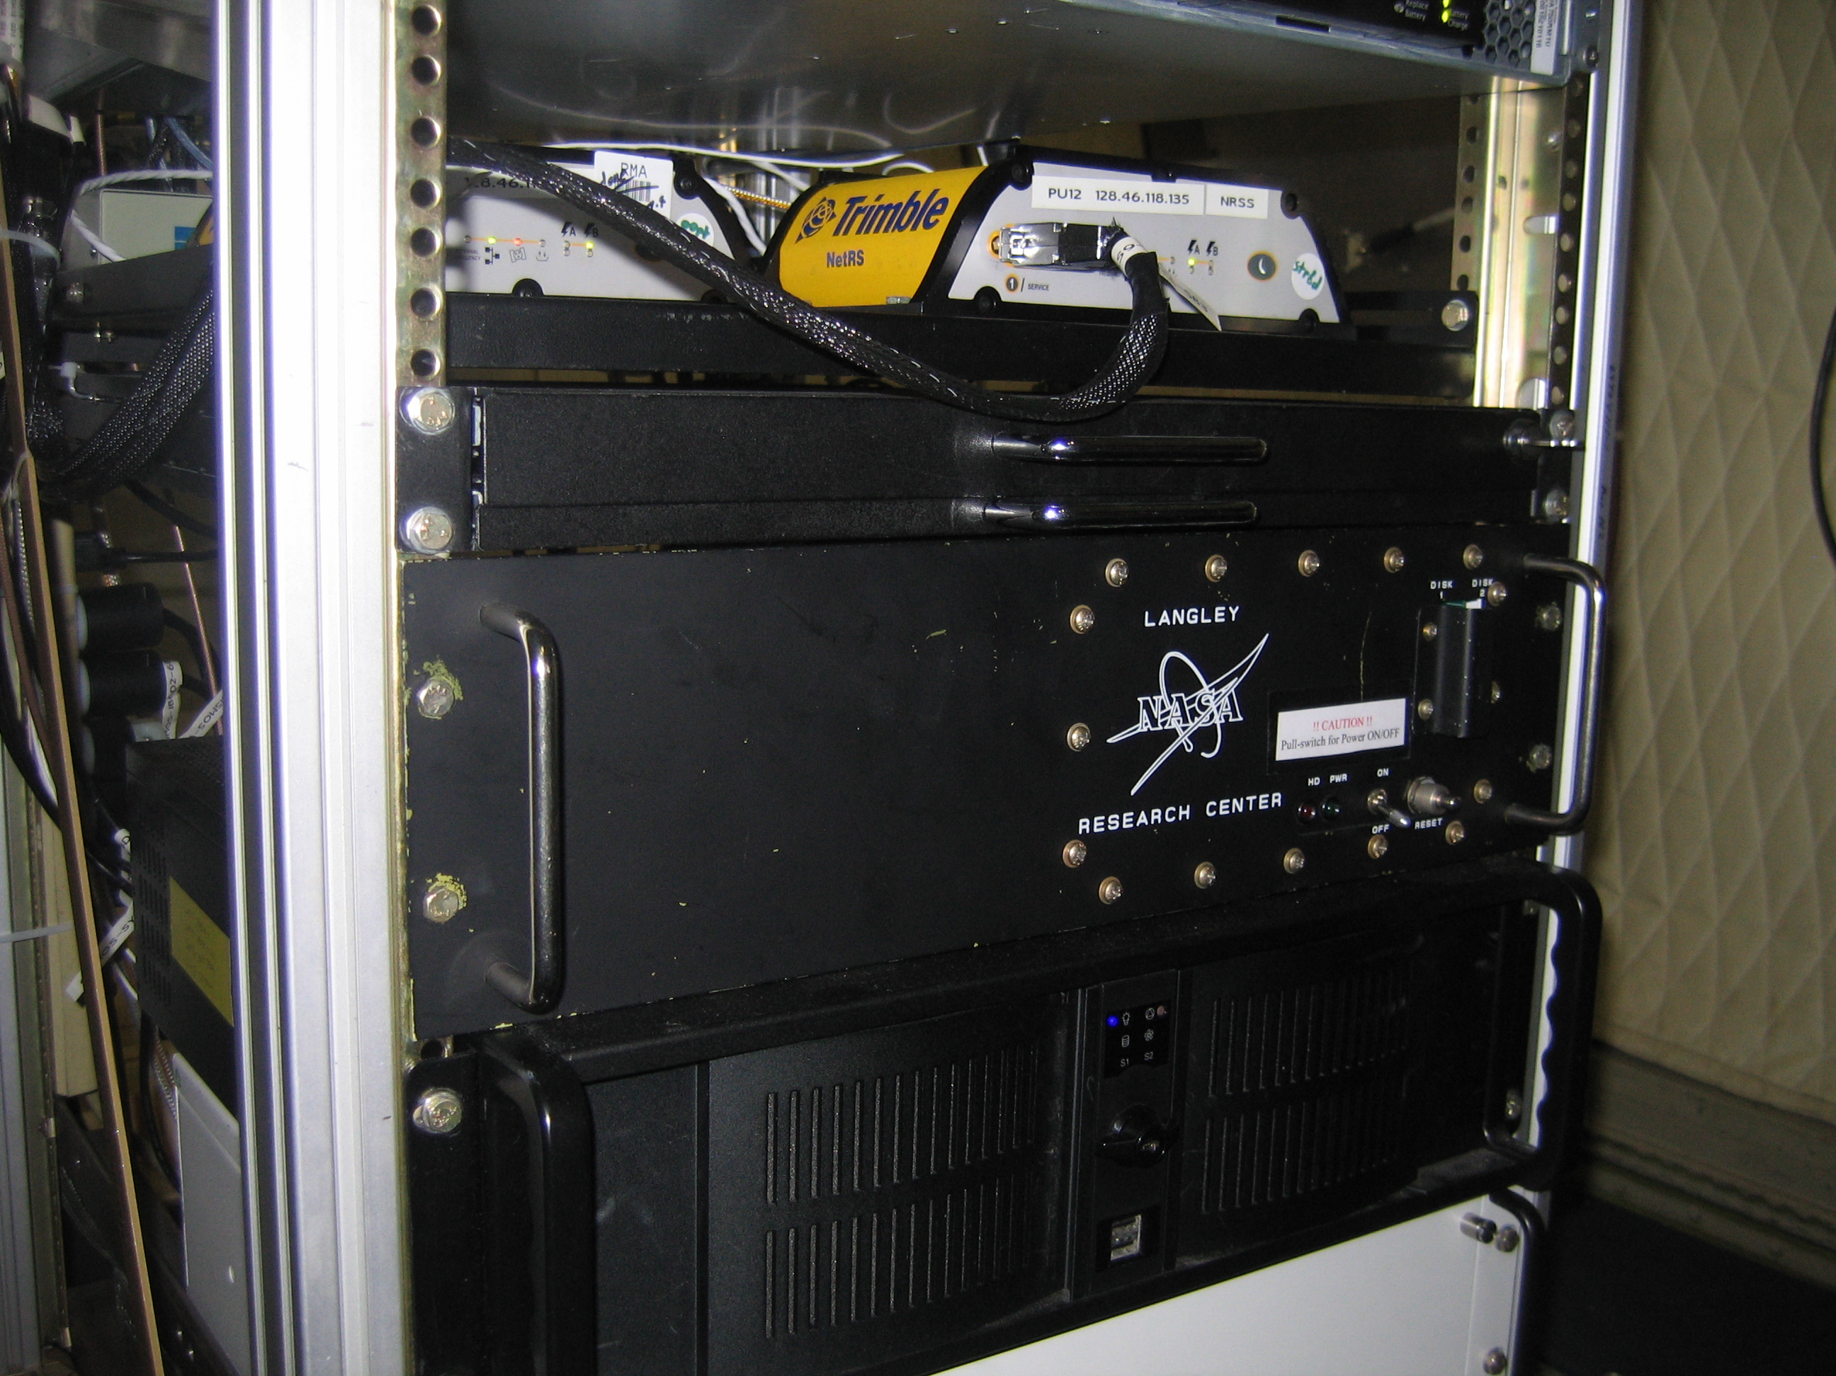
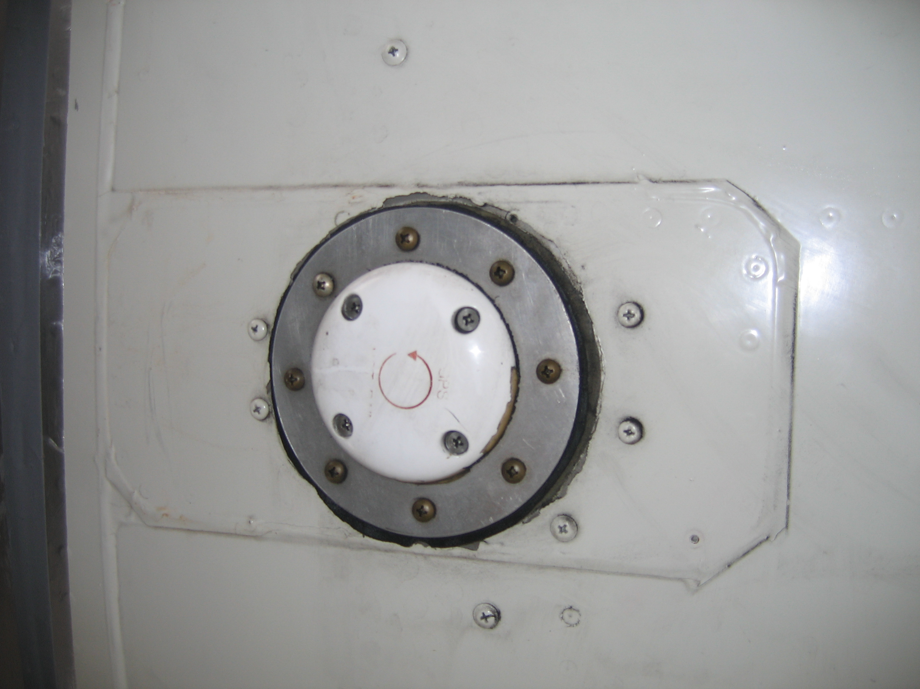
Hi-Winds 2009 Experiment
NASA Langley DMR
Integration at Wallops Is., VA
GNSS-R Antenna

Slide 17
Collaborators
ITT-Exelis: SoOp Receiver development (IR&D)
NASA Langley/South Carolina State: GPS DMR
Flight campaigns: JPL (2009), NRL (2011)
NOAA: Hurricane hunter flights
NCAR: HIAPER-GISMOS Receiver
Purdue Dept. Earth & Atmospheric Science, School of Agricultural and Biological Eng.

Slide 18
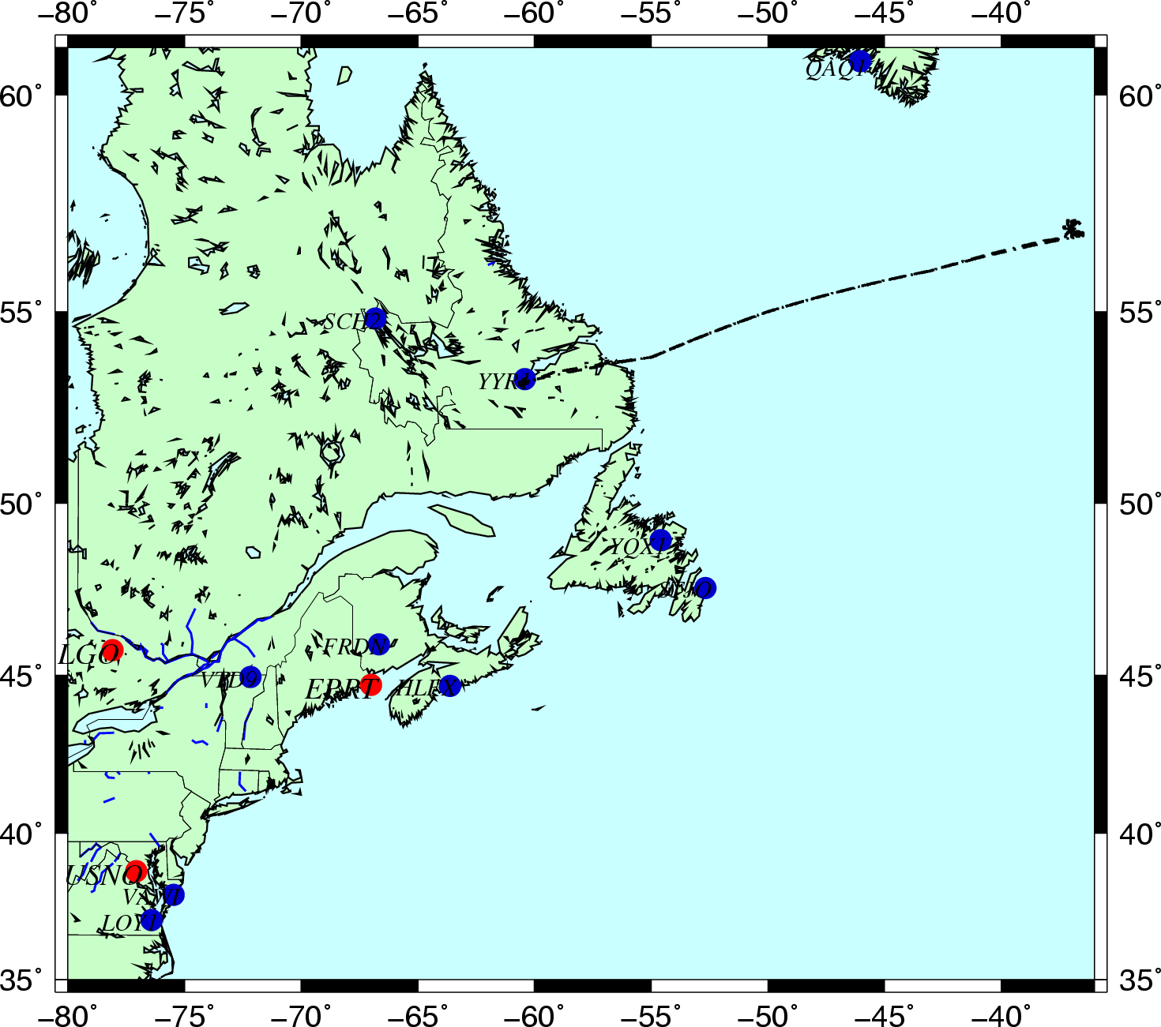
Hi-Winds 2009 Experiment

Slide 19
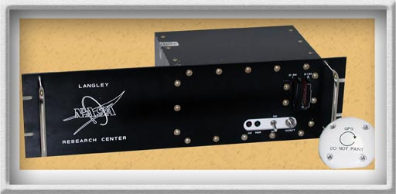
NASA Langley GPS-DMR
Description
Weight: 0.860 – 3.00 Kg
Power consumption: 13 watts
Dimensions: 23 x 13 x 17 cm
Antenna diameter: 10 cm
http://dragon.larc.nasa.gov/gps
Points of contact
Dr. Stephen J. Katzberg, PI
Phone: (803) 516-6068
Email: Stephen.J.Katzberg@nasa.gov
George G. Ganoe
Phone: (757) 864-3707
Email: michael.s.grant@nasa.gov
Potential applications
Soil moisture mapping
Altimetry
Freeze/thaw monitoring

Slide 20
GPS technique is UAV friendly
Langley Research Center – Research and Technology

