Slide 1
HIRAD
Hurricane Imaging Radiometer
PI: Dan Cecil, NASA MSFC
HIRAD Team (apologies to anyone I missed!):
MSFC: Cecil, Mark James, Brent Roberts, Sayak Biswas (NPP), Tim Miller (retired)
UAH: Dave Simmons, Lori Schultz
UCF: Linwood Jones, Jim Johnson, Saleem Sahawneh, Zoubair Ghazi, Ruiyao Chen, Spencer Farrar
UMich: Chris Ruf, Mary Morris
NRL: Pete Black
AOML: Robert Atlas, Eric Uhlhorn
HS3 Science Team Meeting, May 2013

Slide 2
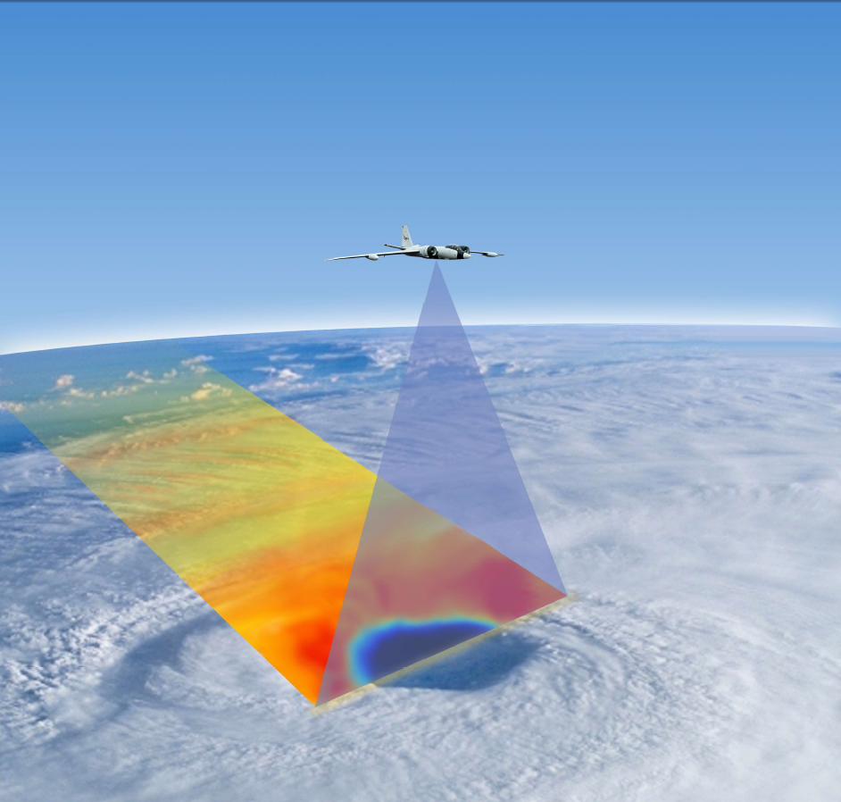
Hurricane Imaging Radiometer (HIRAD)
A passive microwave radiometer (C-band, 4 frequencies), similar to SFMR: Measures emissivity and retrieves hurricane surface wind speeds and rain rates over a wide-swath:
  Swath Width ~ 60-80 km
  Resolution ~ 1- 5 km
  Wind speed ~10 – 85 m/s
  Rain rate ~ 5 – 100 mm/hr
Synthetic Thinned Array Radiometer (not mechanically scanning) sees a wide swath below the aircraft
Flight History:
Hurricane Earl (2010 GRIP, WB-57)
Hurricane Karl (2010 GRIP, WB-57)
HS3 2012 Pacific Flight (AV-1)

Slide 3
Principles of Operation
HIRAD measures ‘emissivity’ over a range of incidence angles, emitted from ocean surface foam coverage (a function of wind speed) and intervening rain.
At the C-band microwave frequencies used (4-7 GHz), wind-driven foam coverage is invariant with frequency, while at the same time rainfall emissivity is a strong function of frequency.
These physical characteristics allow two geophysical variables (wind speed and rain rate) to be derived from emissivity measurements at 4-6 discrete C-band frequencies, which is an ‘over-determined’, ‘least-squares’ problem solvable with conventional mathematical techniques.
Surface wind speed and rain rate retrievals are derived from the correlation of HIRAD measured emissivity at operating incidence angles with modeled values. At nadir, these relationships have been validated via SFMR with co-located GPS dropsonde surface wind observations.

Slide 4
4 C-band Channels to constrain geophysical parameters wind speed, rain rate, SST (SST can have an assumed value)
4 GHz
5 GHz
6 GHz
6.6 GHz
4 GHz channel noisy on Global Hawk in 2012
Could not reproduce noise in lab
Will test for interference sources at integration in July 2013

Slide 5
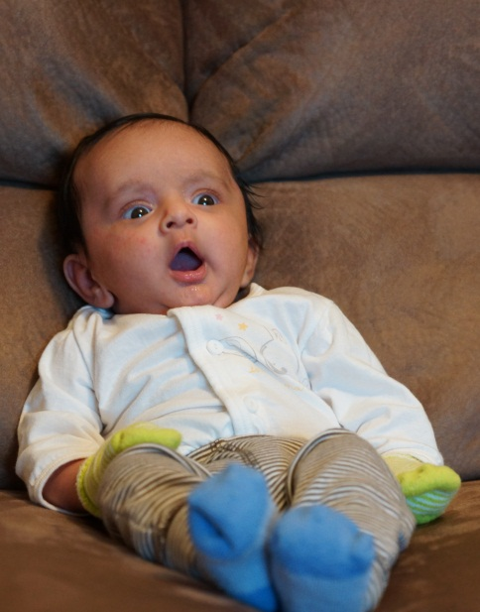
APC Slope Coefficients: 4 GHz
No Good Subbands for 4 GHz!
They should look similar to one of the 5 GHz patterns, below:
Sayak Biswas investigated so many ideas to try to find a source for the 4 GHz noise in 2012 Global Hawk flights, it started to frighten his family…

Slide 6
HS3 2012 Pacific Flight
5 GHz
6 GHz
6.6 GHz

Slide 7
Observed TB Leg #1 - 4
5 GHz
6 GHz
6.6 GHz
Observed TB has incidence – angle dependence (related primarily to polarization)
Retrievals use excess TB, after subtracting a background value that accounts for this dependence

Slide 8
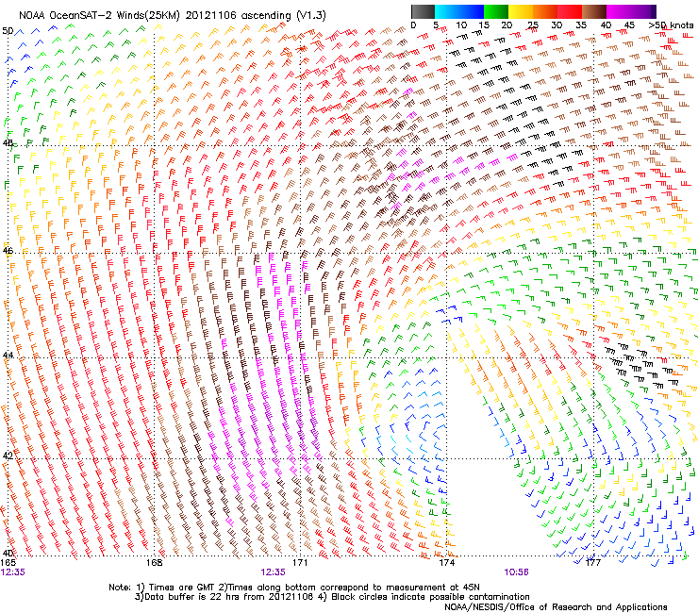
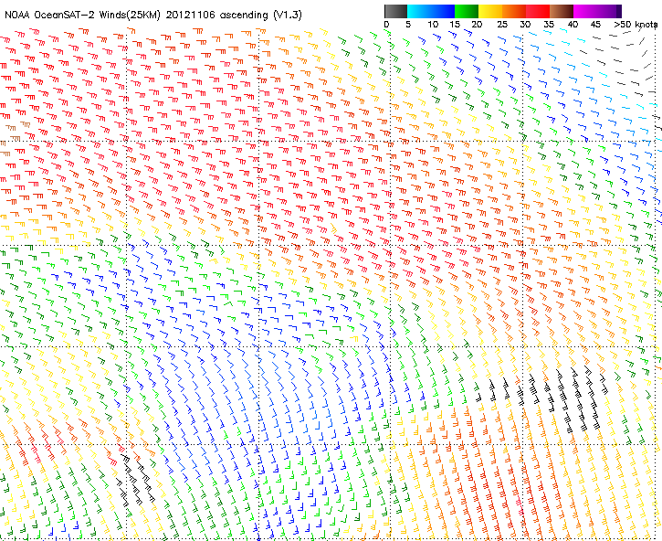
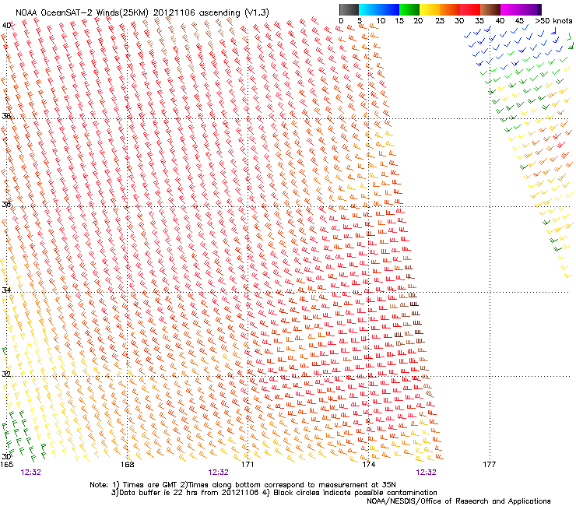
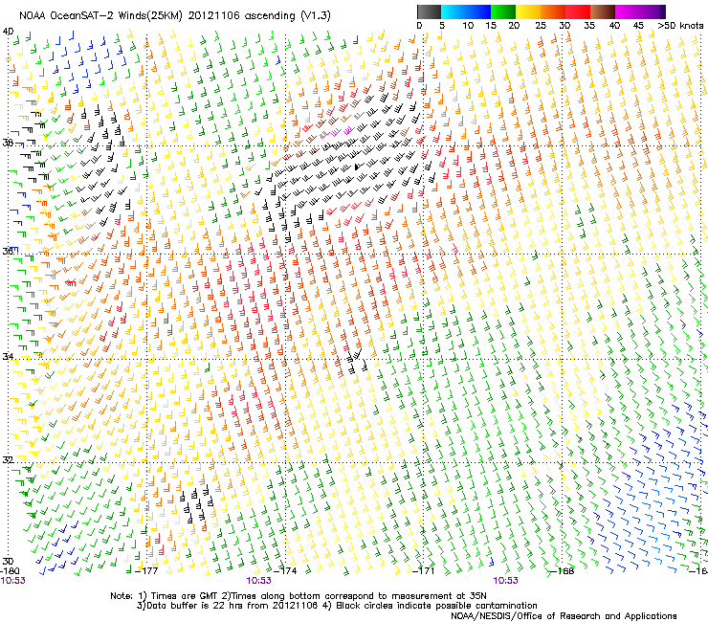
0850Z
0923Z
1010Z
1123Z
1205Z
OSCAT 06 Nov 12Z
30 kt- solid
40 kt dashed

Slide 9
Excess TB relative to RT model
5 GHz
6 GHz
6.6 GHz
Observed TB has incidence – angle dependence (related primarily to polarization)
Retrievals use excess TB, after subtracting a background value that accounts (somewhat) for this dependence. The above figures do not yet account for H-V polarization mixing, which is significant near edge of swath.

Slide 10
Excess TB relative to observed minimum
5 GHz
6 GHz
6.6 GHz
Observed TB has incidence – angle dependence (related primarily to polarization)
Retrievals use excess TB, after subtracting a background value that accounts (somewhat) for this dependence

Slide 11
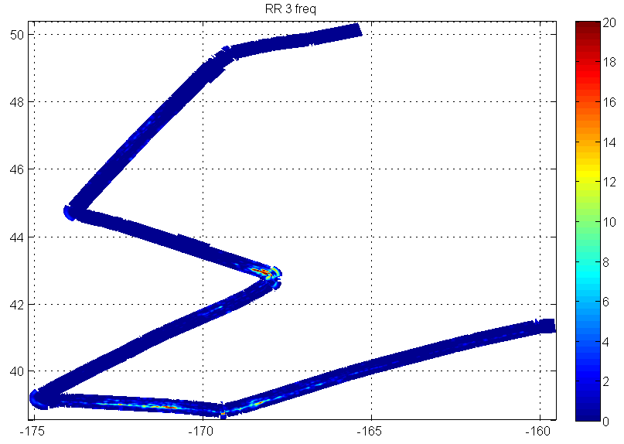
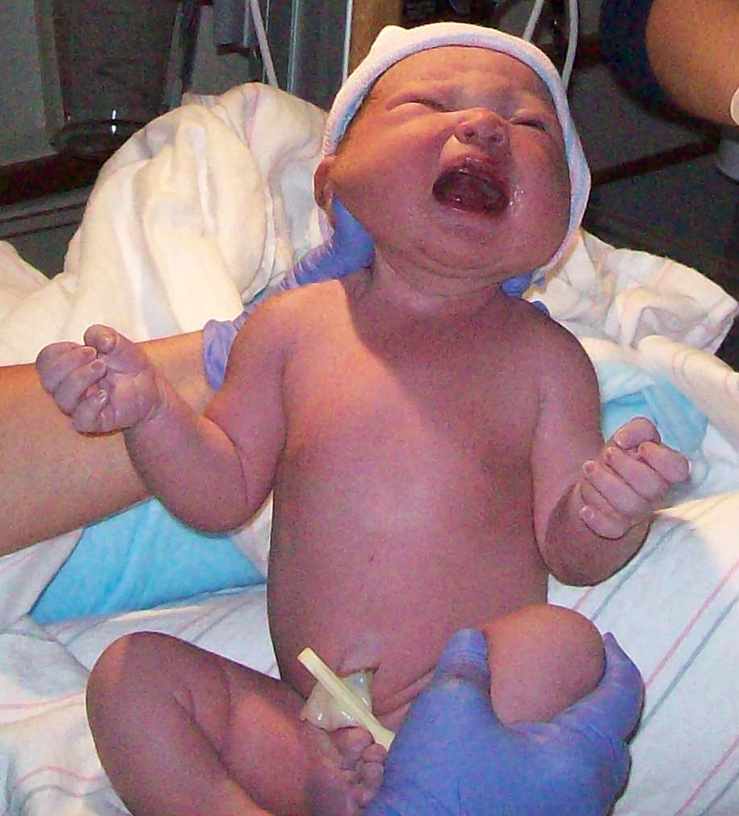
First HS3 2012 retrievals – subject to revision!
Wind Speed
Rain Rate
25 m/s
>30 m/s, but likely rain contamination
20
15
10
Rain rate retrieval (right) looks unrealistic, resulting in too much of the signal being attributed to wind (left) in some places. The pattern looks right, just not the magnitude.
Having a “clean” 4 GHz channel and better-characterized thermal system (therefore better calibration) should help with future flights.
My daughter vehemently objects to these retrievals

Slide 12

Hurricane Earl (GRIP 2010)
HIRAD & SFMR Simultaneous WS Comparisons -Leg-4
HIRAD swath
SFMR swath
HIRAD WS, m/s
X
SFMR WS
HIRAD WS
These are single-channel (5 GHz) HIRAD retrievals, so eyewall rain column contaminates retrieval inside eye near swath edge
HIRAD swath west-to-east, compared with south-to-north SFMR trace (34 minute time difference)
Notes:
HIRAD WS retrieval on Leg 4, using 5 GHz algorithm, compared to storm
centric, collocated SFMR retrievals. WS up to approximately 55 m/sec.
Time difference (reference) between HIRAD samples and SFMR pass
approximately 34 min. Time series goes from HIRAD right swath to left
swath.

Slide 13
HIRAD Rain Rate Retrievals compared to SFMR -Leg-4
HIRAD swath
SFMR swath
HIRAD RR, mm/hr
X
HIRAD RR
SFMR RR
These are single-channel (5 GHz) HIRAD retrievals, so eyewall rain column contaminates retrieval inside eye near swath edge
HIRAD swath west-to-east, compared with south-to-north SFMR trace (34 minute time difference)
Notes:
RR retrieval comparison on Leg 4, using 6.6 GHz algorithm. SFMR Time
difference (reference) between HIRAD samples and SFMR pass
approximately 34 min. HIRAD responded to rain in the eye-wall
(40 mm/hr.) and matched SFMR , but did not match SFMR with the rain
cell on left side of swath. This data shows improved spatial resolution in
the inner swath.

Slide 14
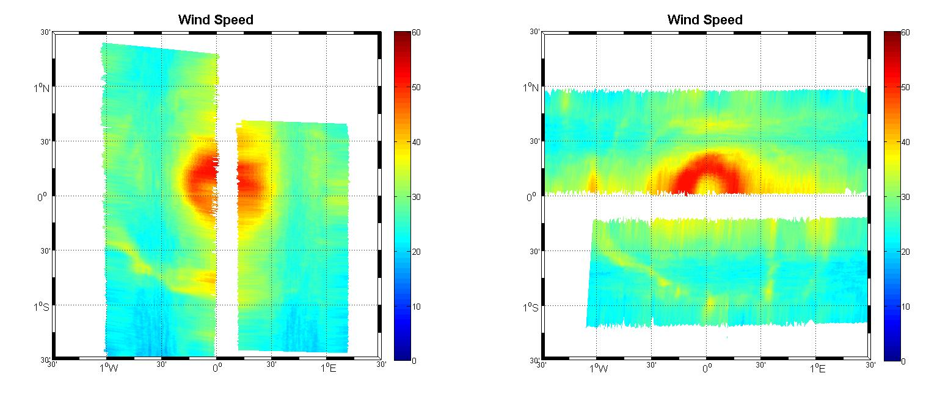
HIRad Wind Speed Retrievals for Earl: 4 Legs
Leg 4
Leg 6
Leg 3
Leg 1
m/s
m/s

Slide 15
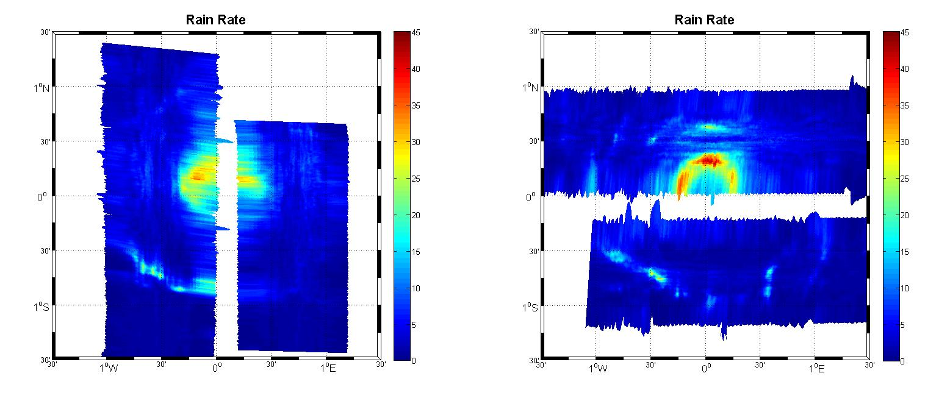
HIRad Rain Rate Retrieval for Earl: 4 Legs
Leg 4
Rain rate, mm/hr
Leg 6
Leg 3
Leg 1
mm/hr

Slide 16
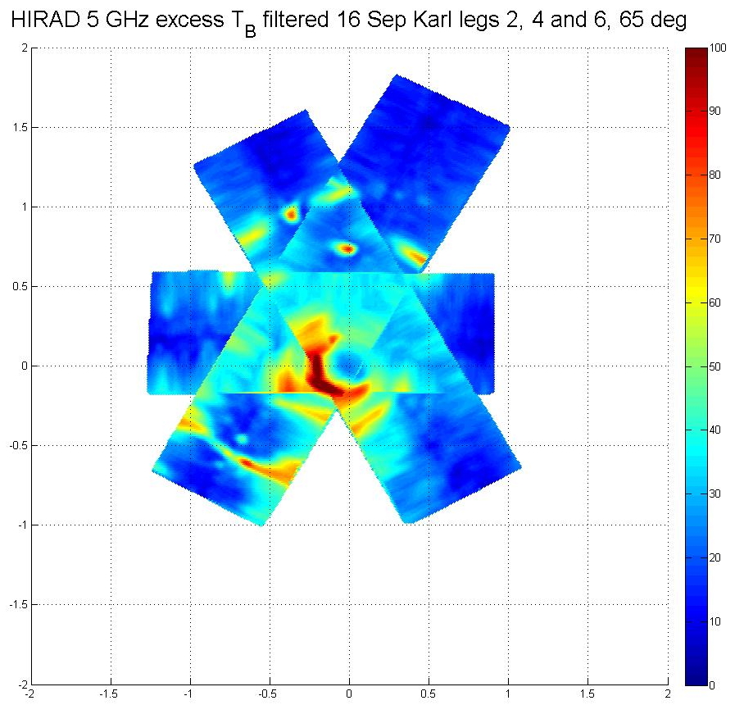
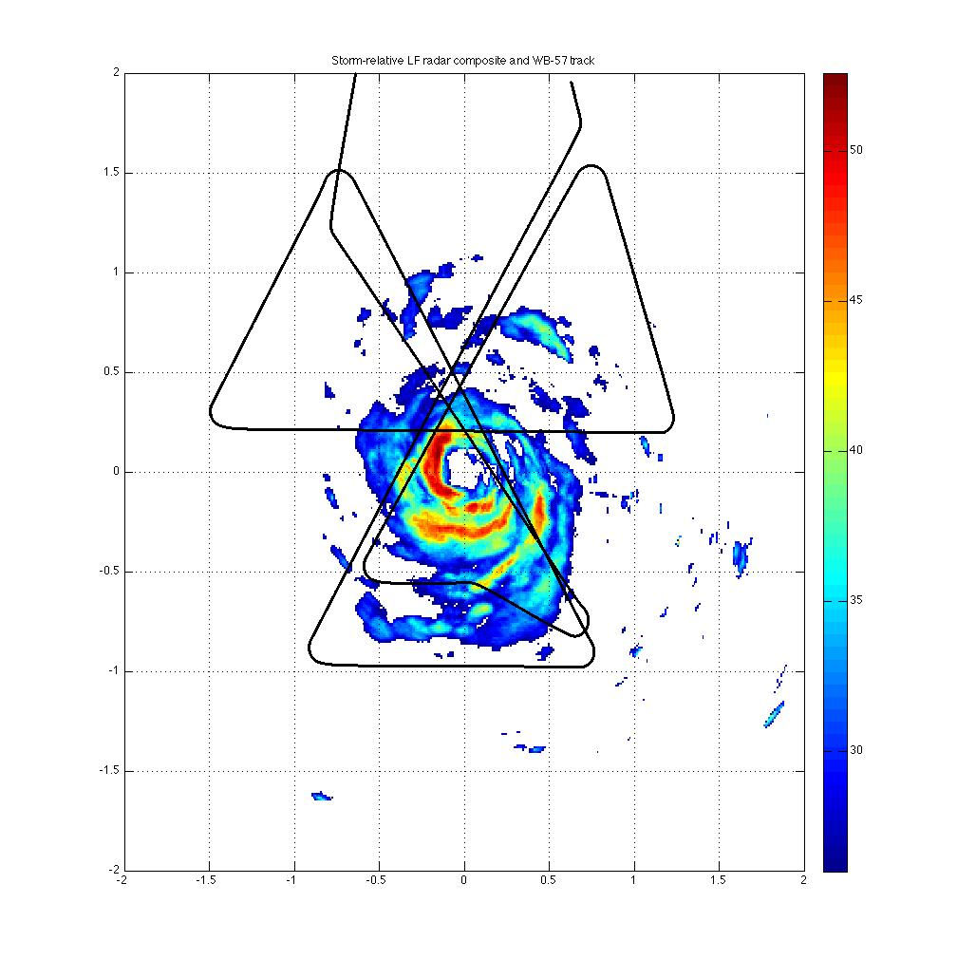
Hurricane Karl (2010 GRIP)
P3 radar reflectivity (left)
HIRAD excess Tb 5 GHz (right)
B-57F
track
Good feature agreement between WP-3D LF radar composite (left) and
HIRAD excess brightness temperature (T_{B}) composite (right)
P3 radar center crossings
WB-57 HIRAD center crossings at
19:16:49, 19:52:37, 20:33:44

Slide 17
HIRAD data status
HS3 2012 (Pacific Flight) HIRAD brightness temperatures are stable (except 4 GHz) during the legs over disturbed weather, have some drift during transits
Not a good case for HIRAD, between being an unsuitable target and having unexplained noise in 4 GHz
Can put brightness temperatures and low-confidence geophysical retrievals on servers, if desired
H. Earl (2010) from GRIP is the best case for HIRAD. Retrievals have not been sent to public servers / archive, but they can be sent. Current retrievals are empirical (from UCF); expect to transition to radiative-transfer based retrievals in June

Slide 18
HIRAD instrument status
Housekeeping board repaired and replaced
Thermal system modeling underway, to better control and characterize receiver temperatures during flight
Thermal chamber testing in late May – test effectiveness of new heater set-points
Test for interference sources after integrating on AV-1 in July
No obstacles to flight; these actions are all to improve data quality
For best calibration, we need a well-characterized clear, calm ocean scene at some point in a flight. “Clear, calm ocean” is the more important factor there – a buoy is helpful but not necessary.
A sequence of 360° turns (CW and CCW) at constant bank angle (~10-20°) over clear, calm ocean > 500 km from land would help calibration. Maneuvering every flight would be ideal, but two flights sufficient.

