Slide 1
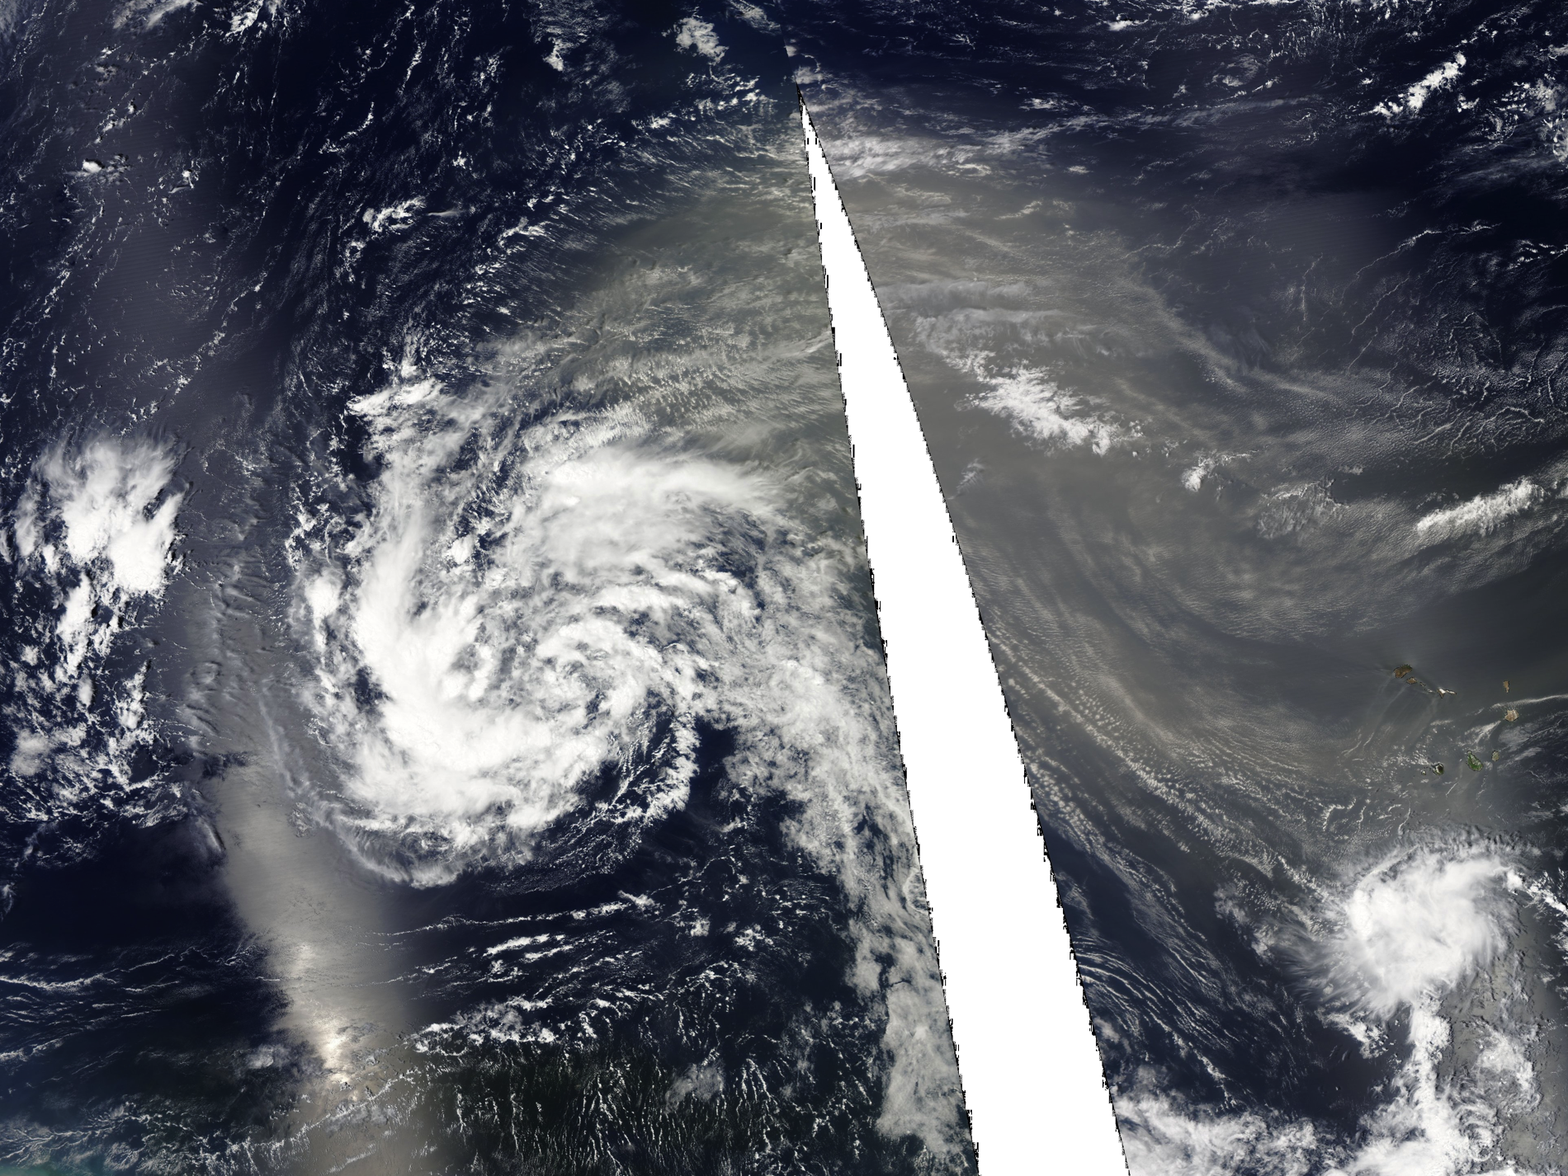
The Interfaces between Dry Air and Hurricane Nadine
Deanna Hence and Scott Braun, NASA GSFC
HS3 Science Team Meeting, May 8th 2013

Slide 2
Science Questions
What were the characteristics of the air masses bordering Nadine?
How are these air masses being modified at their interfaces?
Do these air masses have a large-scale environment conducive to intrusion into the storm?

Slide 3
From JPL HS3 Portal http://hs3.jpl.nasa.gov
The NW Sector: 850 hPa Easterly Jet

Slide 4
The NW Sector: Strong Subsidence in upper levels
From JPL HS3 Portal http://hs3.jpl.nasa.gov

Slide 5
Strong shear away from storm center

Slide 6
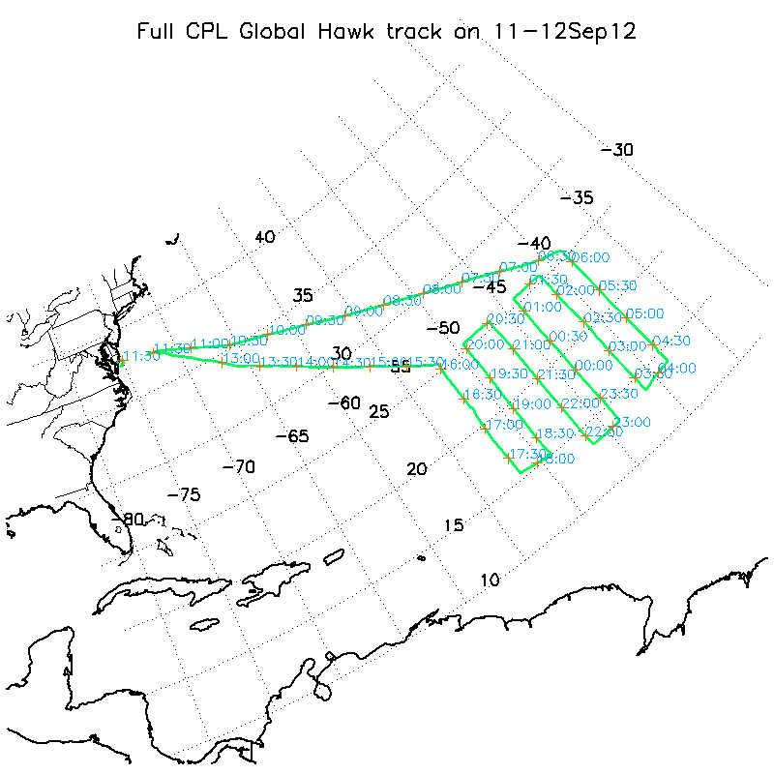

Slide 7
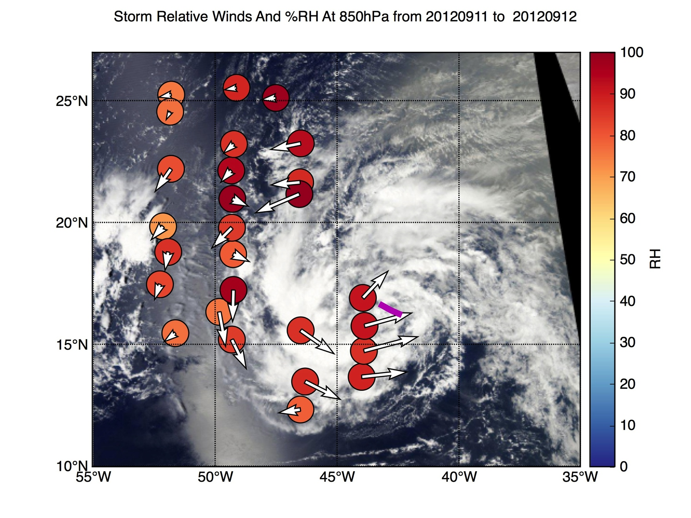
Minimal changes in 850 hPa RH

Slide 8
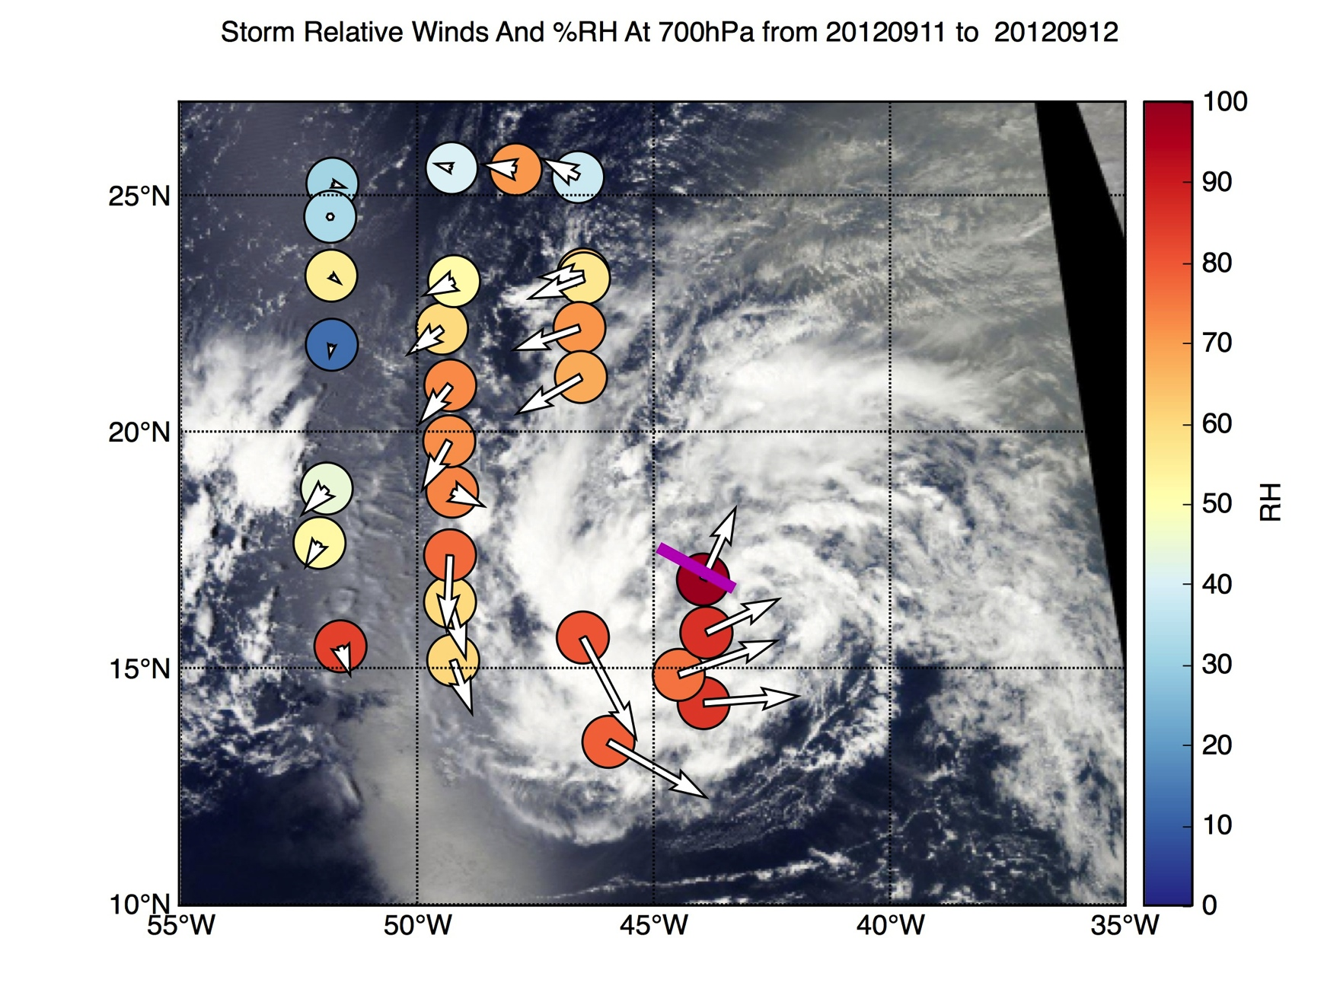
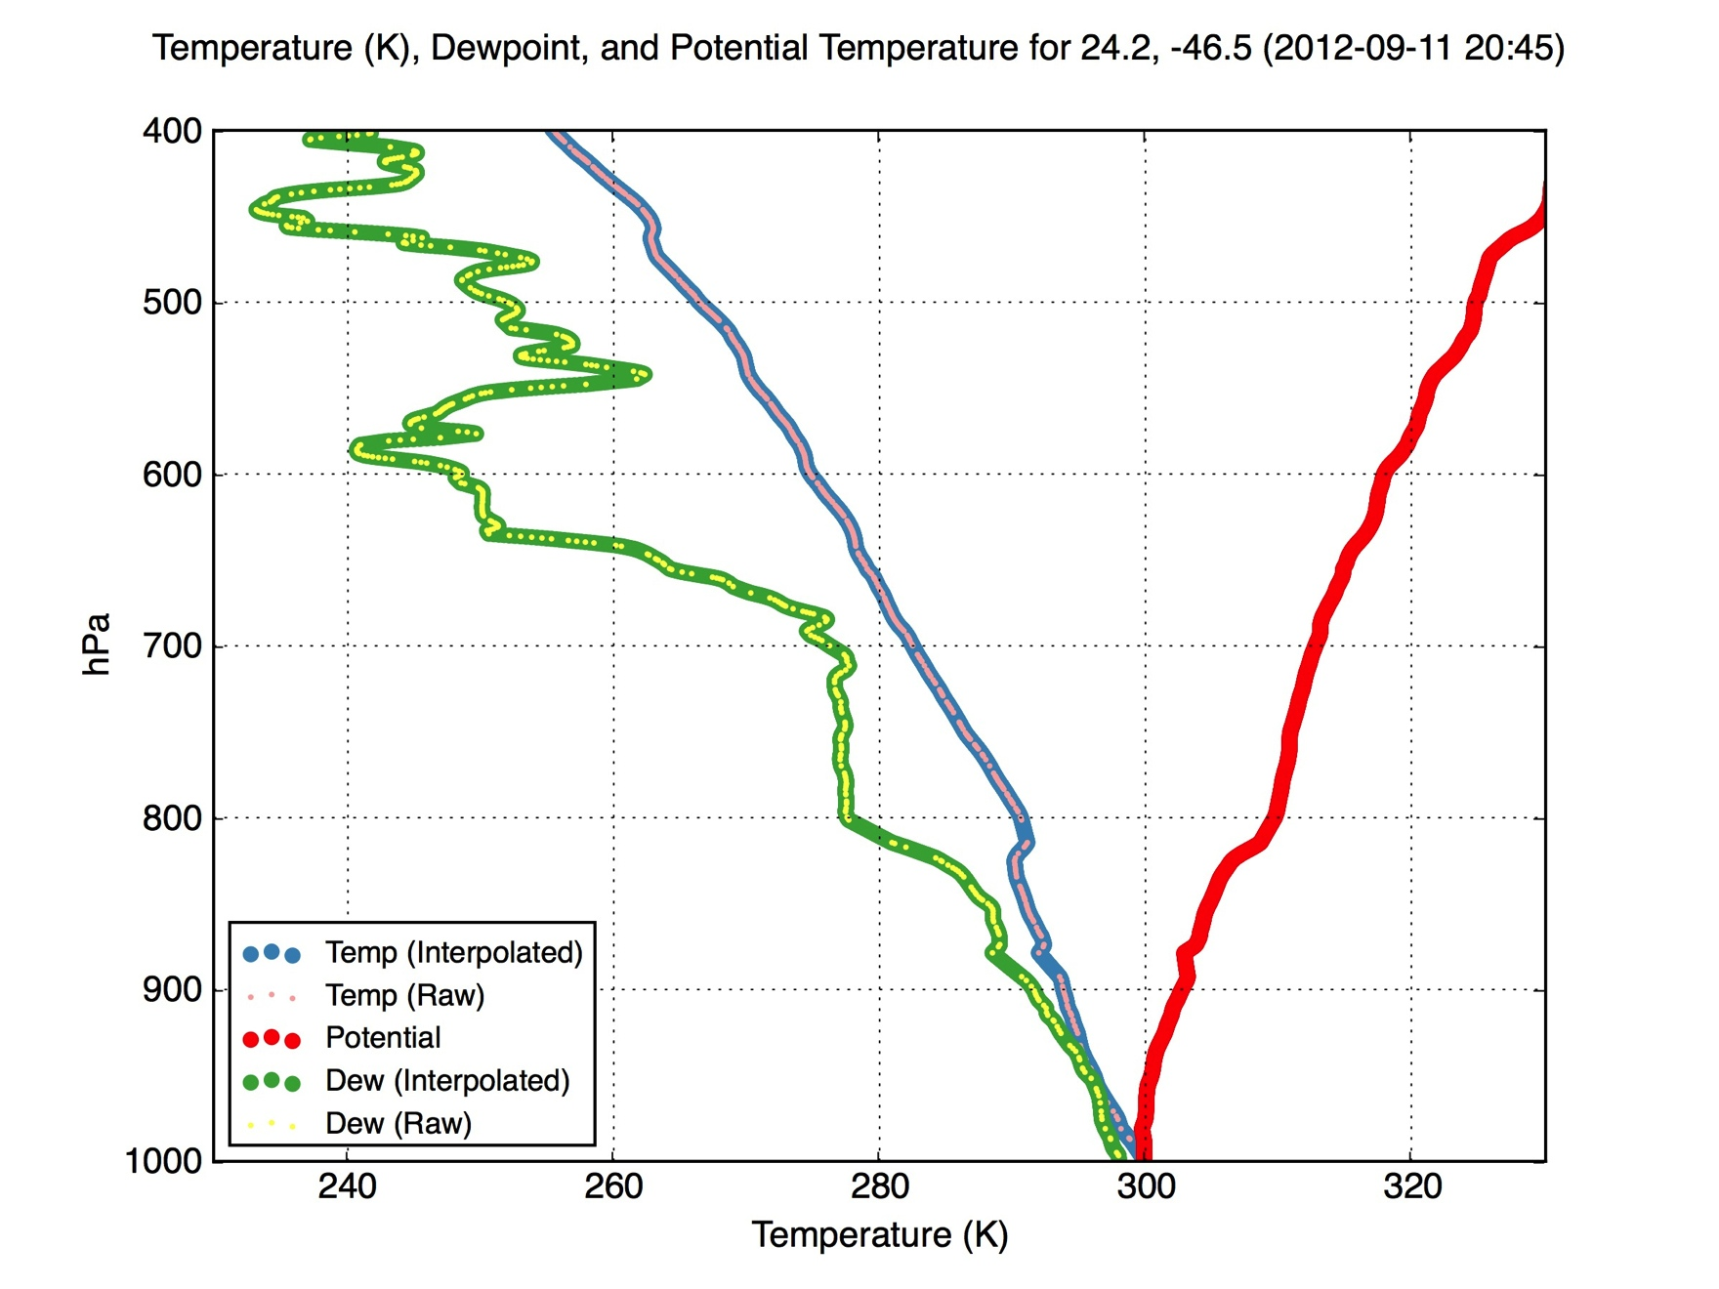
Layer Boundaries near 700 hPa
Disappears along flight track

Slide 9
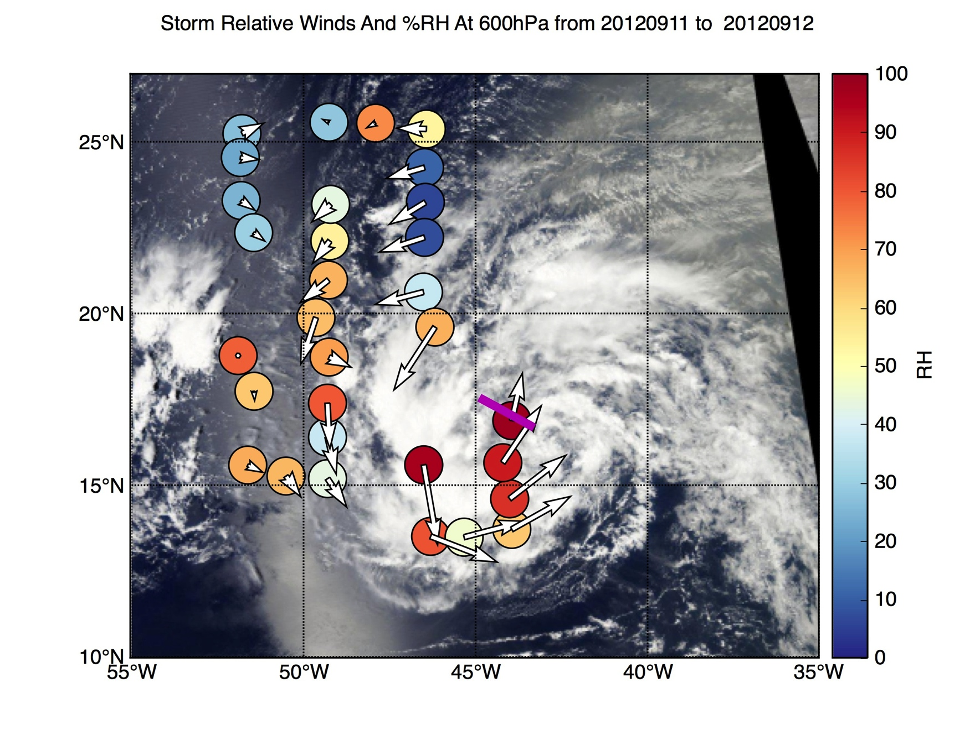
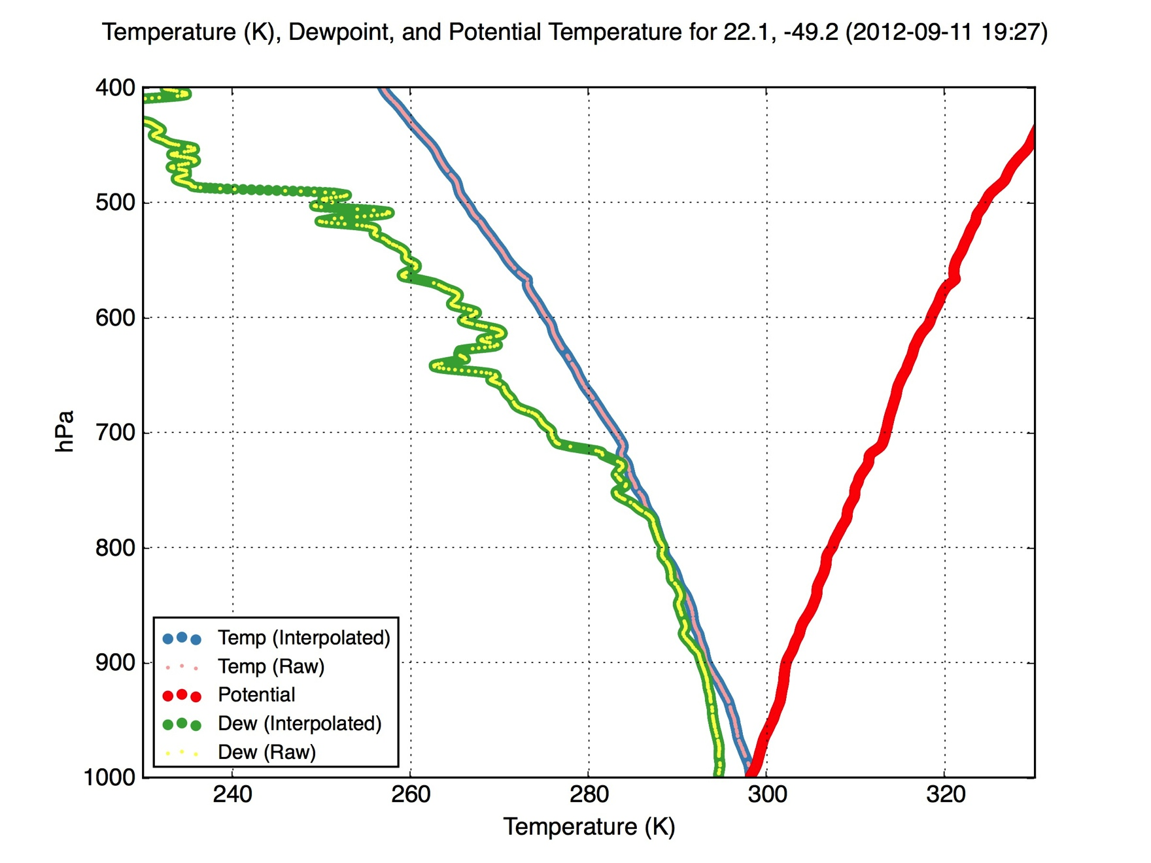
Dry upper layers overriding SAL

Slide 10
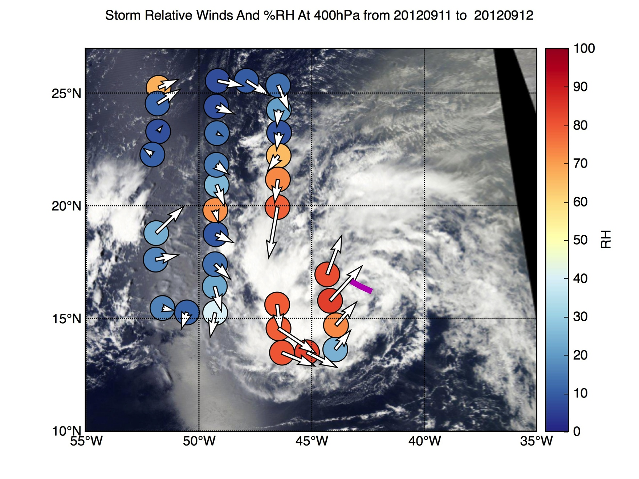
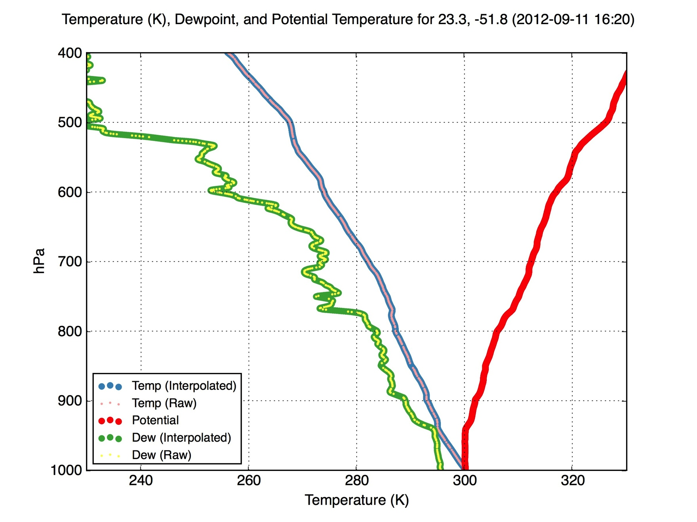

Slide 11
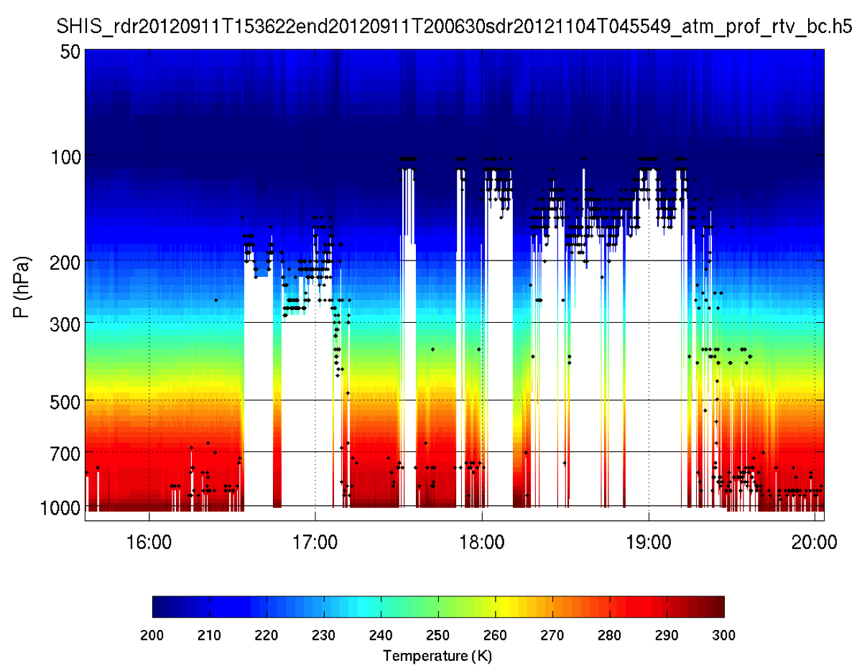
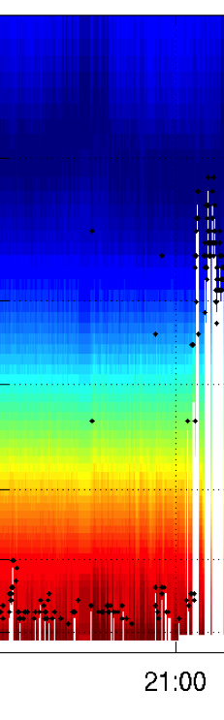
S-HIS Temperature Retrieval for 20120911
Slight warming in the low levels?

Slide 12
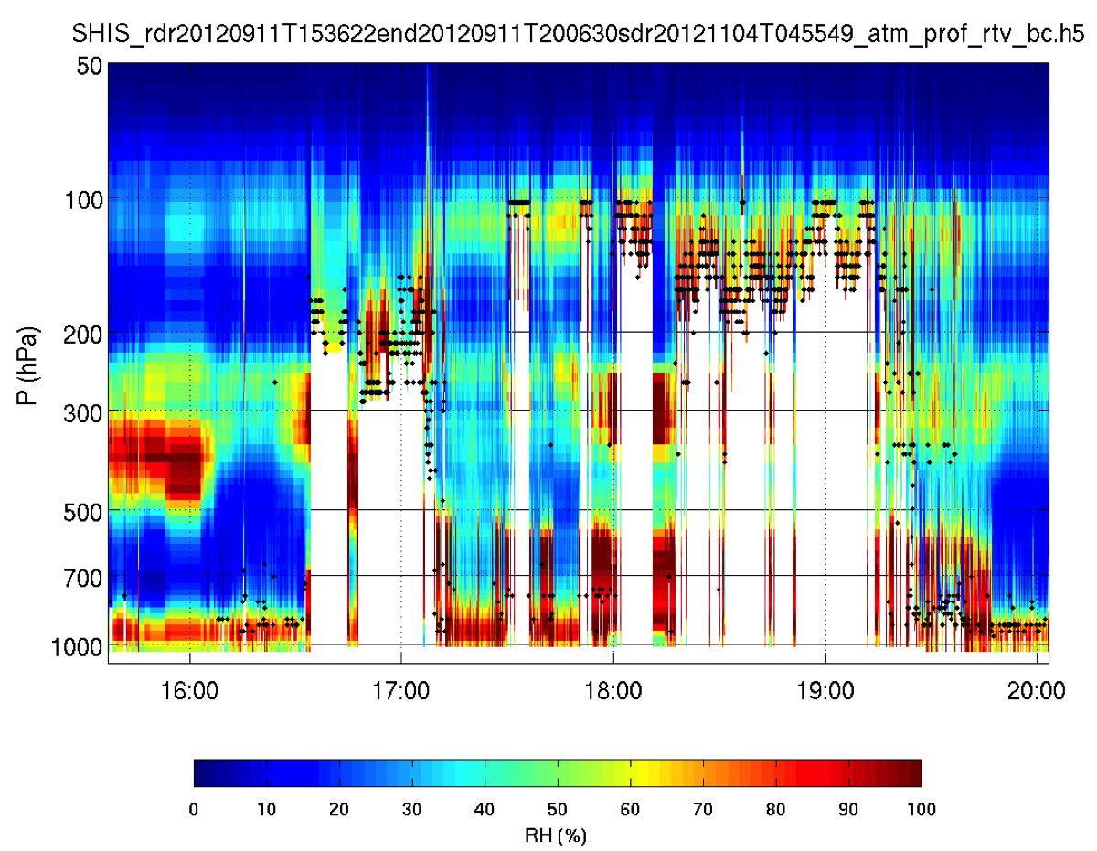
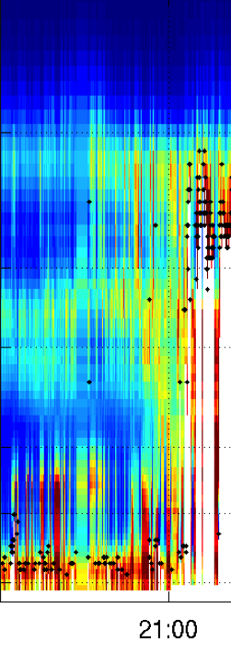
Low level humidity signature
S-HIS Relative Humidity Retrieval for 20120911

Slide 13
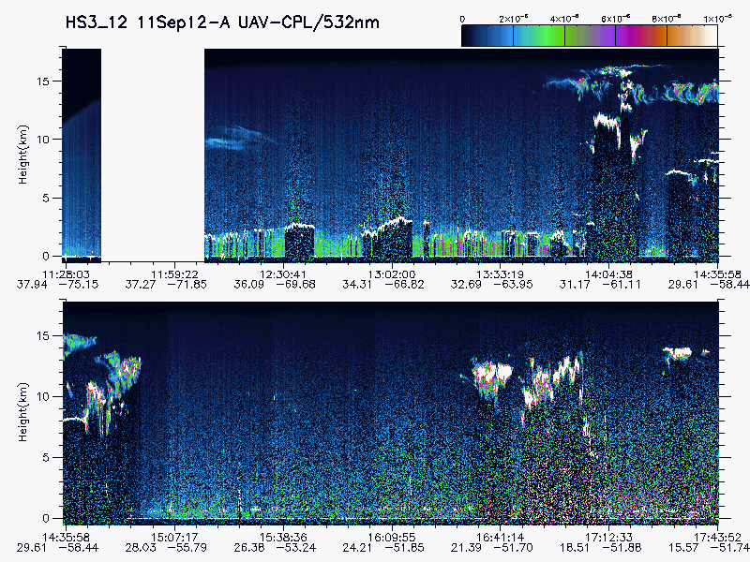
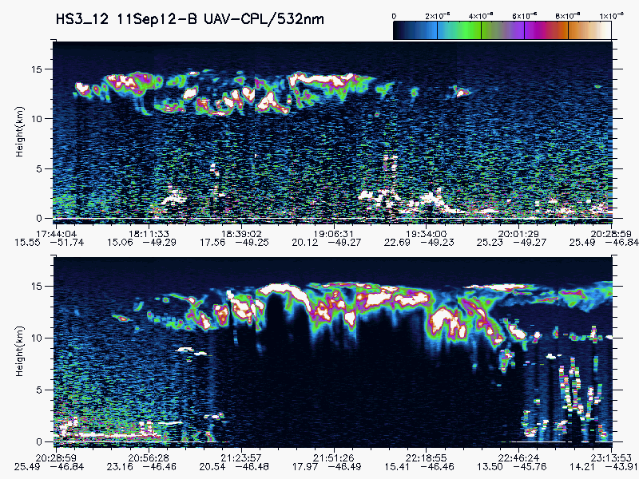

Slide 14
From JPL HS3 Portal http://hs3.jpl.nasa.gov
The NW Sector: 850 hPa jet far to the SE

Slide 15
From JPL HS3 Portal http://hs3.jpl.nasa.gov
The NW Sector: 200 hPa Ridge and Jet

Slide 16
High Shear on the NNW Side

Slide 18
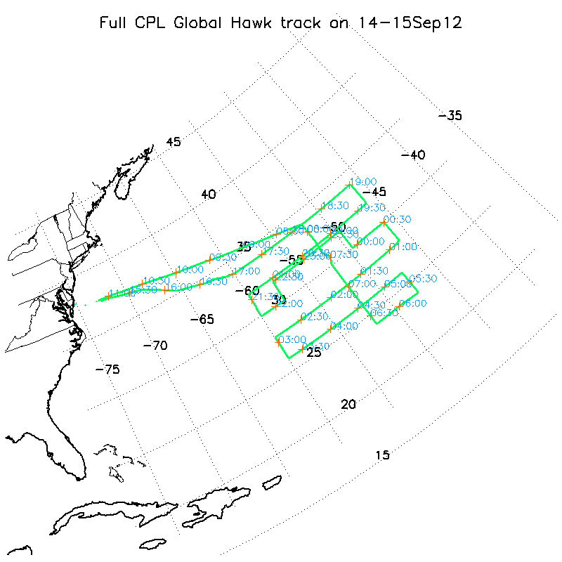

Slide 19
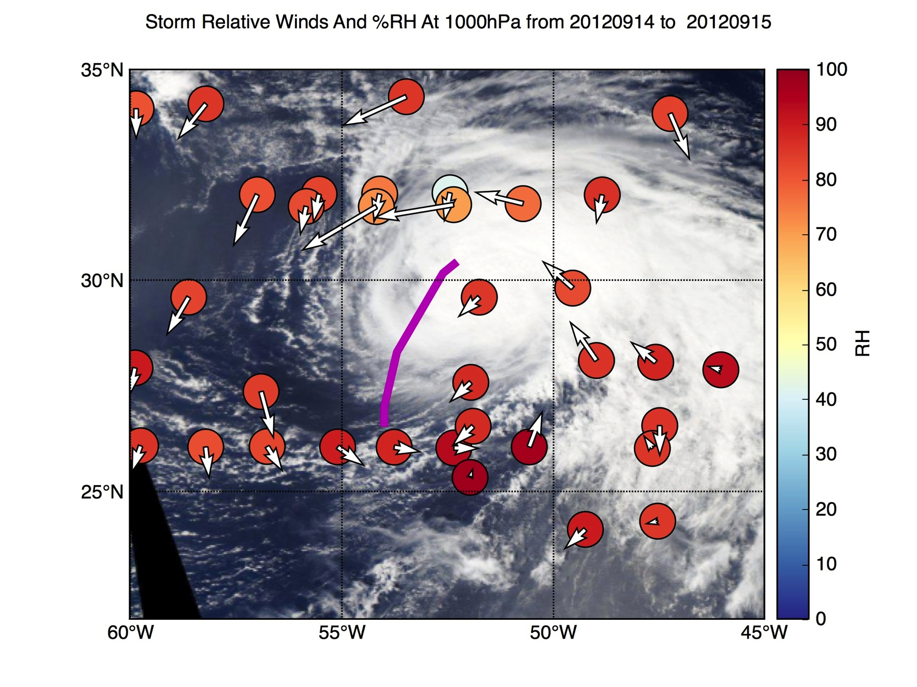

Slide 20
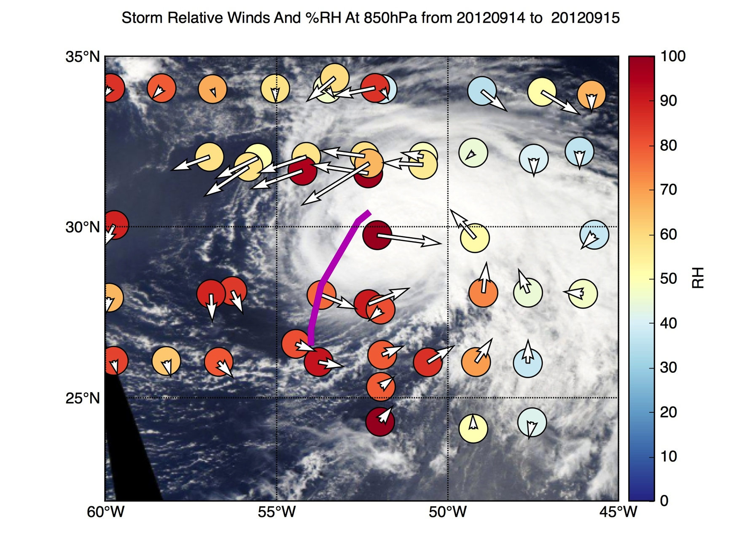
Dry Anomaly associated with SAL

Slide 21
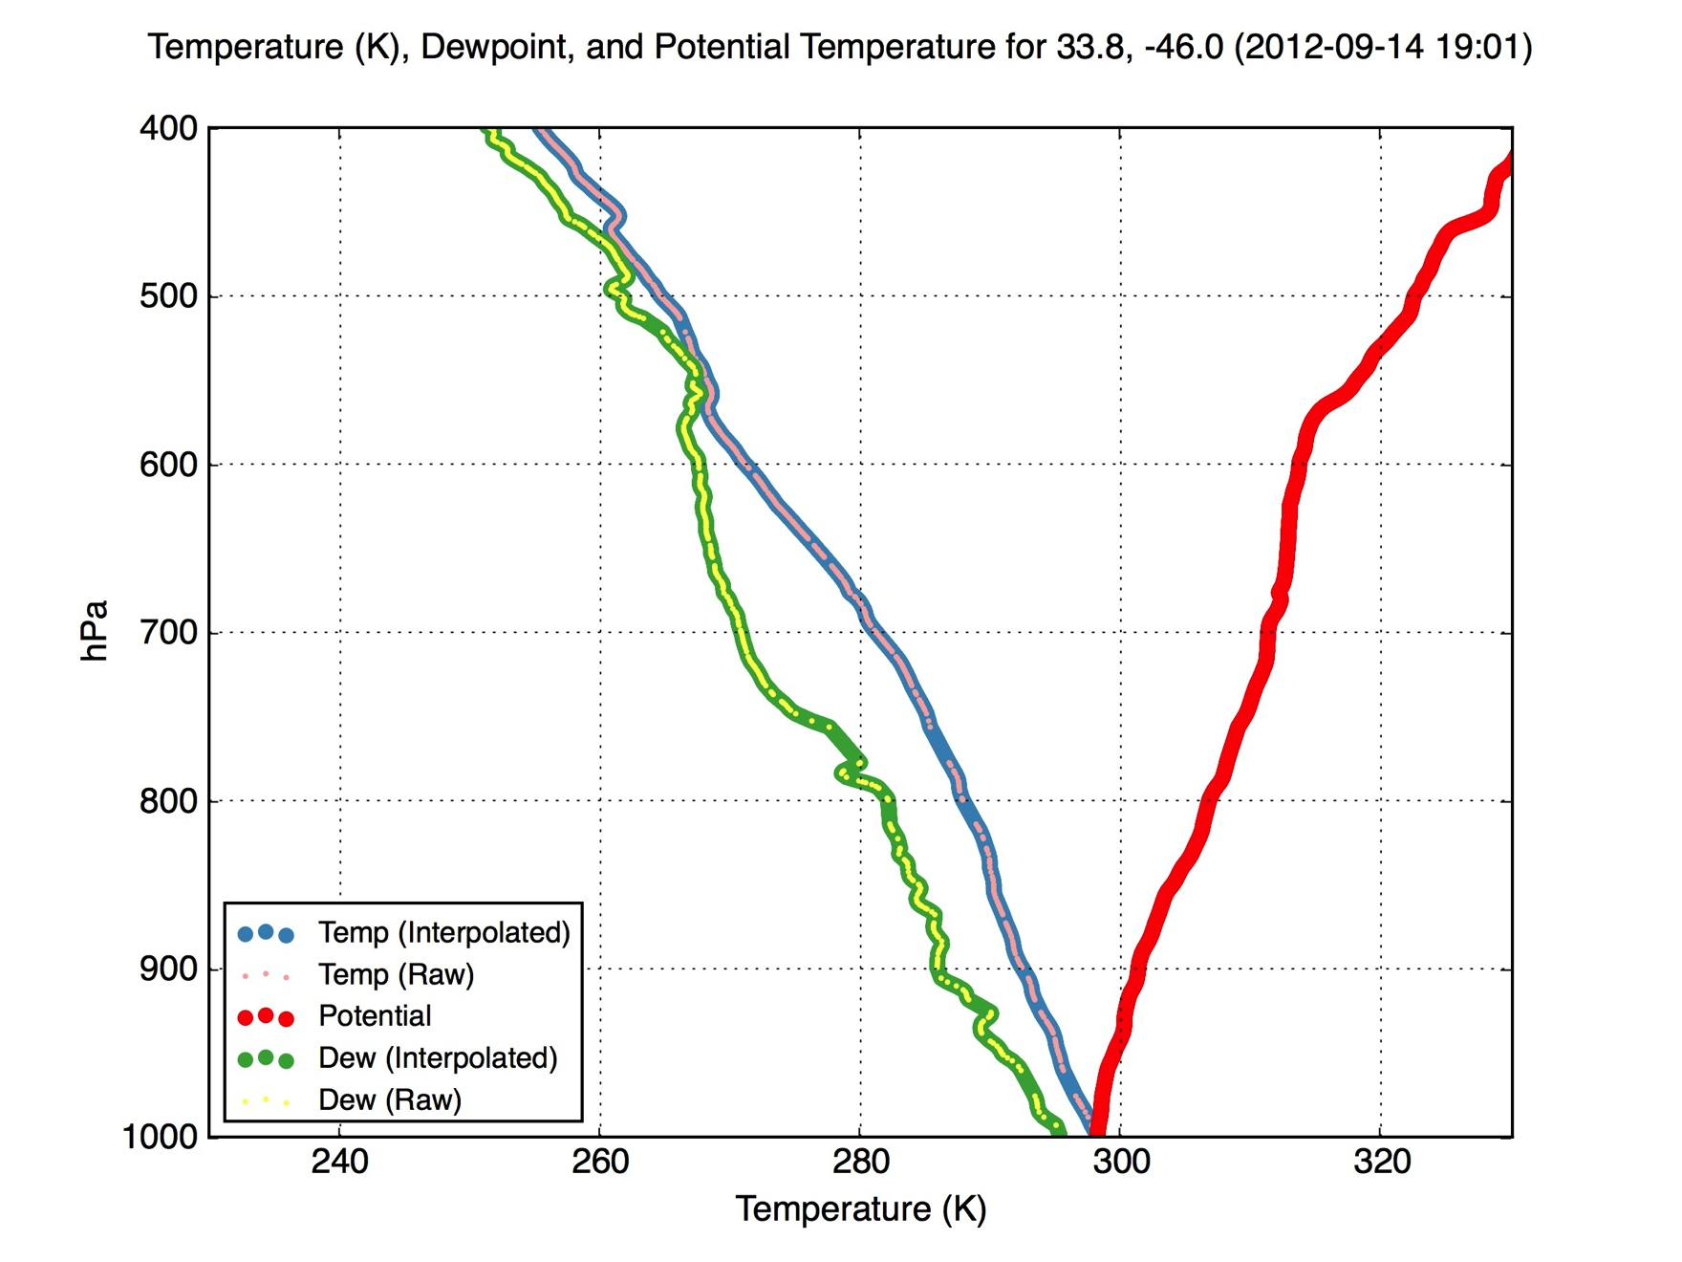
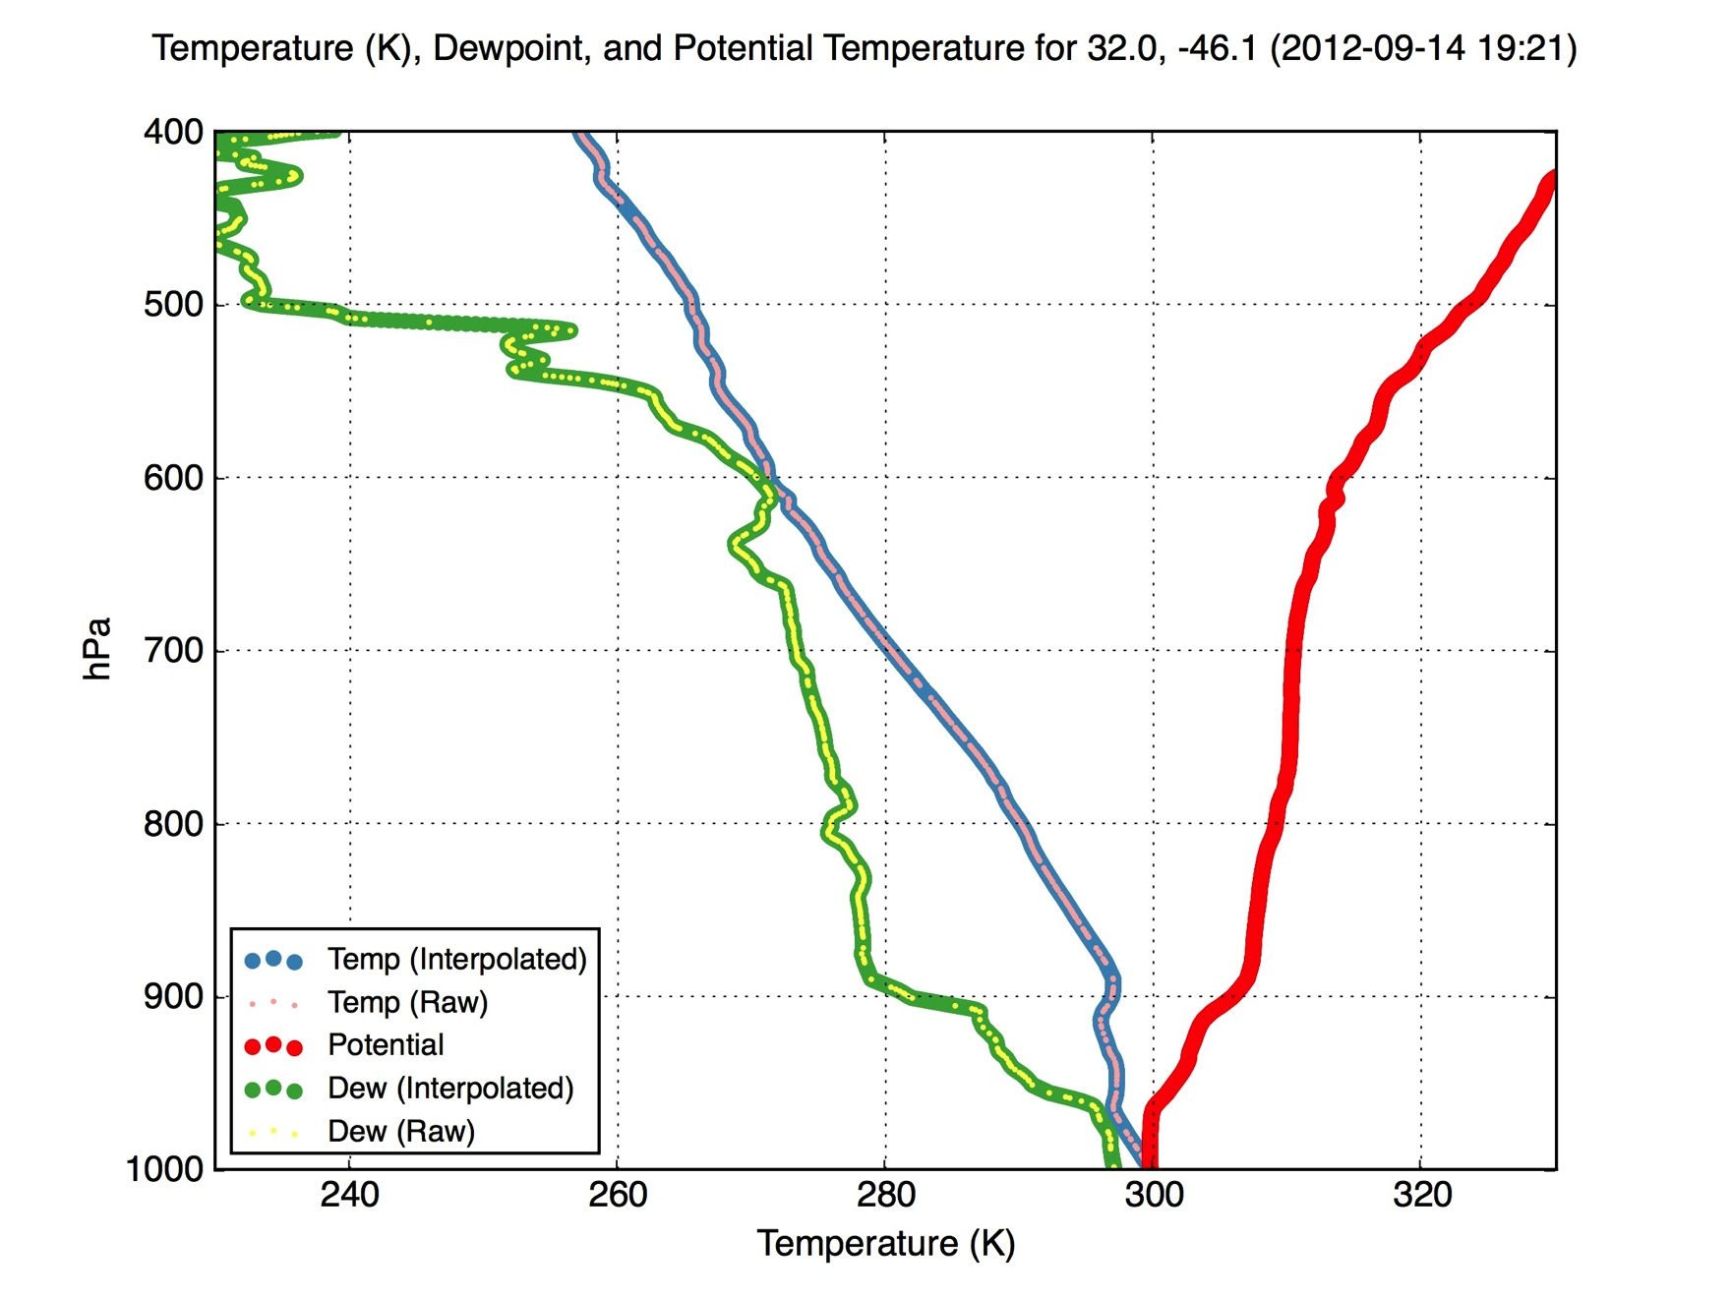
Dry anomaly associated with SAL

Slide 22
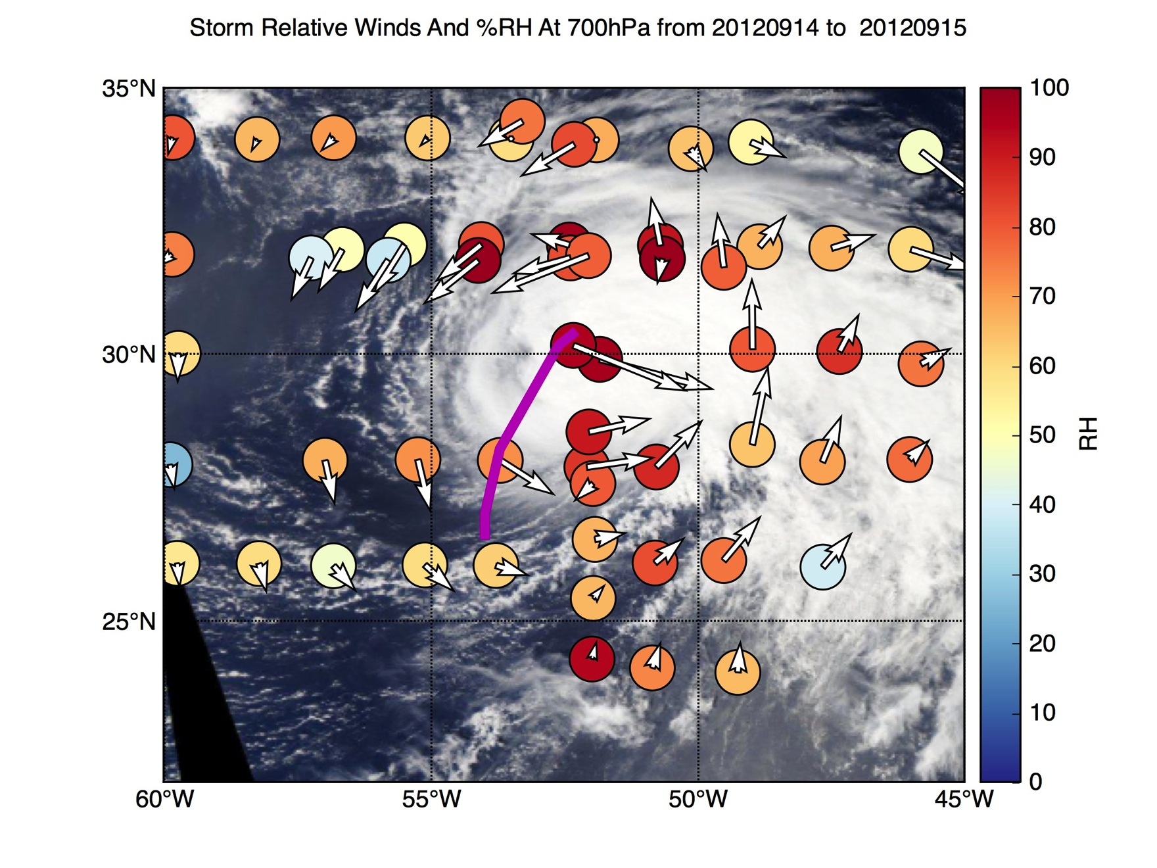
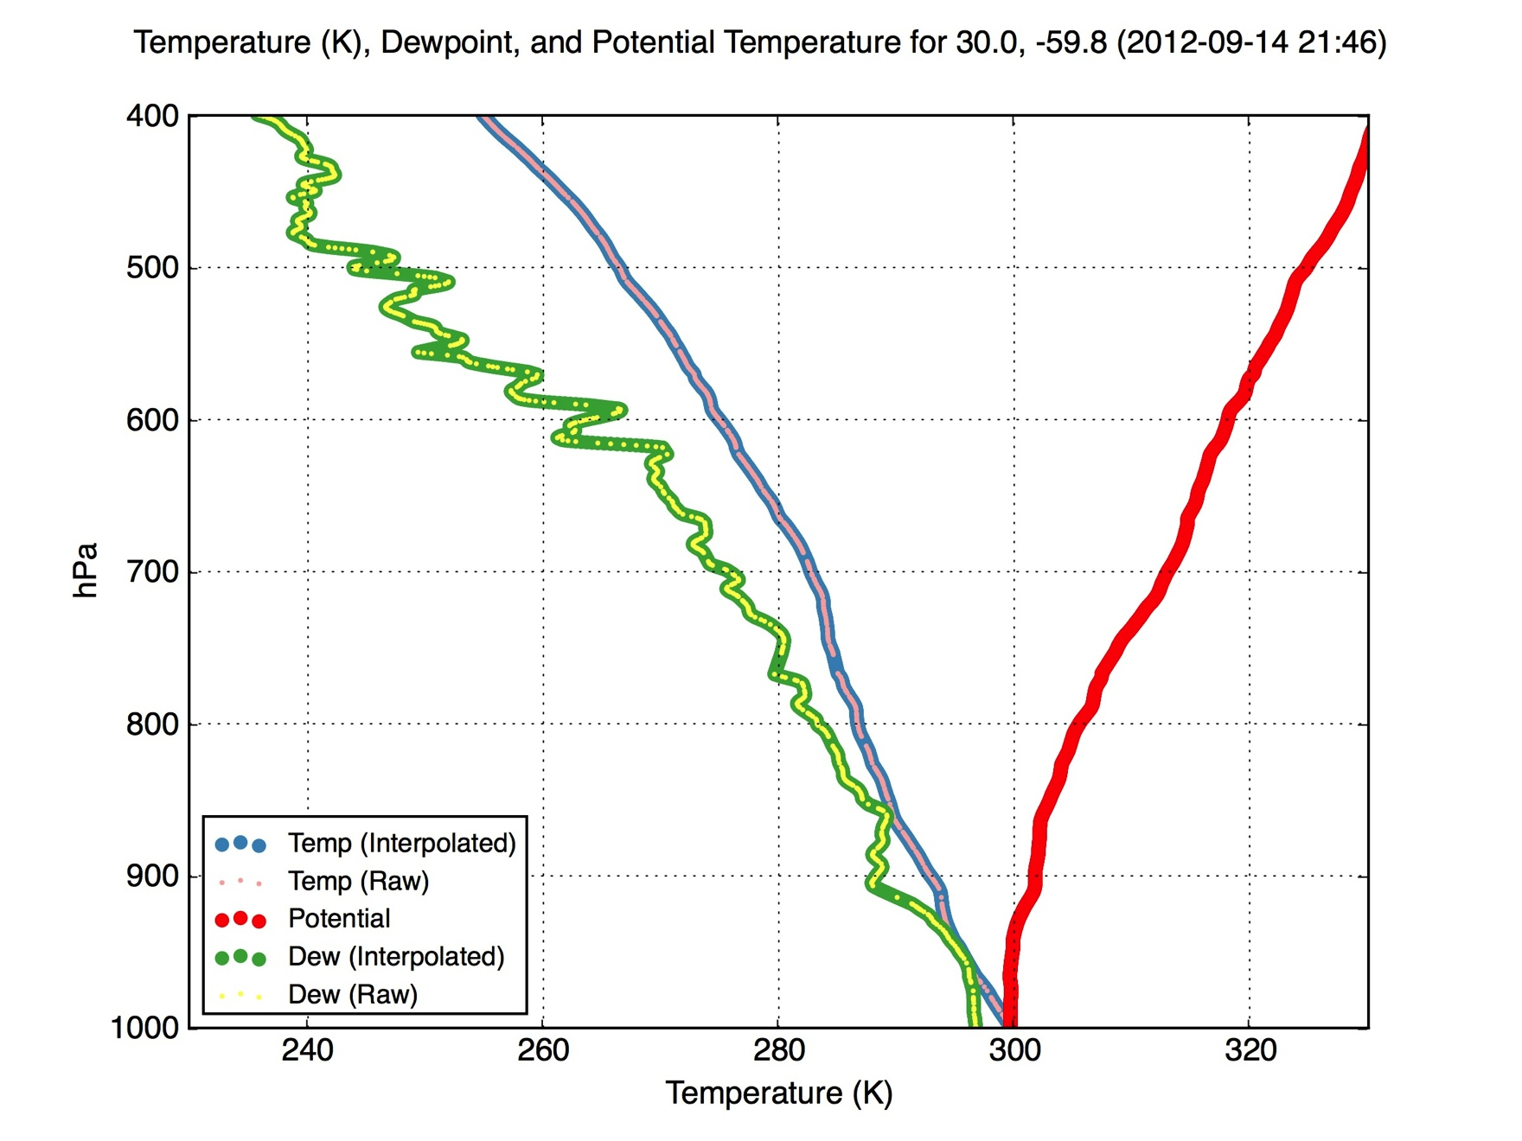
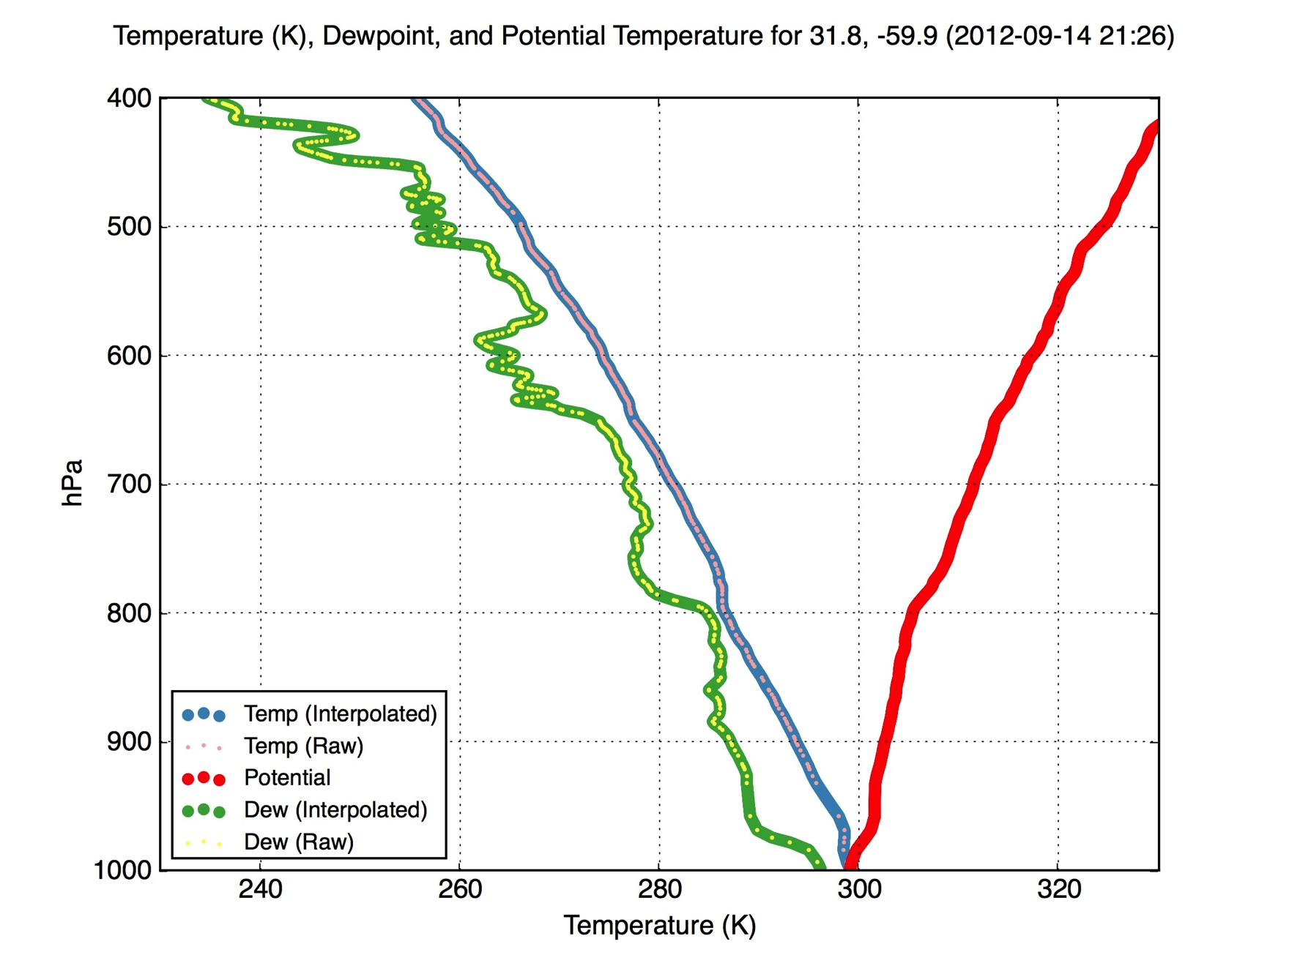
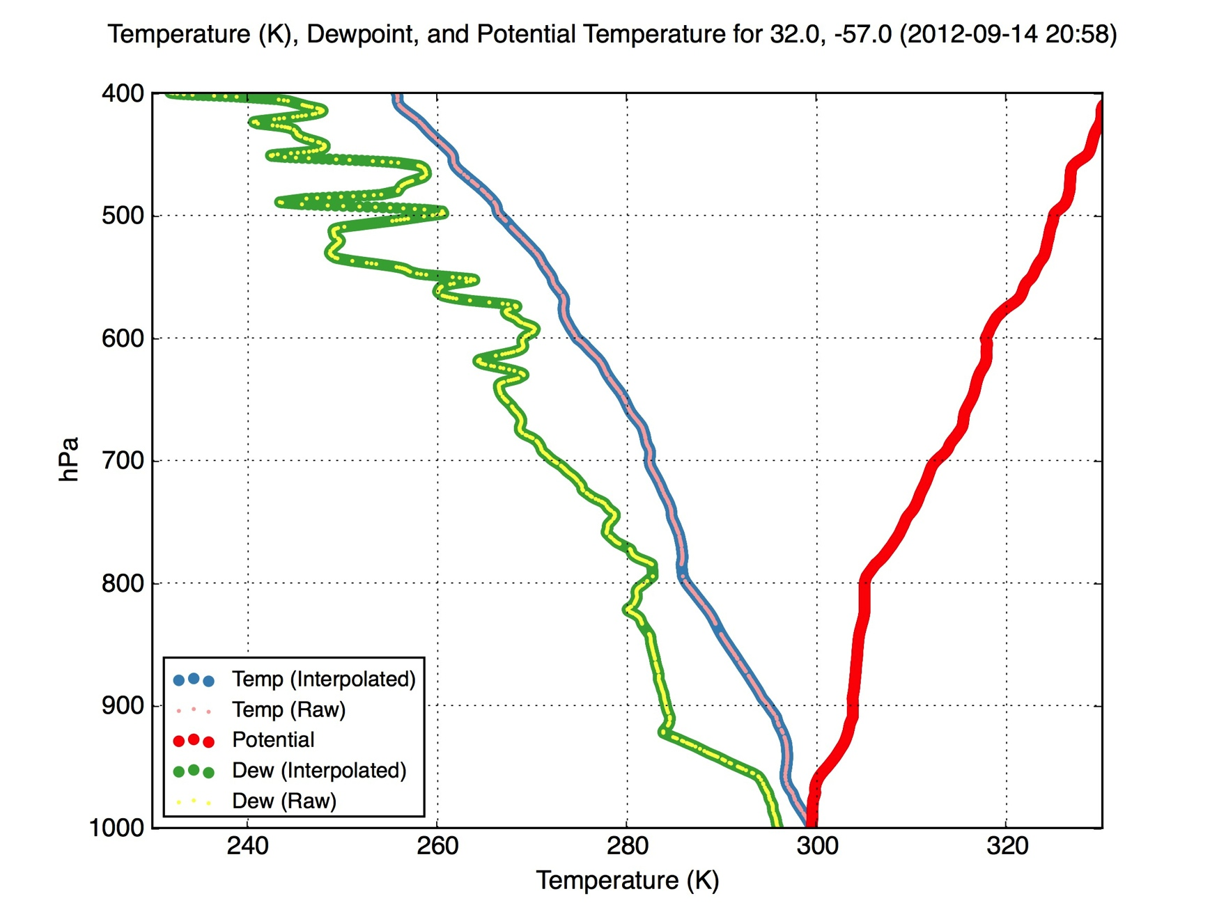
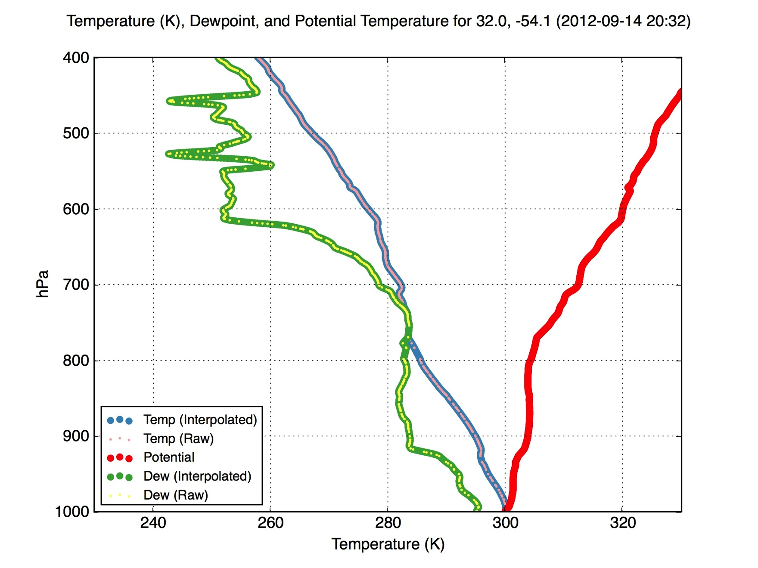

Slide 23
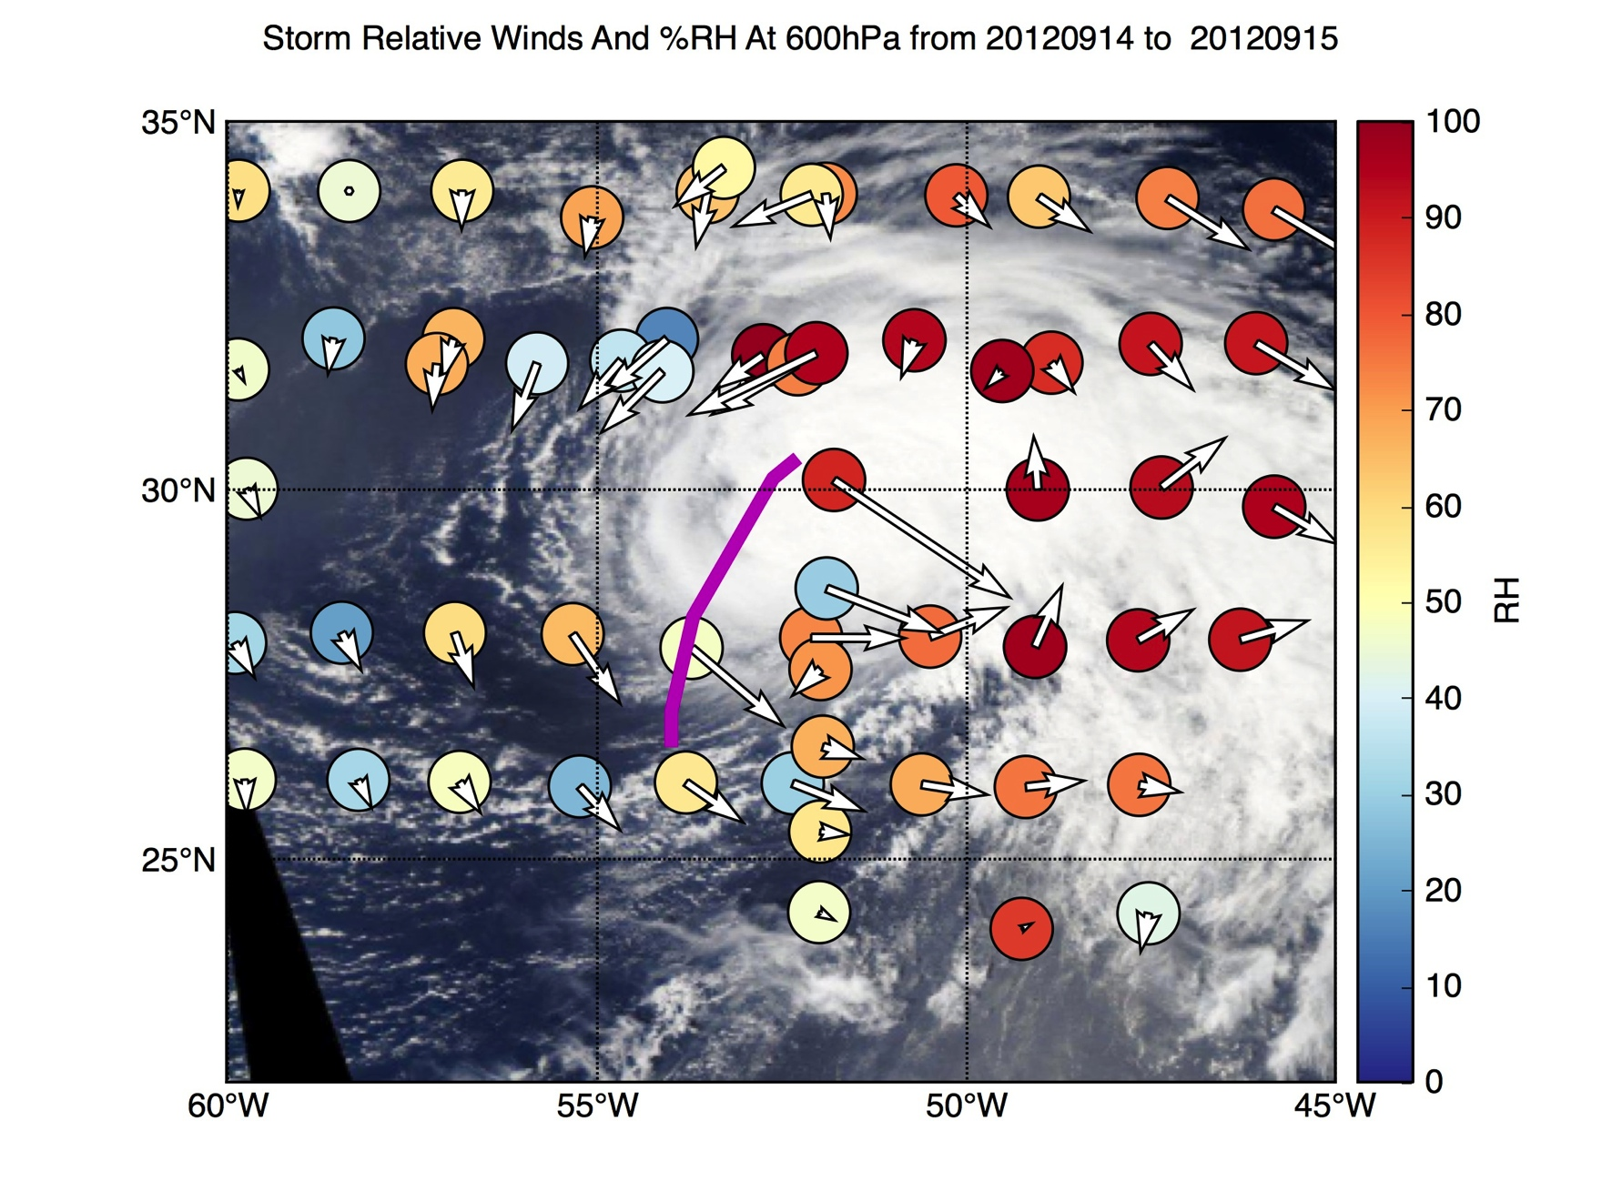
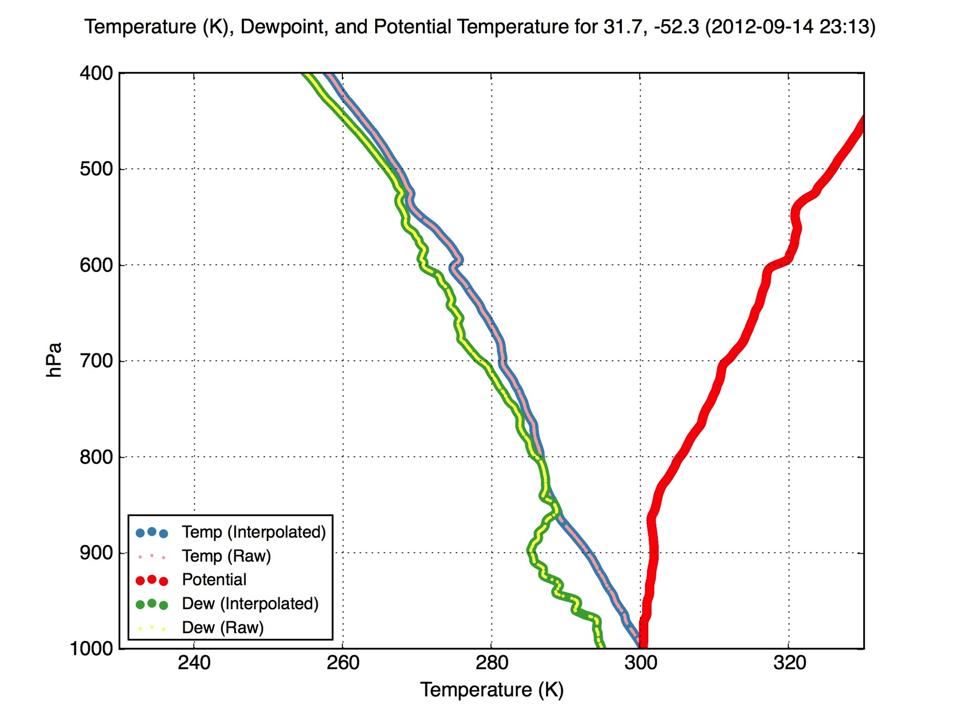

Slide 24
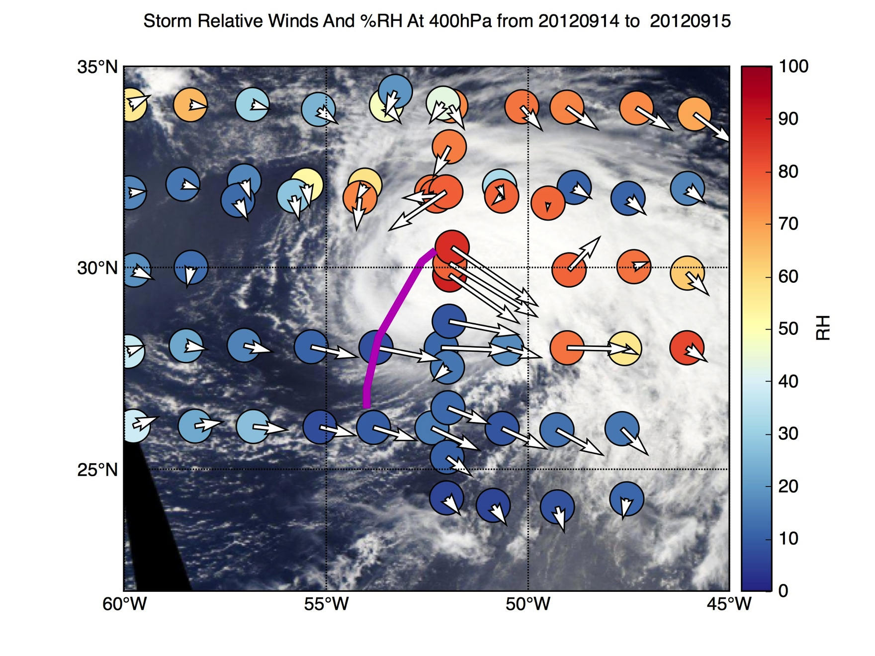
Dry Air impinging from west

Slide 25
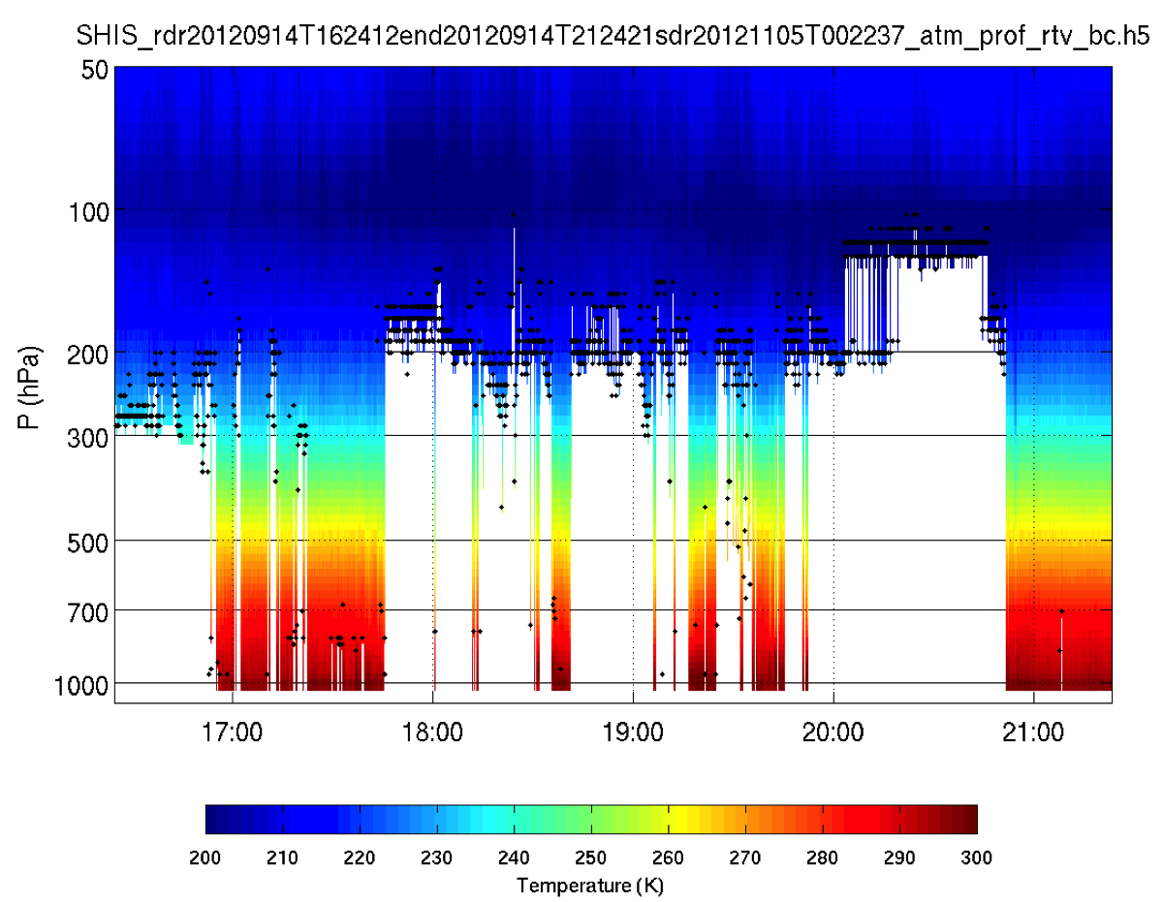
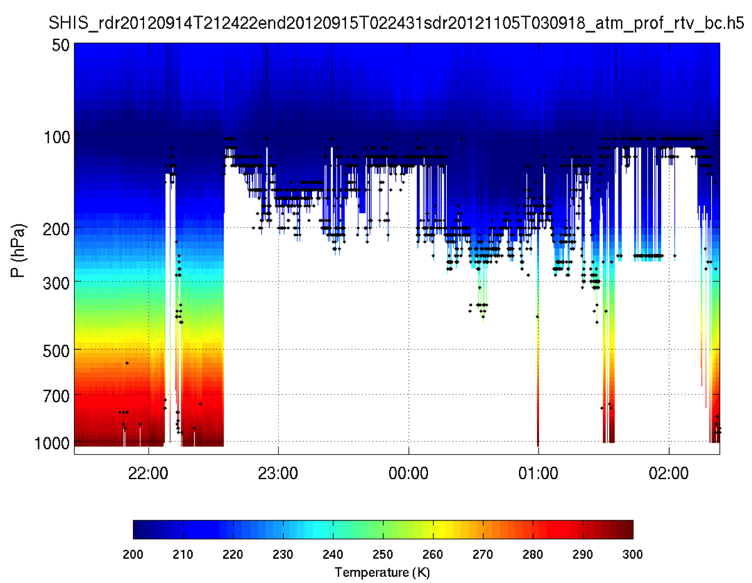
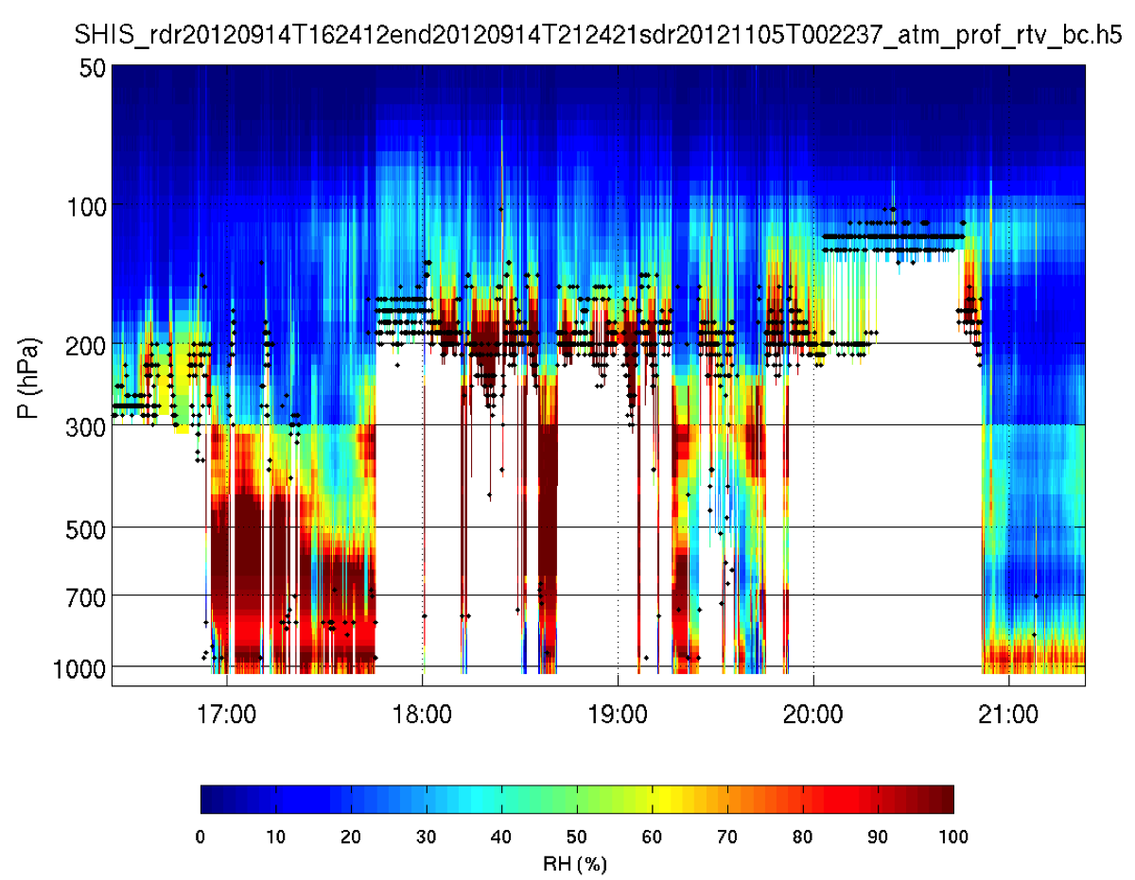
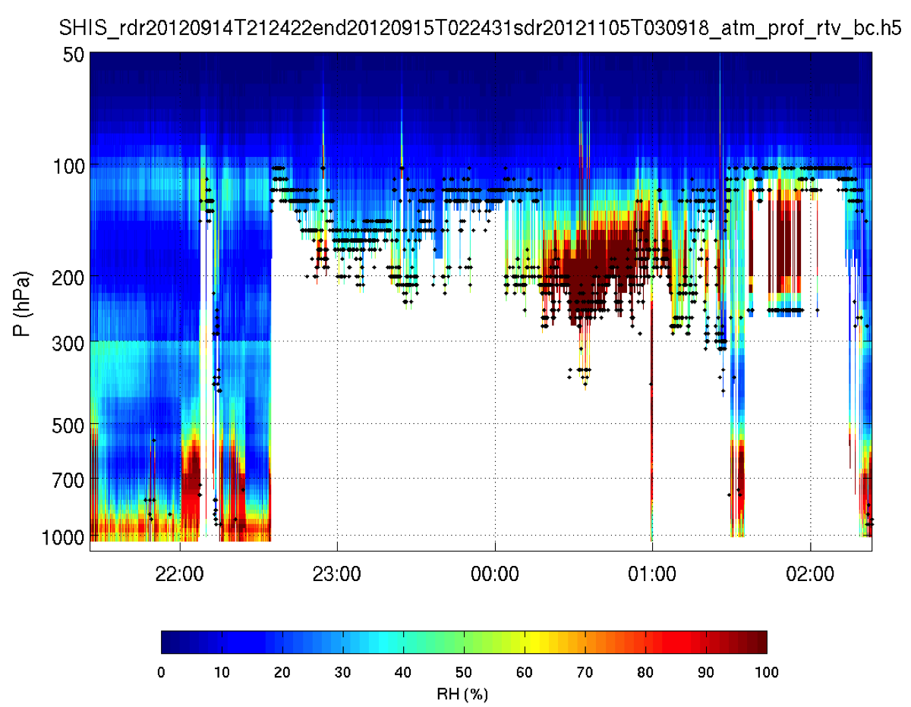
SAL Signature?
S-HIS Temp Retrieval for 20120914
S-HIS RH Retrieval for 20120914

Slide 26
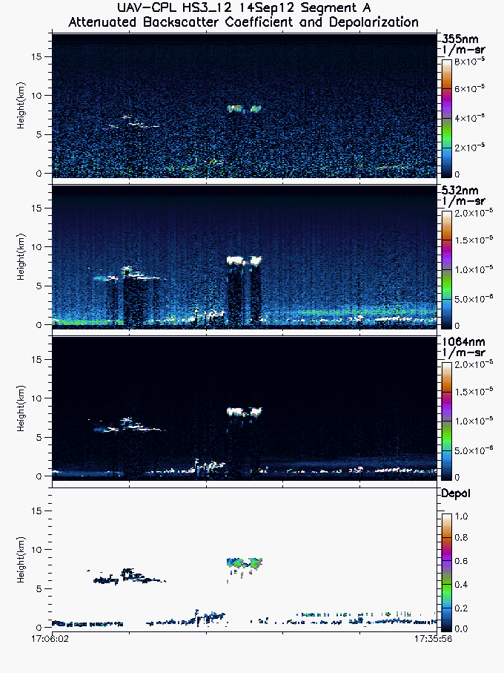
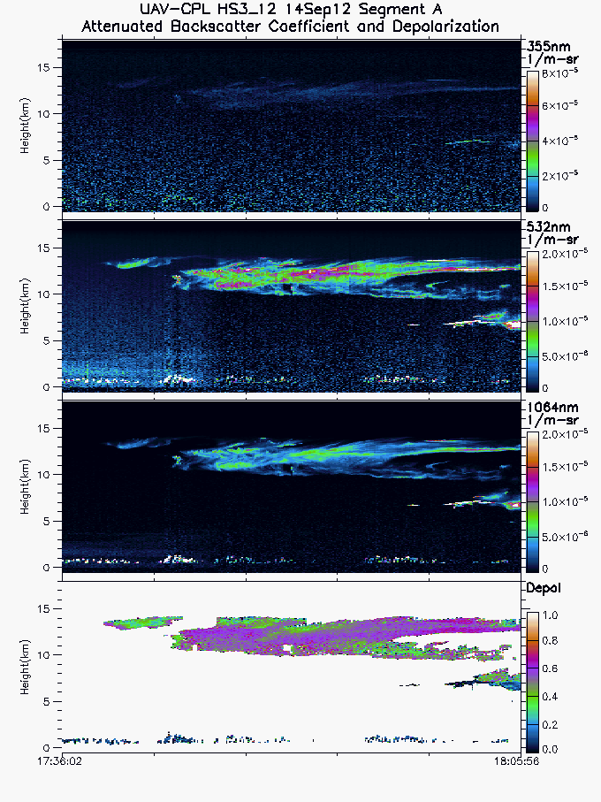
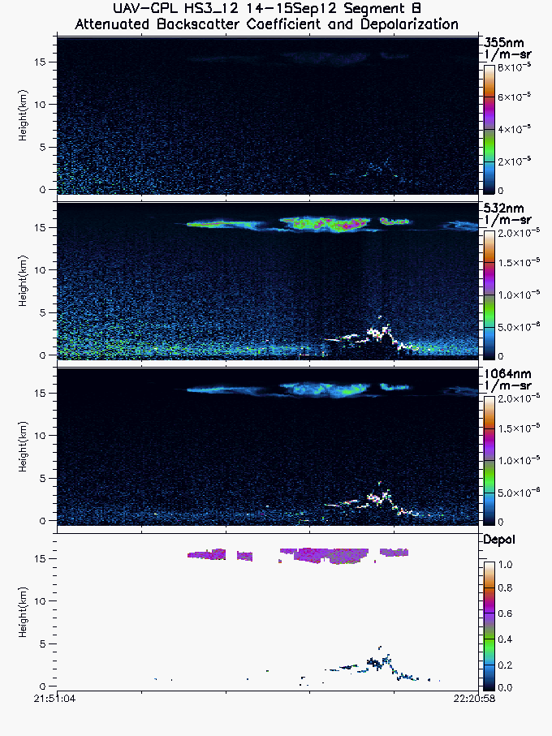
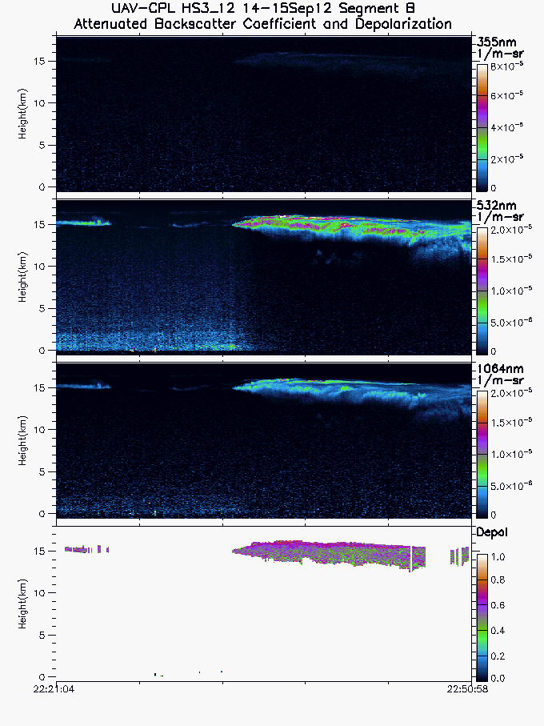
Nose of dust layer
CPL 532nm Backscatter for 20120914

Slide 27
Conclusions
Synoptic conditions may have limited SAL wrapping around Nadine, favored subsidence to west
Dry air possibly favored for impinging upon storm in upper levels
SAL intrusion initially seems more limited

